Slide 1
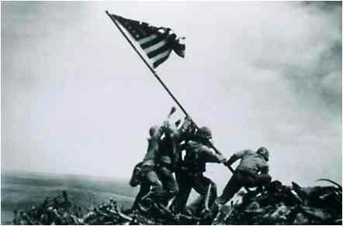
World War II

Slide 2
U.S. Isolationism
Reasons
Disillusionment with WWI
85% of American public agreed we should not fight unless directly attacked
1934, Sen. Nye (N.D.) reported as part of investigating committee that U.S. fought in WWI to help “bankers and arms manufacturers”

Slide 3
U.S. Isolationism
Stimson Doctrine
In response to 1932 Jap. Violation of Open Door Policy
Sec. of State, Henry Stimson: U.S. would refuse to recognize legitimacy of any regime established by force (ex: Japanese rule in China)

Slide 4
U.S. Isolationism
Roosevelt’s Good Neighbor Policy with Latin America
Couldn’t afford Dollar Diplomacy
Needed LA support vs. Fascism
Pan American Conference (repudiated Monroe Doctrine=“work together”)
Nullified Platt Amendment
Encouraged negotiation not intervention when Mexico nationalized U.S. oil fields

Slide 5
U.S. Isolationism
Neutrality Acts
1935: prohibited all arms shipments + Amer. travel on belligerent ships
1936: forbade extension of loans to belligerents
1937: forbade shipment of arms to opposing sides in Spanish Civil War

Slide 6
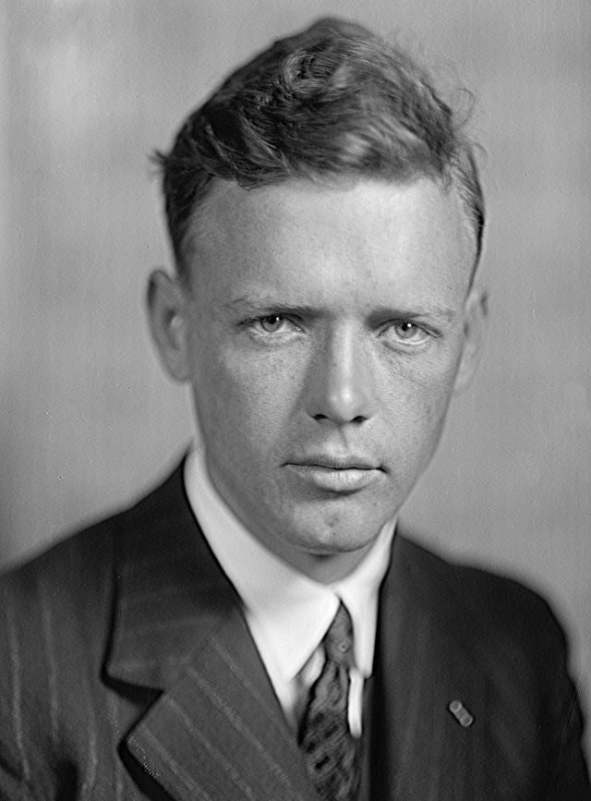
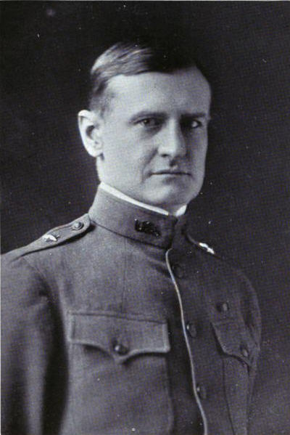
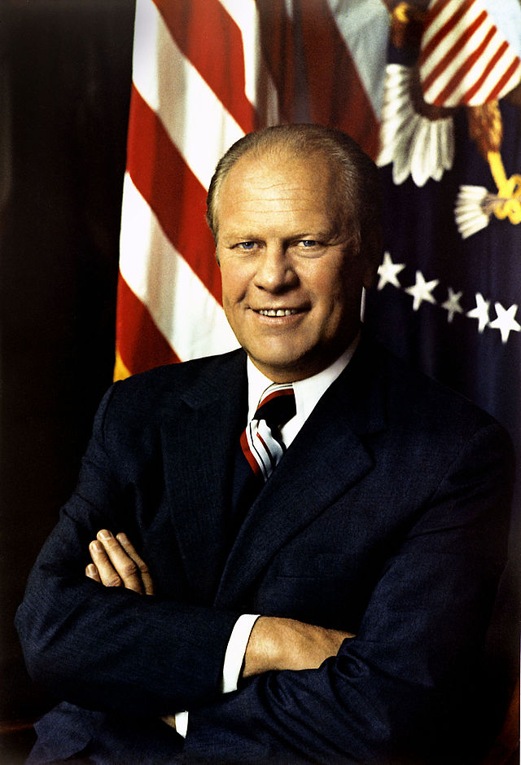
U.S. Isolationism
America First Committee
Charles Lindbergh
Robert E. Wood
Gerald R. Ford

Slide 7
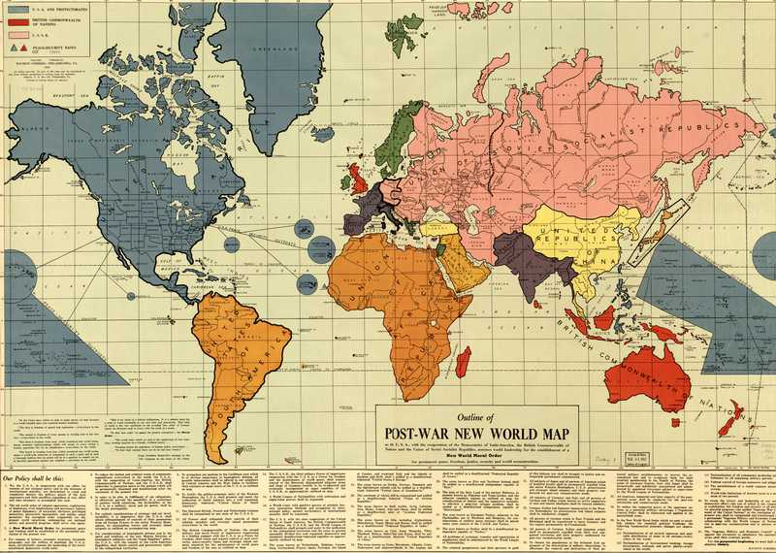
Origins
German resentment of Treaty of Versailles
$33 billion in reparations, lost of Alsace-Lorraine +Rhineland, assumption of war guilt, demilitarization
Failure of peace process
League of Nations, (1925) Kellogg-Briand Pact
Japanese aggression in Asia
Italians in Ethiopia
Spanish Civil War
German aggression in Europe
1939 Nazi-Soviet Neutrality Pact

Slide 8
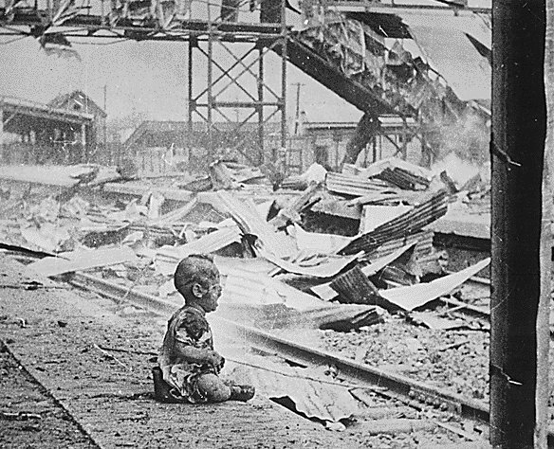
Japanese Aggression in Asia
1930 Nationalist militarists
Take Manchuria (pull out of League)
1932 Invasion of China/bombing of Shanghai
1937 Occupation of China

Slide 9
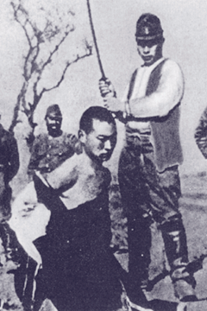
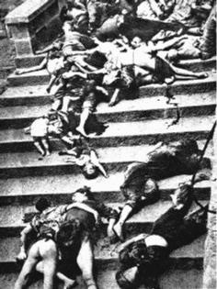
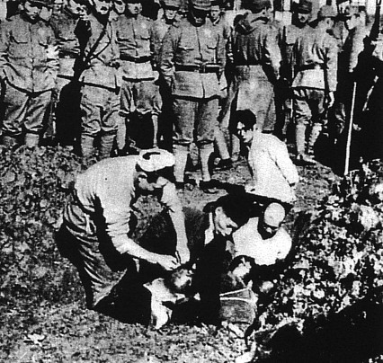
Bombing of Shanghai/Rape of Nanking
6 weeks of carnage
20 Americans/Euros est. 2.5 sq. mi. “safety zone” w/Red Cross flags
300,000 Chinese civilians take refuge
Rest of the 300,000 perish
Occupation: 15 million Chinese soldiers/civilians die

Slide 10
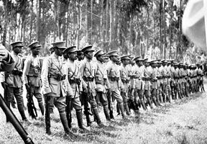
Italians in Ethiopia (1936)
Italians bomb the forces of Emperor Haile Selassie (“Abyssinia”/Ethiopia)

Slide 11
Spanish Civil War (1936)
Nationalist (Fascists)
Germany, Italy
Generalissimo Francisco Franco (“el Caudillo”)
led “Falange”
Won with “5th Column”
Loyalists/“Republicans” (Communists, socialists, anti-fascists)
Russia, Gr. Britain, US, France
Lost because support is not unified

Slide 12
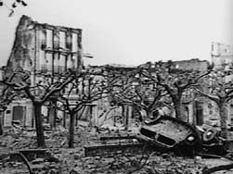
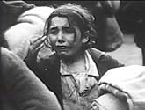
Guernica (Basque)
Bombed for 3 hours during “market day”
70% of town destroyed
1600 civilians killed (1/3 of population)
No strategic value
Testing ground for Nazi carpet bombing to demoralize civilian populations

Slide 13
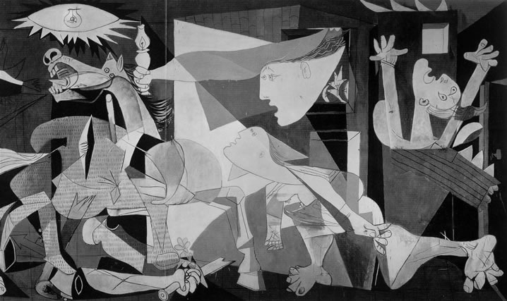
Guernica by Pablo Picasso

Slide 14
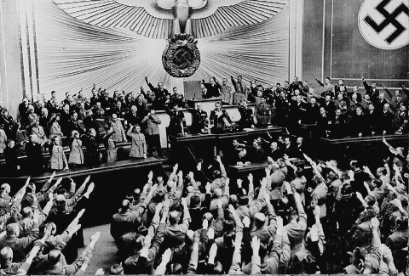
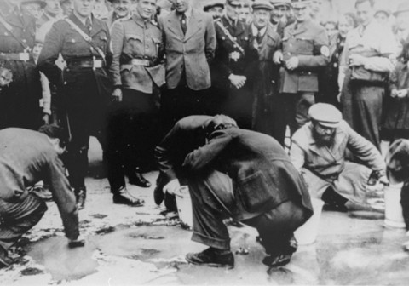
Fascist Aggression
1933 Hitler pulls out of League of Nations
1936 Reoccupies the Rhineland
1936 Rome-Berlin Axis, Anti-Comintern Treaty (Japan)
1938 Anschluss “union” with Austria

Slide 15
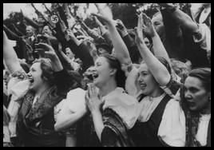
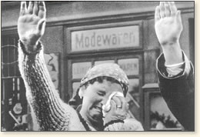
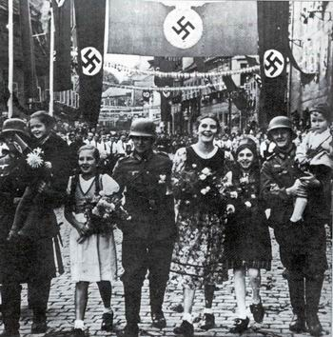
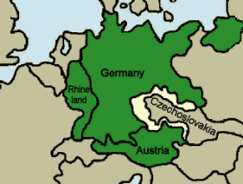
Fascist Aggression
1938 The Sudetenland
“Volksdeutsch”

Slide 16
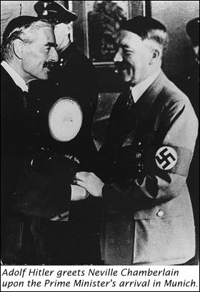
Munich Conference (1938)
Chamberlain (GB), Daladier (Fr), Mussolini (It) agree to hand over Sudetenland (Stalin furious)
Regarding his first impression of Hitler, Chamberlain commented: "In spite of the hardness and ruthlessness I thought I saw in his face, I got the impression that here was a man who could be relied upon when he had given his word."
Appeasement!

Slide 17
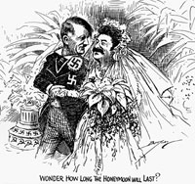
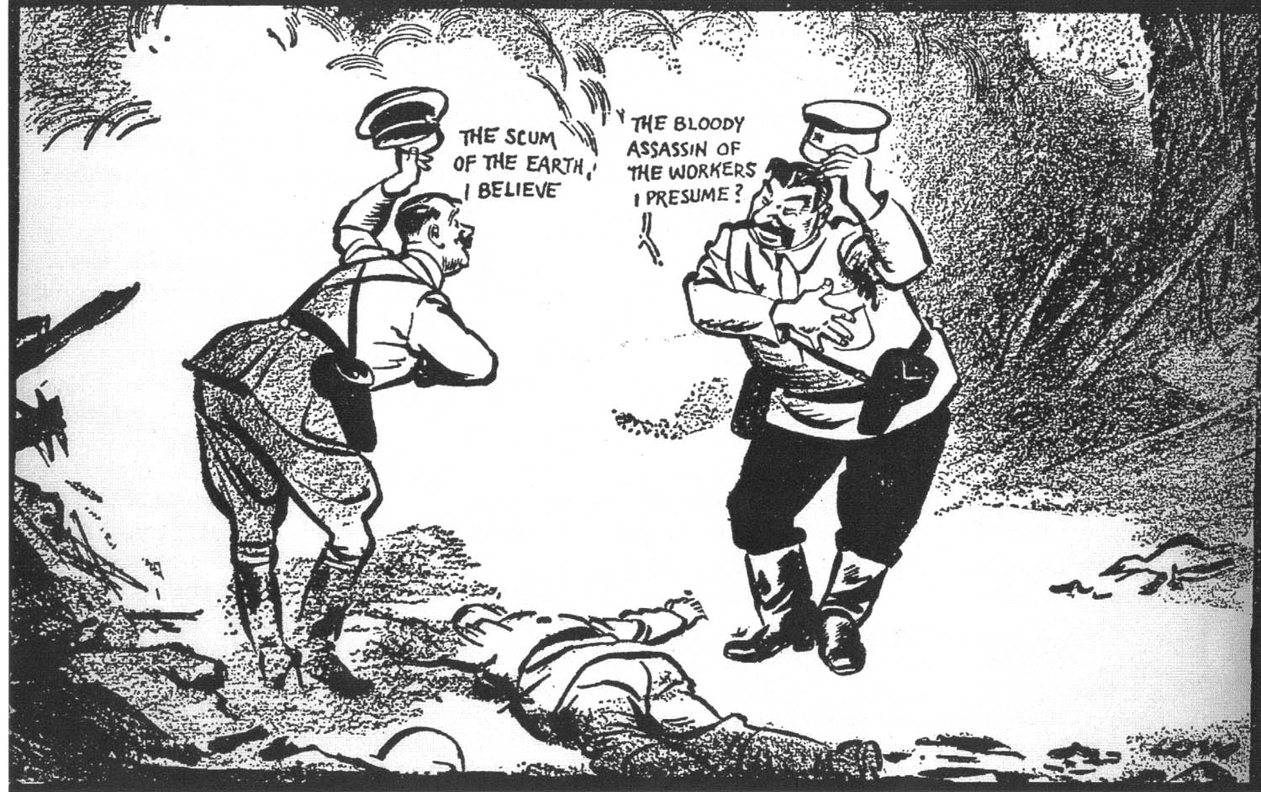
Nazi-Soviet Neutrality Pact (1939)

Slide 18
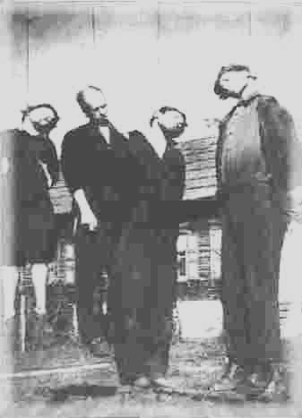
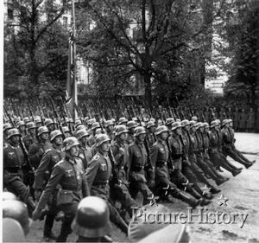
Invasion of Poland September 1, 1939

Slide 19
1940

Slide 20
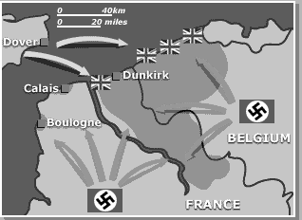
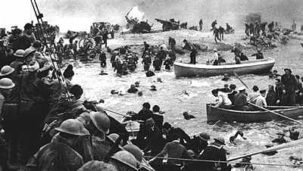
Evacuation of Dunkirk Operation Dynamo May 26 to June 3, 1940
200,00 British + 140,000 French rescued
Total: 338,226
Left behind on the beaches of Dunkirk were some 2,472 guns, 84,427 vehicles of all kinds and 657,000 tons of ammunition.

Slide 21
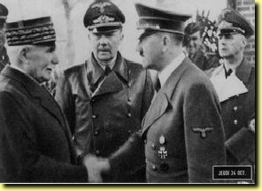
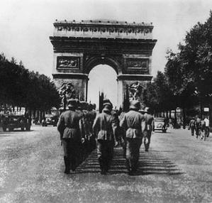
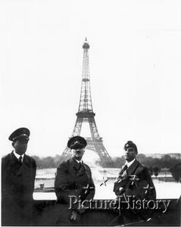
Fall of France
Vichy France (collaborators) Occupied France (Germans)
Marshall Petain

Slide 22
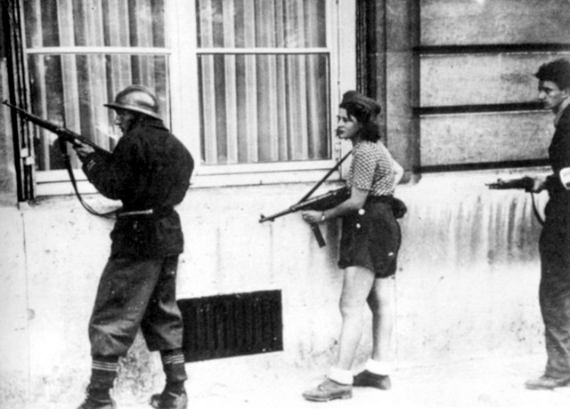
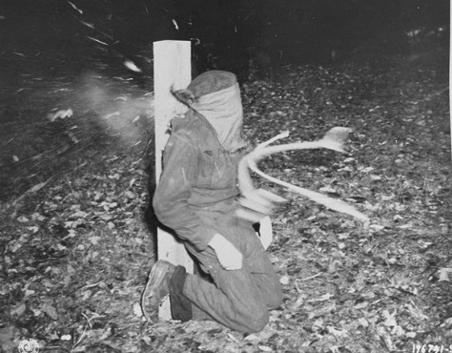
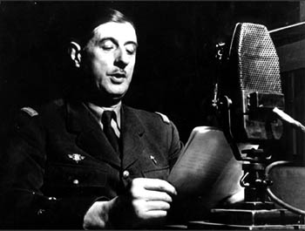
Is the last word said? Has all hope gone? Is the defeat This Is the last word said? Has all hope gone? Is the defeat definitive? No. Believe me, I tell you that nothing is lost for France. This war is not limited to the unfortunate territory of our country. This war is a world war. I invite all French officers and soldiers who are in Britain or who may find themselves there, with their arms or without, to get in touch with me. Whatever happens, the flame of French resistance must not die and will not die.
Free France
Is the last word said? Has all hope gone? Is the defeat definitive? No. Believe me, I tell you that nothing is lost for France. This war is not limited to the unfortunate territory of our country. This war is a world war. I invite all French officers and soldiers who are in Britain or who may find themselves there, with their arms or without, to get in touch with me. Whatever happens, the flame of French resistance must not die and will not die.
Is the last word said? Has all hope gone? Is the defeat definitive? No. Believe me, I tell you that nothing is lost for France. This war is not limited to the unfortunate territory of our country. This war is a world war. I invite all French officers and soldiers who are in Britain or who may find themselves there, with their arms or without, to get in touch with me. Whatever happens, the flame of French resistance must not die and will not die.
Charles de Gaulle

Slide 23
U.S. Isolationism
Neutrality Act of 1939 (allowed arms sales to belligerents on “cash and carry” basis)
Technically neutral but helped Britain
End of Isolationism: Fall of France in June 1940
1940 Selective Service Act (all men 21-35) = 1st peacetime draft
Continued to restrict Jewish immigration

Slide 24
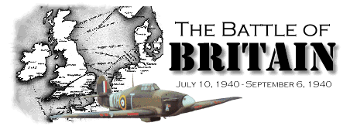
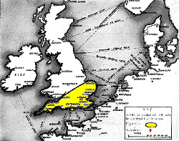

Slide 25
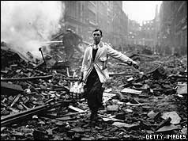
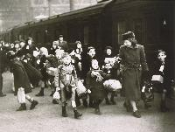
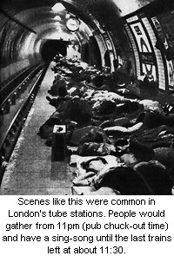
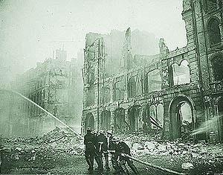
LONDON “BLITZ”

Slide 26
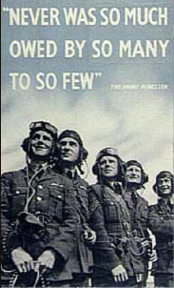
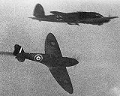
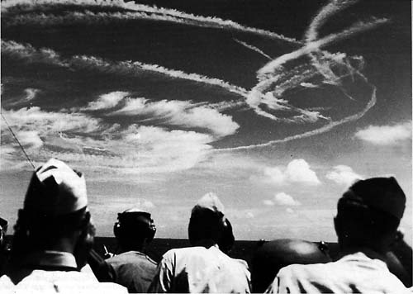

Slide 27
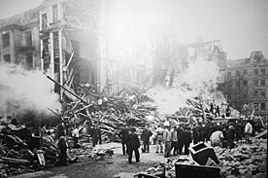
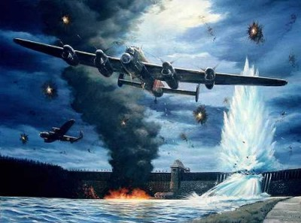
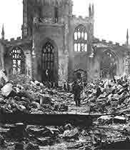
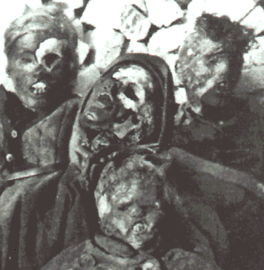
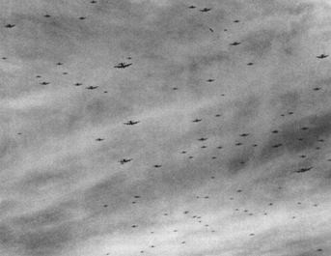
Strategic Bombing: “Morale Bombing”
Hamburg
Dambusters
Coventry

Slide 28
1941

Slide 29
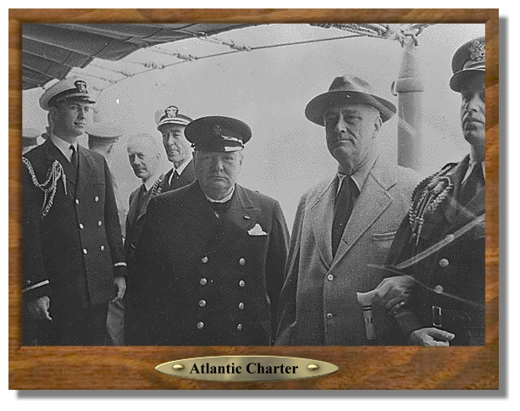
Atlantic Charter (1941)
During August 9-12, 1941 President Roosevelt and Prime Minister Churchill rendezvoused in a secret meeting in the North Atlantic, on the USS Augusta, for the purpose of discussing the principles they saw as governing the post-War world. This Conference resulted in the eight-point Atlantic Charter, which was officially announced on August 14, 1941.

Slide 30
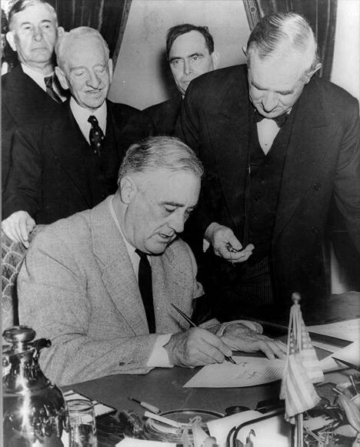
Lend-Lease Bill October 23, 1941
In 1941, President Roosevelt was faced with a puzzle: How could the U.S. help Great Britain with its efforts in World War II without violating the United States' official position of neutrality? With the help of the Senate, he found a way. On October 23, 1941, the Senate passed the $5.98 billion supplement to the Lend-Lease bill, originally passed in March at Roosevelt's urging. The Lend-Lease Act gave Roosevelt virtually unlimited authority to direct material aid such as ammunition, tanks, airplanes, trucks, and food to the war effort in Europe without the U.S. actually entering the war. By the end of the war, the United States had extended $49.1 billion in Lend-Lease aid to more than 40 nations.

Slide 31
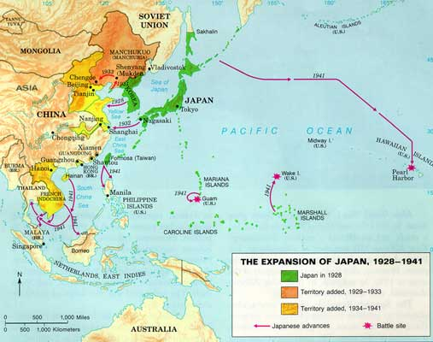
Pearl Harbor

Slide 32
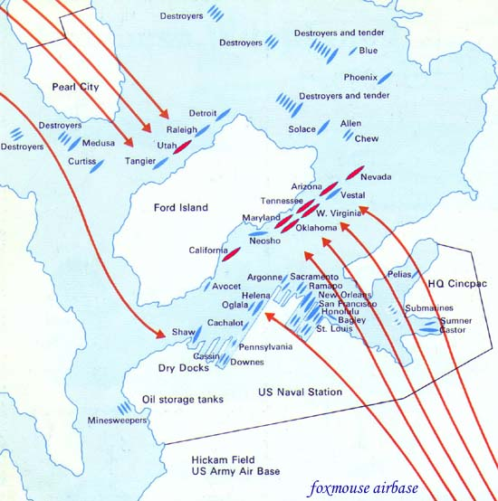
To ra! To ra! To ra! (Lightning Attack: the Tiger)
December 7, at 7:53 AM
351 Japanese aircraft attacked “Battleship Row” at Ford Island
Lasted less than 2 hours
American losses:
8 battleships
11 lesser class warships
2,403 people killed
70% of planes (188) at Hickam (B-17’s), Wheeler (P-40’s), & Bellows Fields

Slide 36
Philippines
Attacked 10 hrs. after Pearl Harbor
Gen. McArthur withdrew
Japanese occupation lasted 3 yrs. With 1 million Filipino casualties
Bataan Death March (10,000+ Br., Amer. died)

