Slide 1
Planning for the Future
Karen H. Reeves
Edmund Burke Academy

Slide 2
Georgia Institute of Technology
Class of 2023
GPA: 4.0
SAT/ACT: 1468/33
Acceptance rate: 18.8%

Slide 3
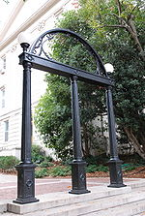
University of Georgia
Class of 2023
GPA: 3.98
SAT/ACT: 1320/29
Acceptance rate: 54%

Slide 4
Georgia College & State
Class of 2023
GPA: 3.63
SAT/ACT: 1216/27
Acceptance rate: 85%

Slide 5
Georgia Southern
Class of 2023
GPA: 3.34
SAT/ACT: 1171/24
Acceptance rate: 65%

Slide 6
Augusta University
Class of 2022
GPA: 2.93
SAT/ACT: 1055/21
Acceptance rate: 54.7%

Slide 7
University of North Georgia
Class of 2022
GPA: 3.60
SAT/ACT: 1109/25
Acceptance rate: 66%

Slide 8
Valdosta State University
Class of 2023
GPA: 3.13
SAT/ACT: 1055/21
Acceptance rate: 74%

Slide 9
Emory University
Class of 2023
GPA: 3.91
SAT/ACT: 1435/32
Acceptance rate: 18.5%

Slide 10
Mercer University
Class of 2023
GPA: 3.85
SAT/ACT: 1250/28
Acceptance rate: 73%

Slide 11
Clemson University
Class of 2022
GPA: 3.75
SAT/ACT: 1276/28
Acceptance rate: 51%

Slide 12
University of Florida
Class of 2022
GPA: 3.75
SAT/ACT: 1364/30
Acceptance rate: 38%

Slide 13
Kennesaw State
Class of 2022
GPA: 3.31
SAT/ACT: 1102/23
Acceptance rate: 59%

Slide 14
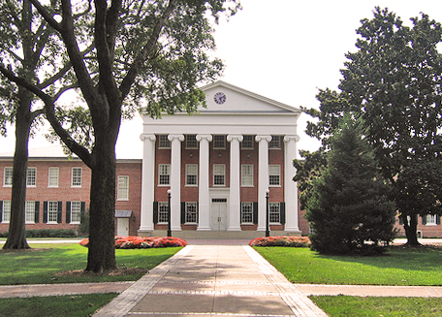
University of Mississippi
Class of 2022
GPA: 3.54
SAT/ACT: 1194/25
Acceptance rate: 79%

Slide 15
Abraham Baldwin (ABAC)
Class of 2022
GPA: 3.0
SAT/ACT: 1015/20
Acceptance rate: 77%

Slide 16
University of South Carolina
Class of 2022
GPA: 3.76
SAT/ACT: 1275/27
Acceptance rate: 68%

Slide 17
Savannah College of Art & Design
Class of 2022
GPA: 3.47
SAT/ACT: 1163/27
Acceptance rate: 69%

Slide 18
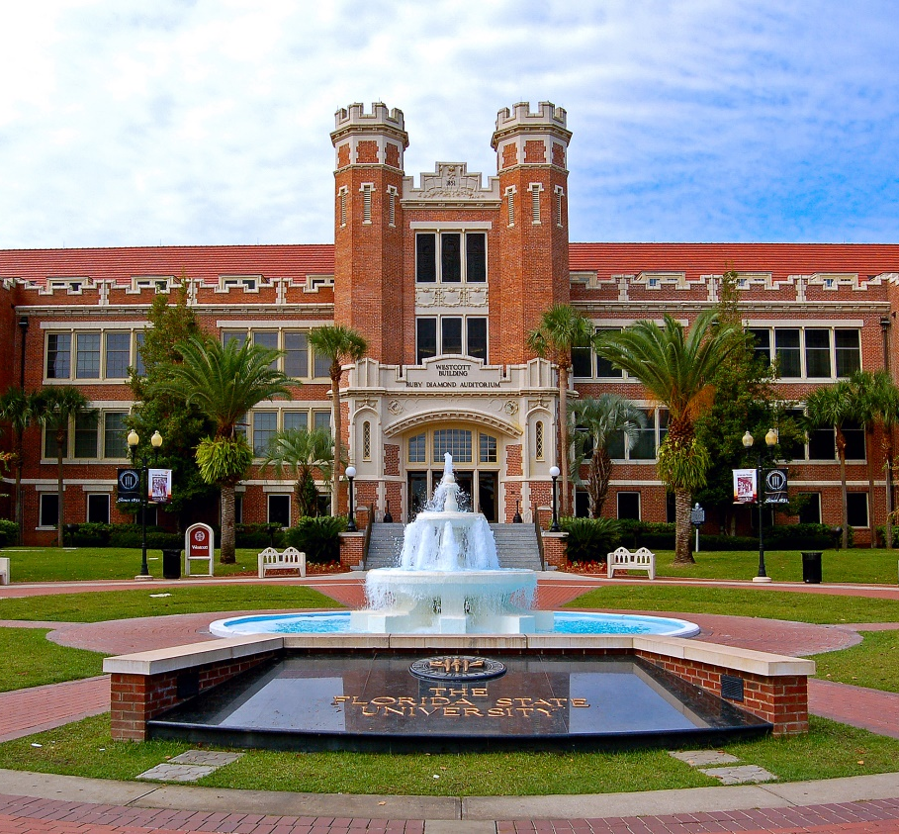
Florida State University
Class of 2022
GPA: 3.73
SAT/ACT: 1345/30
Acceptance rate: 58%

Slide 19
The Citadel
Class of 2022
GPA: 3.62
SAT/ACT: 1231/25
Acceptance rate: 77%

Slide 20
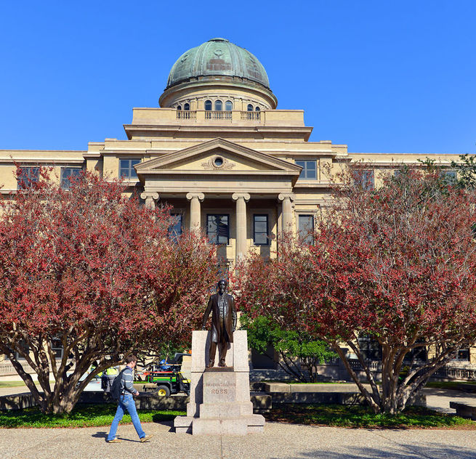
Texas A & M
Class of 2022
GPA: 3.75
SAT/ACT: 1300/30
Acceptance rate: 66%

Slide 21
Duke University
Class of 2023
GPA: 4.0
SAT/ACT: 1480/33
Acceptance rate: 10.8%

