Slide 1
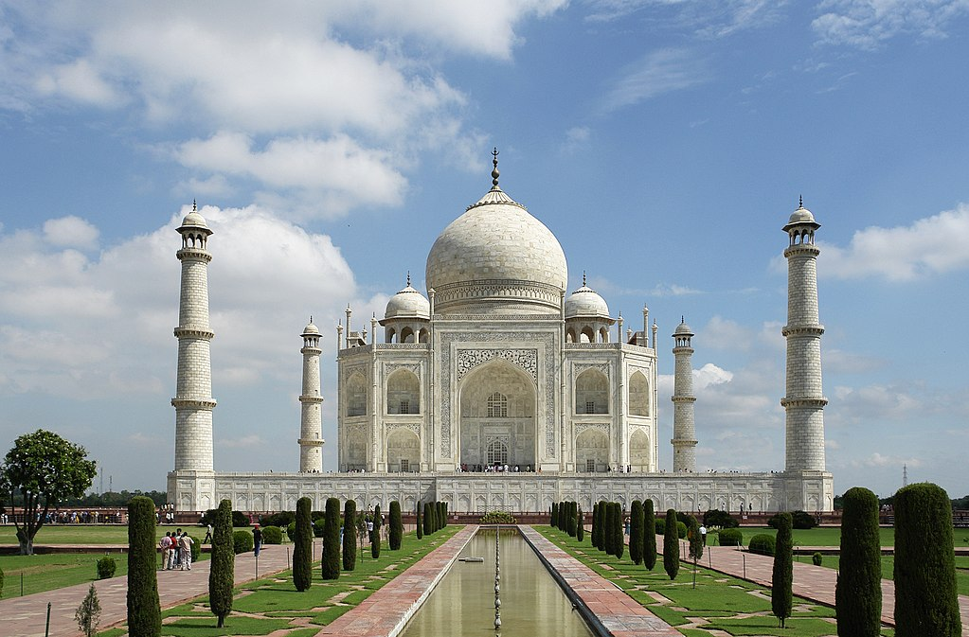
History of India

Slide 2
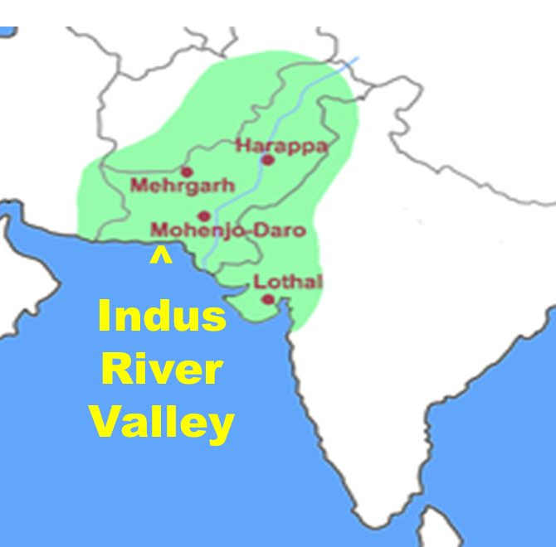
Indus Valley Civilization 4000 BCE

Slide 3
Harappa and Mohenjo-daro 2600 BCE
Achievements
Advanced city planning, multi-story buildings
Sophisticated urban sanitation system with sewers, household running water
Trade network from Mesopotamia to central India
Written script on inscribed seals
View this video
https://www.britannica.com/video/167155/overview-Indus-civilization

Slide 4
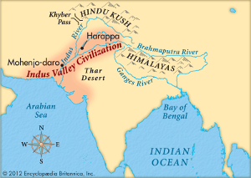

Slide 5
Migration of the Aryans 1800-1500 BCE
Indo-European horsemen, came through Khyber Pass
Indus Valley civilization gradually disappeared
Introduced first Hindu religious works: Vedas
Sacred language: Sanskrit
Introduced the caste system

Slide 6
Important Events
1200 BCE = Rig Veda written (India’s oldest religious text)
273 CE = Ashoka established Mauryan Empire, converts to Buddhism after war with Kalinga
320 CE = Chandragupta founds Gupta Empire

Slide 7
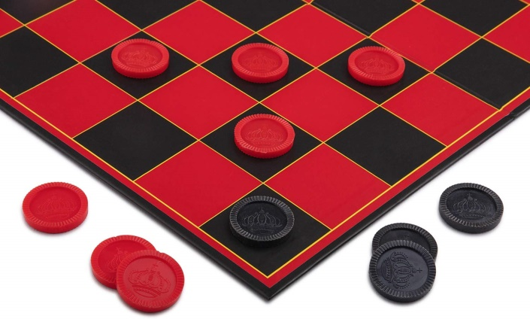
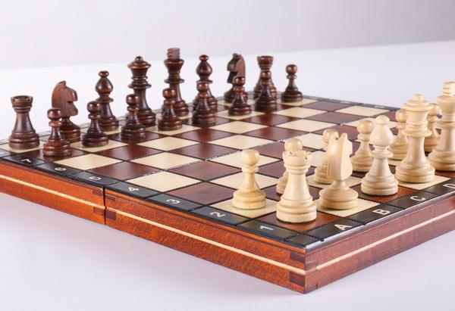
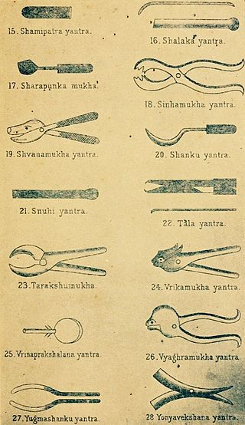
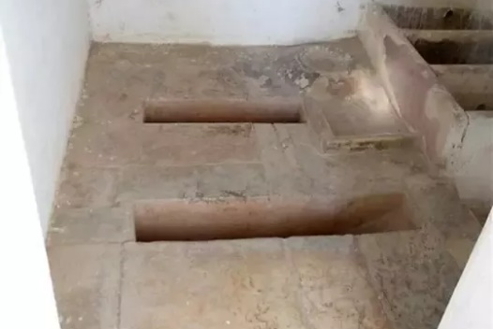
Achievements
Aryabhatta: Introduced “0,” contributed to trig, algebra
Invented Checkers, Chess, Ruler to measure inches, the 1st flush toilet
Sushruta: Father of Surgery 6th C. BCE

Slide 8
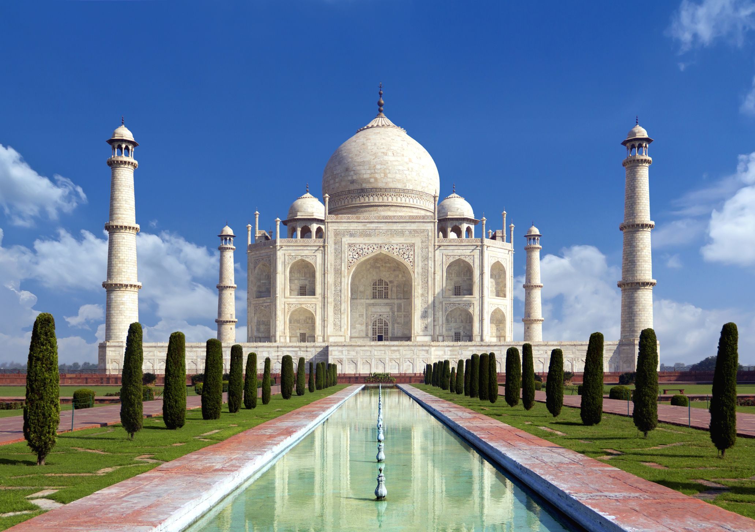
Taj Mahal (built by Shah Jahan in 1632)

Slide 9
Modern History
1498 Vasco de Gama establishes 1st European trading post in India
1612 British East India Company expands influence over India, focus is trade
1756 Black Hole of Calcutta = 146 British pow’s put in small cell for 3 days, 23 survived

Slide 10
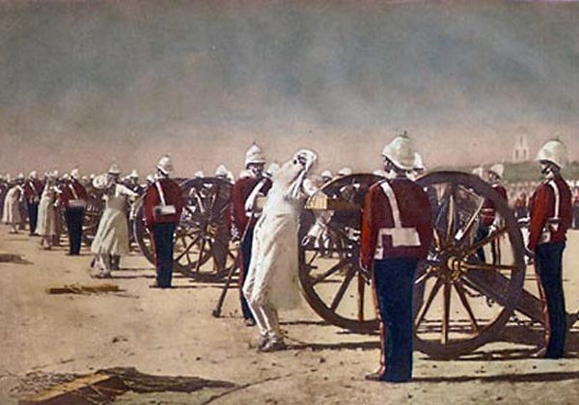
1857 Sepoy (Indian units attached to British military) Rebellion = probably cultural misunderstanding over use of cow, pig fat to grease cartridges
Sepoys executed for mutiny
1858 British begin direct rule of India
1915 Mahatma Gandhi returns to India

Slide 11
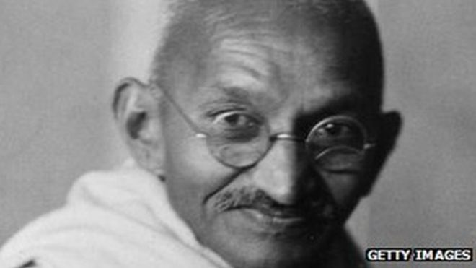
Mahatma Gandhi
Watch this video biography
https://www.biography.com/video/mahatma-gandhi-an-unpeaceful-end-2179183345

Slide 12
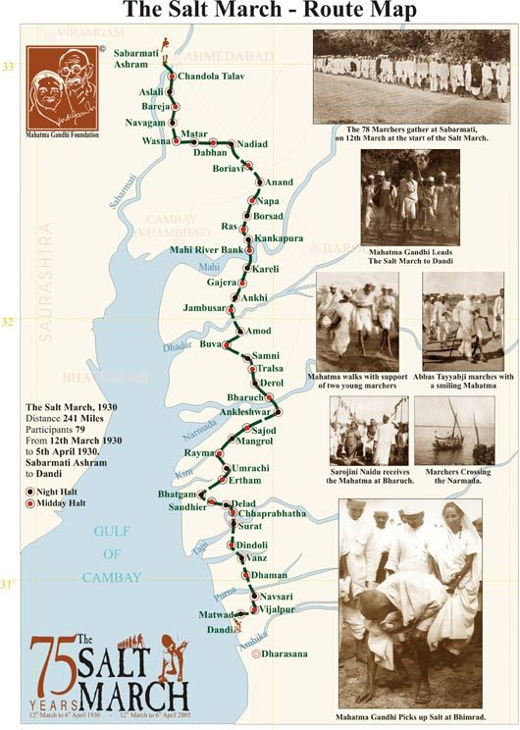
Salt March
1930
Act of non-violent civil disobedience
Had profound effect on the British

Slide 13
Indian Independence
1947 India partitioned into Hindu India and Muslim Pakistan
Violent clashes between Hindus, Sikhs, and Muslims followed
India voted to remain in British Commonwealth
Relations between two countries close (1.6 million Indians in GB)

Slide 14
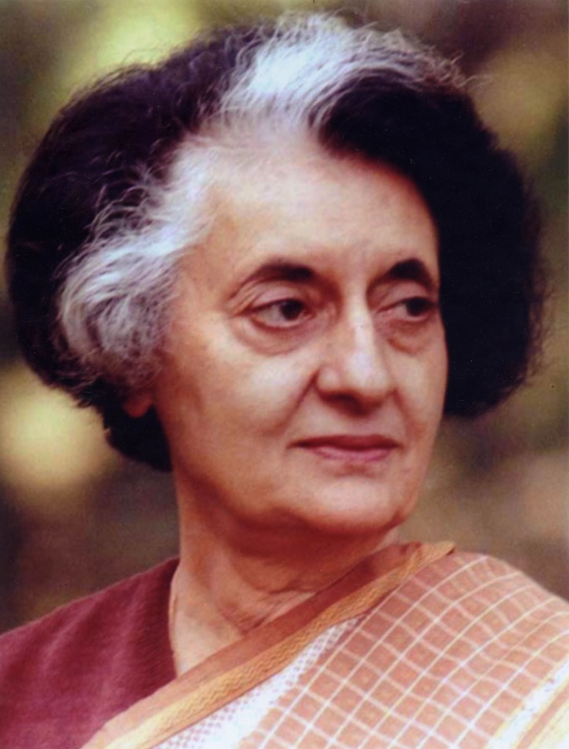
Indira Gandhi
Indira Gandhi
Daughter of Jawaharlal Nehru, the first prime minister of India
Only female PM of India
Centralized gov’t, oversaw creation of nuclear power, liberated Bangladesh
Often viewed as ruthless
Assassinated in 1984 by Sikh body guards

