Slide 1
History
Of the
Christian Church

Slide 2
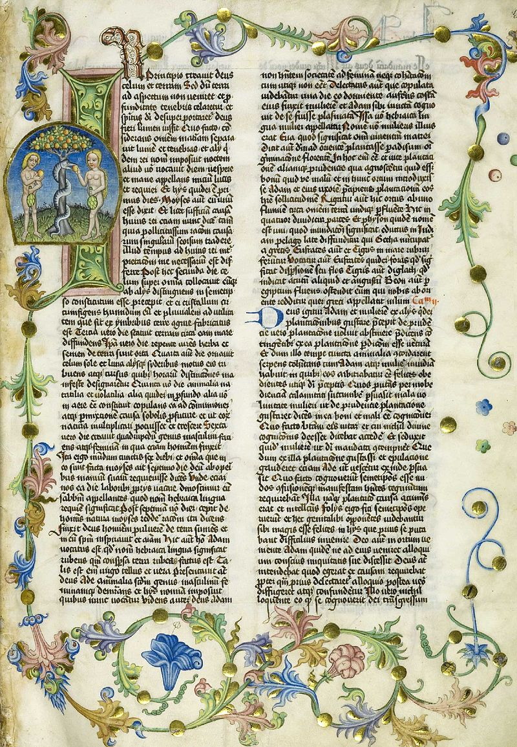
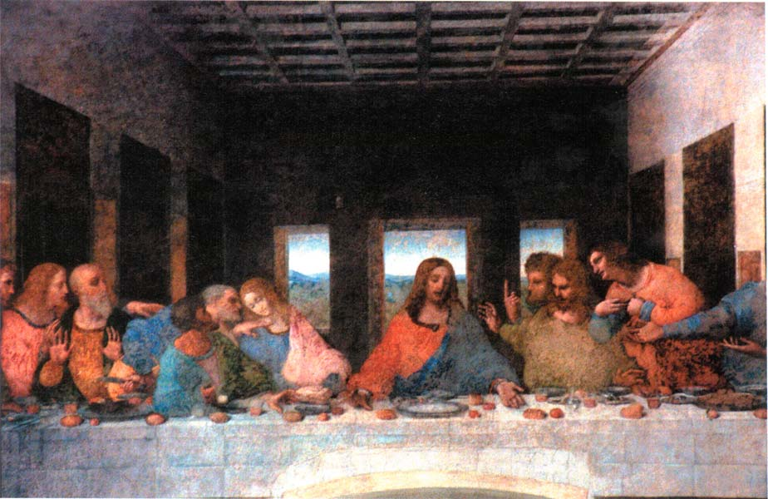
Life of Jesus
Born 6 – 4 BC: during reign of Judean King Herod
Massacre of the Innocents
AD 28?: Baptism by John the Baptist (beheaded by Herod Antipas)
40 days of temptation, Ministry
AD 30 – 33: Arrest, Crucifixion by Pontius Pilate, during reign of Tiberius
Resurrection

Slide 3
Timeline of Christian Church
Apostolic Age
First converts Orthodox Jews
Pentecost (descent of Holy Spirit on believers)
Paul’s “road to Damascus” conversion
Roman Centurion Cornelius first Gentile convert
Paul’s letters to the churches
Gospels first recorded
Persecution under Nero
Ignatius (Bishop of Antioch) declares “Lord’s Day
AD 37-80: Linus declared 2nd Bishop of Rome (Pope)

Slide 4
Timeline of Christian Church
Ante-Nicean Age
AD 110: Bishop of Antioch declares church katholikos (“catholic”)
AD 135: Final Jewish revolt (“Judea, Jerusalem” erased from Roman maps: Palestine)
AD 301: Armenia 1st nation to adopt Christianity
AD 312: Vision of Constantine ( in hoc signo vinces = in this sign though shalt conquer)

Slide 5
Timeline of Christian Church
We believe in one God, the Father Almighty, Maker of all things visible and invisible.
And in one Lord Jesus Christ, the Son of God, begotten of the Father the only-begotten; that is, of the essence of the Father, God of God, Light of Light, very God of very God, begotten, not made, being of one substance (ὁμοούσιον) with the Father; by whom all things were made both in heaven and on earth; who for us men, and for our salvation, came down and was incarnate and was made man; he suffered, and the third day he rose again, ascended into heaven; from thence he shall come to judge the quick and the dead. And in the Holy Ghost.
Ecumenical Councils
AD 325: First Council of Nicaea
Established Christian orthodoxy
Nature of the trinity
Nicaean Creed

Slide 6
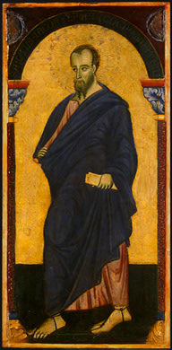
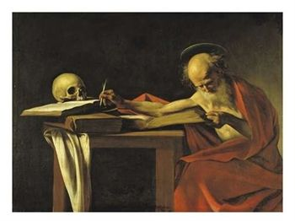
Timeline of Christian Church
Middle Ages
AD 400: Jerome’s Vulgate Bible (Latin)
AD 432: St. Patrick converts Ireland
AD 476: Fall of Roman Empire
AD 800: Charlemagne crowned King of Franks by Pope Leo III
AD 1054: Schism = Eastern Orthodox v. Roman Catholic
AD 1096: Urban II calls for Crusades

Slide 7
Timeline of Christian Church
Renaissance
AD 1305-1378: Avignon Papacy
AD 1378-1415: Great Schism
AD 1380: Wycliffe Bible (in English)
AD 1453: Fall of Constantinople
AD 1455: Gutenberg Bible (1st printed)

Slide 8
Timeline of Christian Church
Reformation
AD 1517: Martin Luther’s 95 Theses (Wittenberg)
AD 1521: Diet of Worms (“here I stand; I can not do otherwise…”)
AD 1534: English Reformation
AD 1545: Council of Trent
AD 1455: Gutenberg Bible (1st printed)

Slide 9
