Slide 1
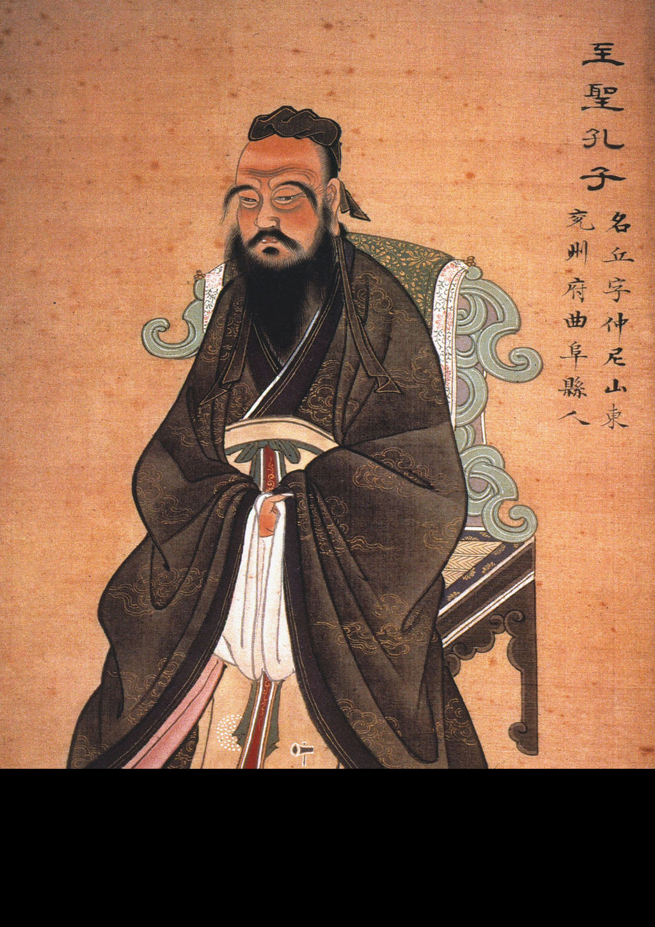
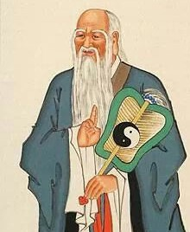
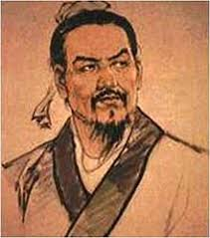
Chinese Philosophies Confucianism, Legalism, Taoism

Slide 2
Confucianism

Slide 3
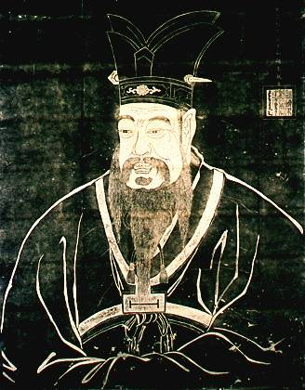
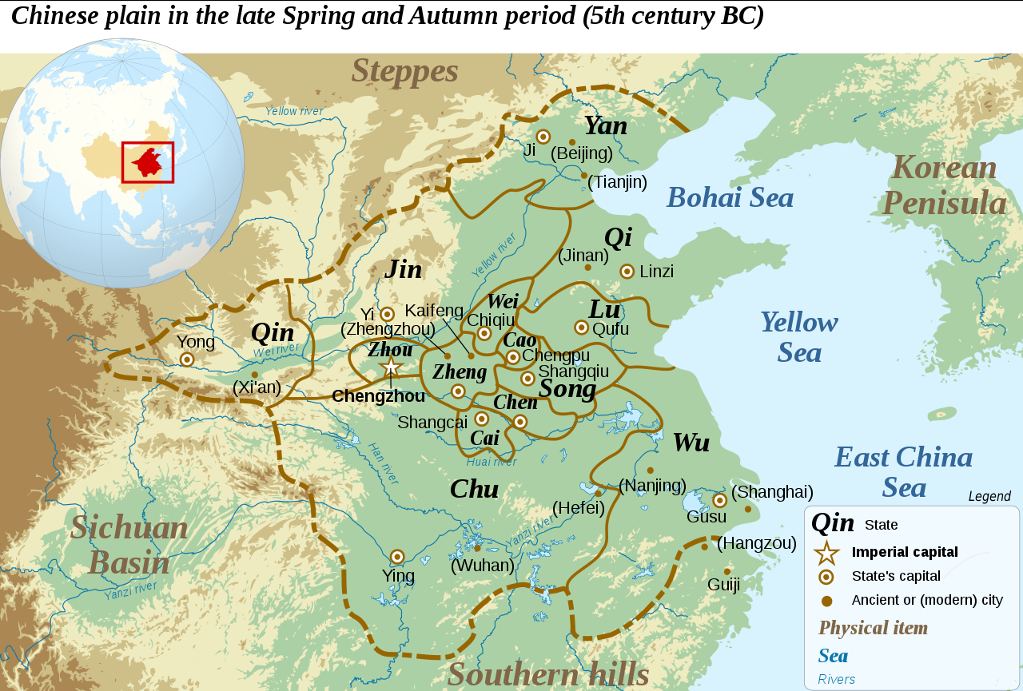
Confucius
551-479 BCE
Born in feudal state of Lu
Kongfuzi (surname + “master”)
Shi class (between aristocracy & commoner)
Government worker for Lu
Became teacher, author

Slide 4
Philosophy
Considered a philosophy, but intended to build on Zhou religious traditions of natural spirits & ancestor worship
Sought basis for “stable, unified, and enduring social order”
Emphasized “ritual” = social mores = civilized society

Slide 5
Major Principles
Social harmony (Everyone knows his/her place & fulfills role well.)
Relationships (Responsibilities are required by each relationship.)
Morality (In order to govern others, one must first govern one’s self.)
Filial piety (Family is the epitome of a society.)

Slide 6
Major Principles
Ren = Humaneness, benevolence, humanity
Li = Ritual, proper conduct (outward expression)
Yi = Righteousness (inward expression)
Shu = Reciprocity, empathy, altruism
Do not do unto others what you would not want others to do unto you.
Xiao = Filial piety (Respect for elders)

Slide 7
Relationships
Ruler Subject
Father Son
Elder brother Younger brother
Husband Wife
Older Friend Younger Friend

Slide 8
Five Classics
Classic of Poetry (songs, hymns to ancestors)
Book of Documents (speeches by early Zhou rulers)
Book of Rites (ancient rituals, court ceremonies)
I Ching (“book of changes,” divination system)
Spring & Autumn Annals (history of Lu).

Slide 9
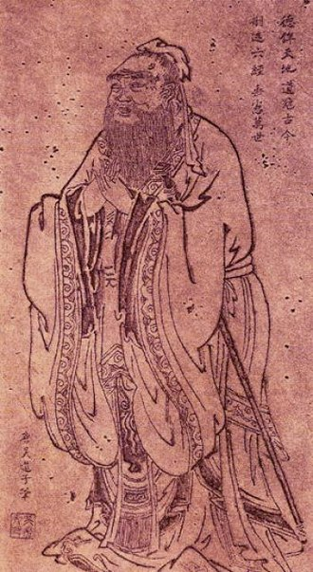
Analects
Most important Confucian work
Analects (“discussions”)
Written ca. 479-221 BCE
Emphasizes the importance of morality for the betterment of oneself and society in general
Teachings for both commoners and rulers to follow in the pursuit of morality.
Basis of Chinese education for 2000 years

Slide 10
Analects
“He who knows all the answers has not been asked all the questions.”
“If you make a mistake and do not correct it, this is called a mistake.”
“Real knowledge is to know the extent of one's ignorance.”
“To see what is right and not do it is the worst cowardice.”

Slide 11
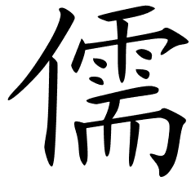
Government (3 requirements): “sufficiency of food, sufficiency of military equipment, and the confidence of the people in their ruler”
“To put the world in order, we must first put the nation in order; to put the nation in order, we must first put the family in order; to put the family in order; we must first cultivate our personal life; we must first set our hearts right.”
Chinese symbol for “Scholar” or Confucian

Slide 12
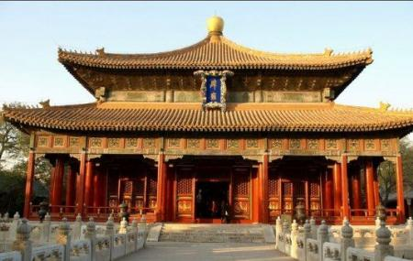

Slide 13
Mencius
372-289 BCE
Disciple of Confucius
Believed people basically good
Should use education, not punishment, for wrong-doing
Good people will mend their ways in accordance to their inherent goodness.

Slide 14
Legalism

Slide 15
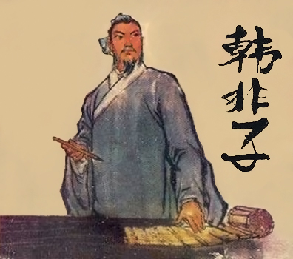
Han Feizi
ca. 280-233 BCE
Lived during Late Warring States
Leading legalist scholar (often compared to Machiavelli)

Slide 16
Major Principles
Human nature is naturally selfish and must be controlled.
Intellectualism and literacy is discouraged.
Law is the supreme authority and replaces morality.
The ruler must rule with a strong, punishing hand.
War is the means of strengthening a ruler’s power.
The state is supreme.

Slide 17
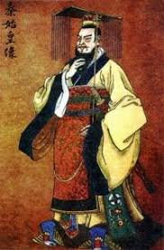
Shi Huangdi
ca. 259-210 BCE
Qin Emperor
Legalist
Lost Mandate of Heaven because of cruelty

Slide 18
Taoism

Slide 19
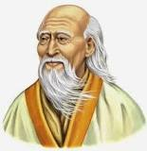
Lao-Tzu
? 6th – 4th C. BCE?
“Old Master”
Wrote Tao Te Ching
Said to have been Confucius’ tutor

Slide 20
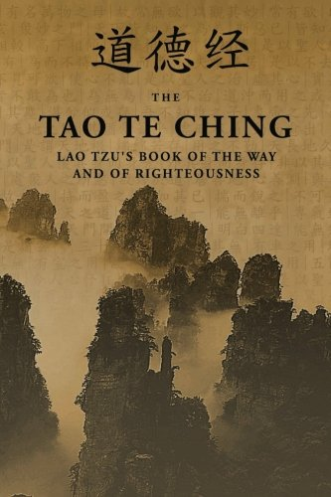
Tao Te Ching
“Book of the Way”
Anti-intellectual
Anti-authoritarian
Way of virtue lies in simplicity
Recognition of the Tao (natural, universal force)
Living in the moment

Slide 21
Major Principles
1. Dao [Tao] is the first-cause of the universe, a force that flows through all life.
2. Chi is balanced energy
3. Believer’s goal is to become one with Dao; one with nature.
4. Wu wei = “Let nature take its course.” “The art of doing nothing.” “Go with the flow!”
5. Man is unhappy because he lives according to man-made laws, customs, & traditions that are contrary to the ways of nature.

Slide 22
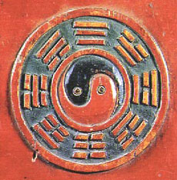
Major Principles
To escape the “social, political, & cultural traps” of life, one must escape by:
1. Rejecting formal knowledge and learning.
2. Relying on the senses and instincts.
3. Discovering the nature and “rhythm” of the universe.
4. Ignoring political and social laws.

Slide 23
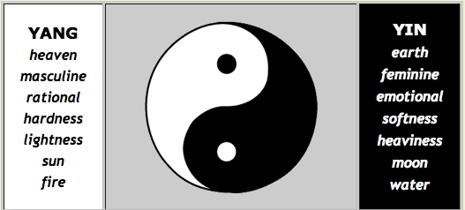
Yin & Yang

Slide 24
Comparison
How does one live in a chaotic world?
Confucianism = moral order in society
Legalism = rule by harsh law & order
Taoism = freedom for individuals, less gov’t, avoid conformity

