Slide 1
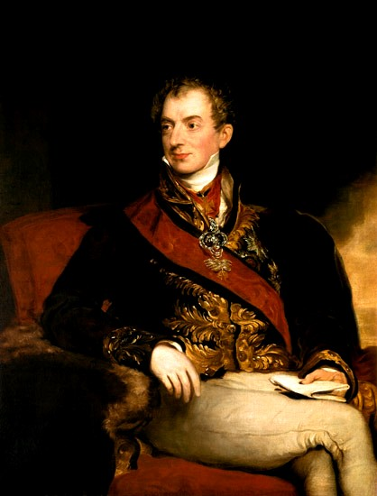
The Congress of Vienna
The Establishment of a Conservative Order

Slide 2
1815

Slide 3
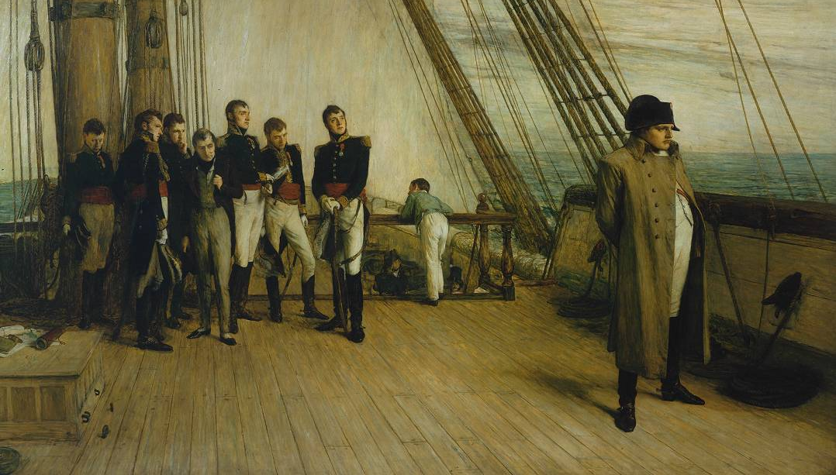
Napoleon’s Surrender

Slide 4
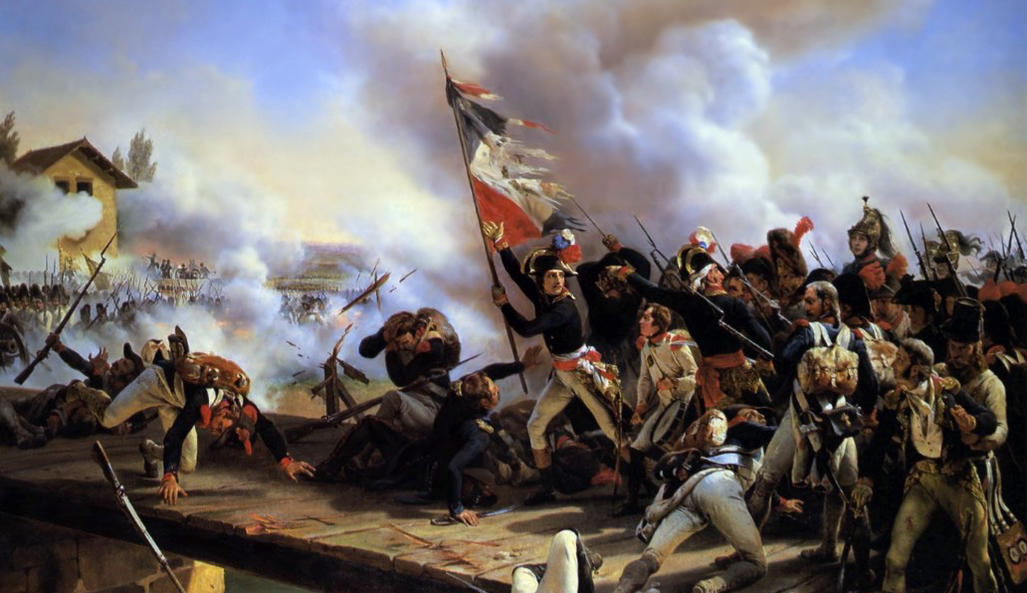
ended a quarter century of continual warfare in Europe.
Notes:
Napoleon Bonaparte leading his troops over the bridge of Arcole, by Horace Vernet.

Slide 5
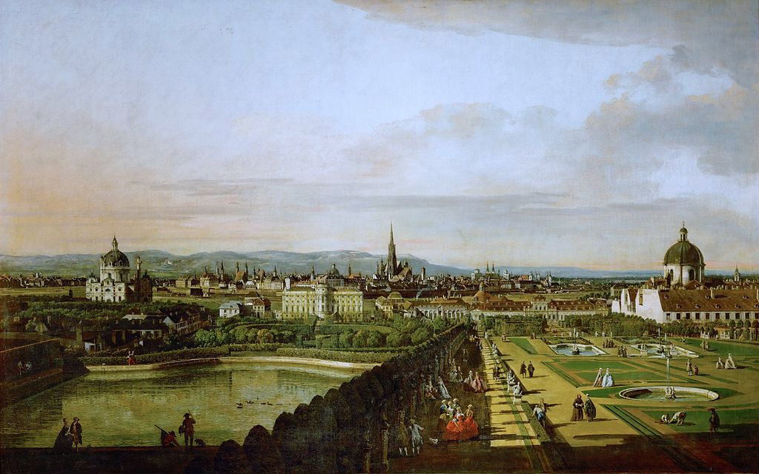
European leaders met in Vienna, Austria, to re-establish order.

Slide 6
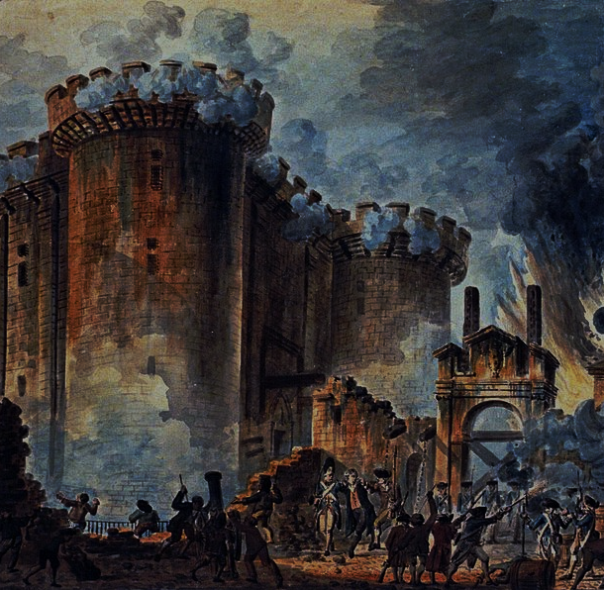
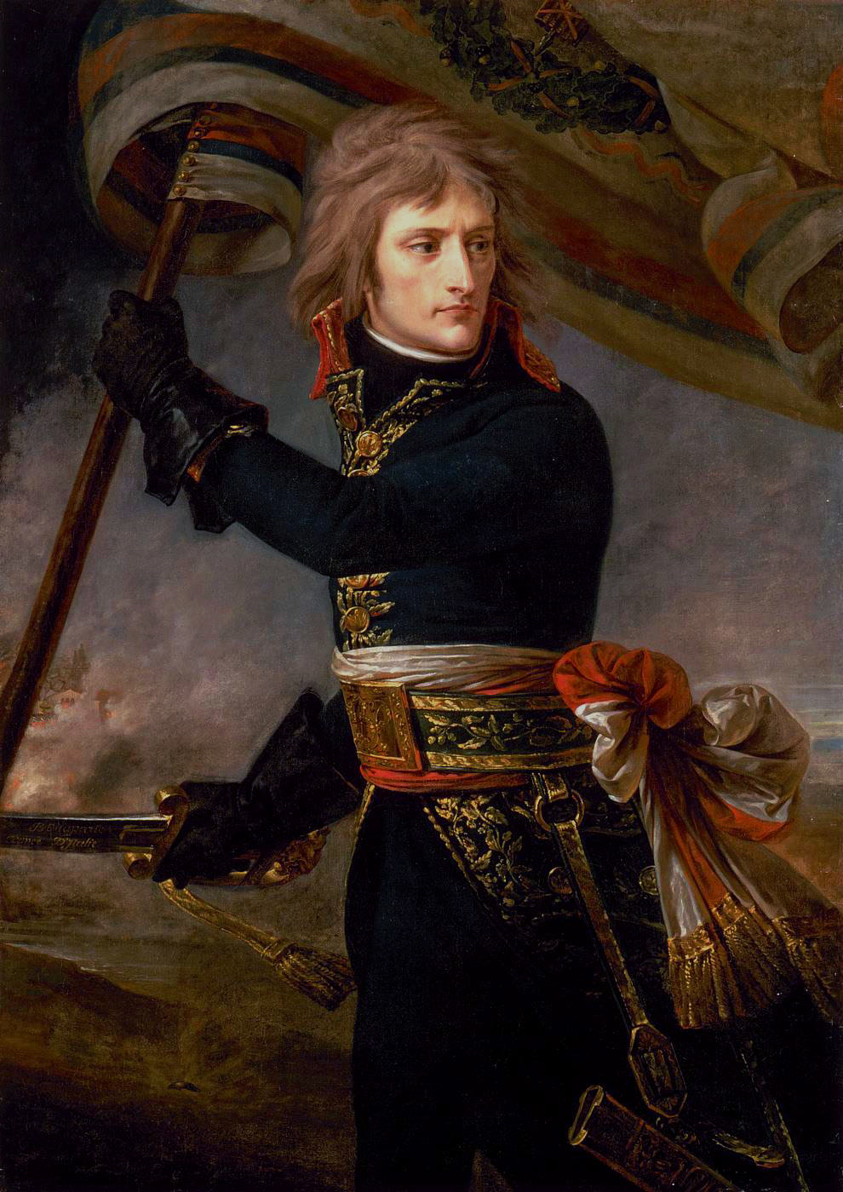
Objective:
(OR AS MUCH OF IT AS POSSIBLE)

Slide 7
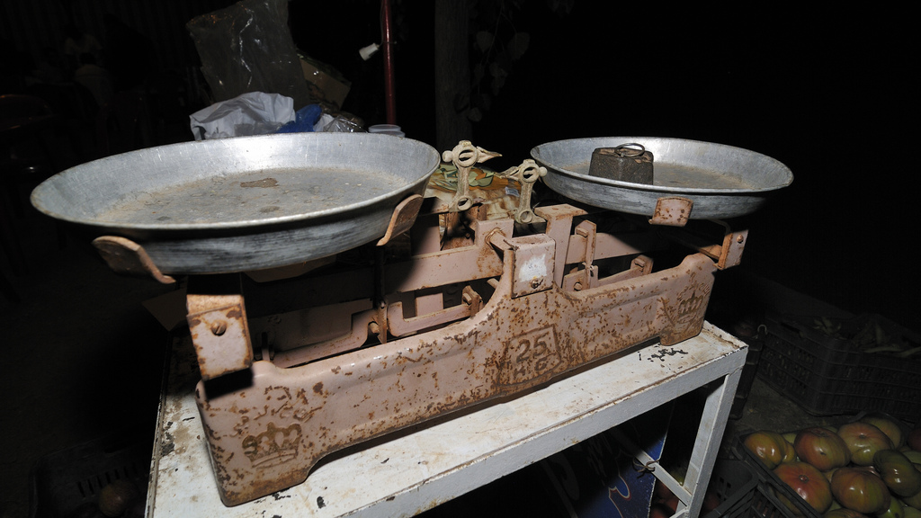
BALANCE OF POWER
Some rights reserved by Serge Melki

Slide 8
Quadruple Alliance
Britain
Russia
Prussia
Austria
Some rights reserved by beeveephoto

Slide 9
PUNISHMENT
Some rights reserved by cogdogblog

Slide 10
France MUST remain a great power.
Britain
Russia
Prussia
Austria
France
Some rights reserved by beeveephoto

Slide 11
BALANCE OF POWER
Some rights reserved by Serge Melki

Slide 12
Prince Klemens von Metternich
Austrian Foreign Minister

Slide 13
“Coachman of Europe”
Some rights reserved by eblaser

Slide 14
Conservatism
Stability within states
Stability between states

Slide 15
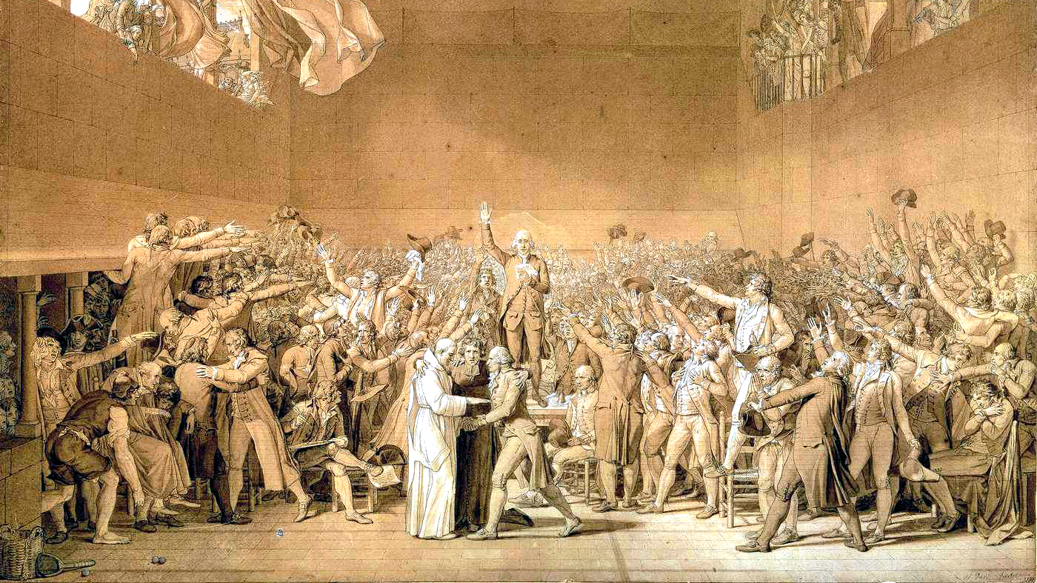

Slide 16
STABILITY within states

Slide 17
Conservatism
TRADITION
INSTITUTIONS
ARISTOCRACY

Slide 18
Conservatism
LIBERAL REFORM
POPULAR GOV
NATIONALISM

Slide 19
STABILITY between states

Slide 20
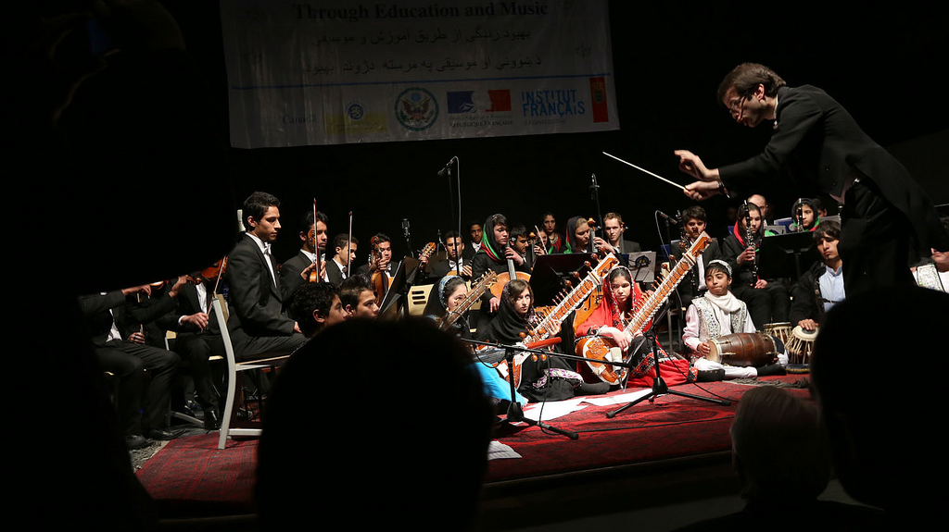
“Concert of Europe”
The Great Powers would (informally) work together to maintain existing national boundaries and prevent revolutions.
Some rights reserved by U.S Embassy Kabul Afghanistan

Slide 21
COLLECTIVE SECURITY
The Concert system was an informal precedent for the more formal European associations of the 20th century (League of Nations, NATO, UN, EU).

Slide 22
The “Holy Alliance”
1815-1825
Agreement between rulers of
RUSSIA, PRUSSIA, & AUSTRIA
to rule in a spirit of Christian charity and to assist each other in times of trouble
Some rights reserved by Guillaume Speurt

Slide 23
The “Holy Alliance”
1815-1825
(i.e., to assist one another in crushing revolutionary activity).
Some rights reserved by Guillaume Speurt

Slide 24
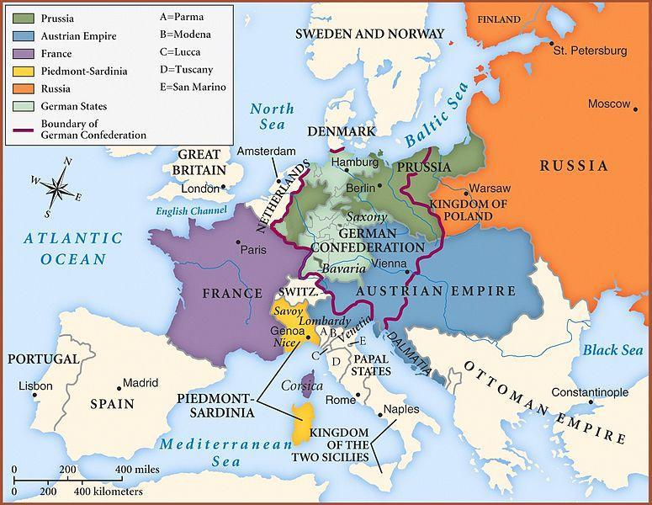
The New Old Map of Europe
Boundaries Re-drawn (largely resembling old boundaries)

Slide 25
France
Restored to 1792 boundaries
WAR REPARATIONS
Bourbons Restored

Slide 26
Russia
Gained Polish Territory

Slide 27
German Confederation
Association of German states
Replaced defunct HRE

Slide 28
39 States
Down from OVER 300

Slide 29
WHO WILL DOMINATE?
Austria or Prussia?

Slide 30
1815-1848 The Age of Metternich

Slide 31
99
Years before the European continent would be torn apart again by another major war

Slide 32
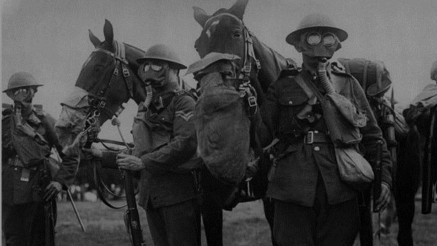
20
Years between WWI and WWII

Slide 33
GREAT SUCCESS
High Five!

Slide 34
LEARNING. DELIVERED.

