Slide 1
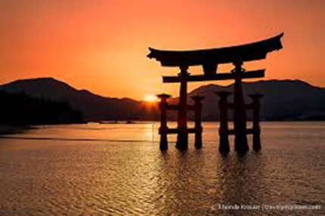

Slide 2
Shintoism
“Way of the gods”
Traditional belief system of indigenous Japan
Primary belief system today along with Buddhism
No founder, no religious texts
Influenced by Confucianism, Taoism
Shinto gods called “Kami”

Slide 3
History
Influenced by Confucianism, Taoism, Buddhism
Late 17th century effort to return to purely Japanese tradition
Meiji Restoration of 1868 made National religion of Japan = Emperor worship
Meiji combined Samurai mentality with Shinto reverence for Emperor
Post-WWII Shintoism and Japanese state were separated

Slide 4
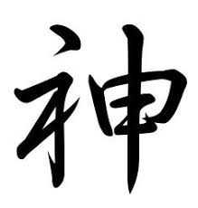
World of the Kami
Sacred spirits which take the form of things and concepts important to life, such as wind, rain, mountains, trees, rivers and fertility
Humans become kami after they die, revered by their families as ancestral kami
Kami of extraordinary people enshrined
Sun Goddess Amaterasu considered Shinto's most important kami.

Slide 5
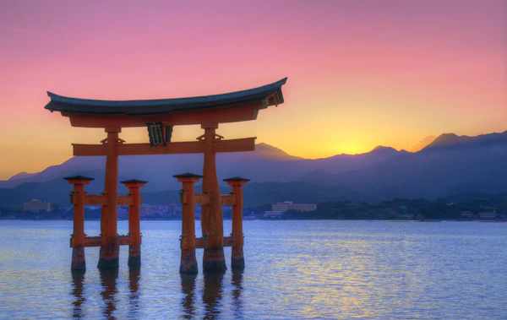
Major Principles
No absolute right and wrong in Shinto
Nobody perfect
Humans thought to be fundamentally good
Evil caused by evil spirits
Purpose of most Shinto rituals is to keep away evil spirits by purification, prayers and offerings to the kami

Slide 6
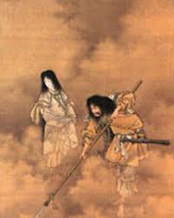
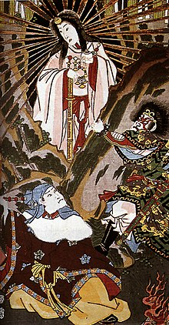
AmaTerasu
Izanami
Izanagi

Slide 7
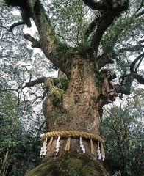
Kami & Yorishiro

Slide 8
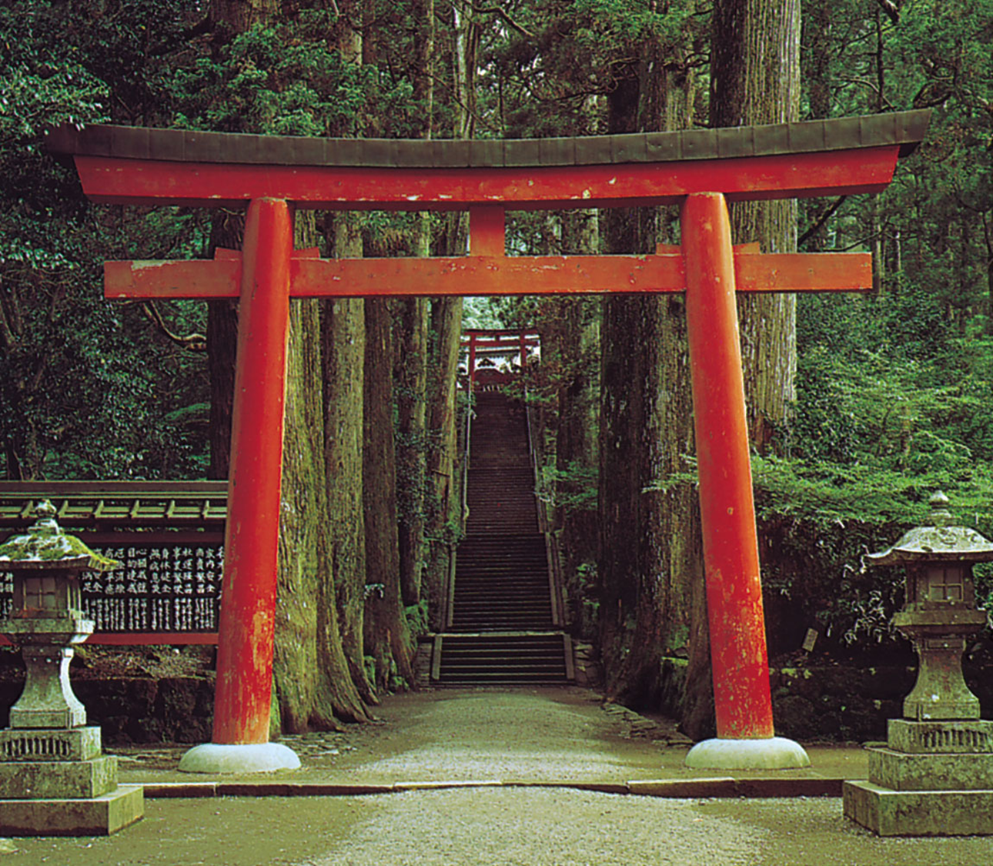
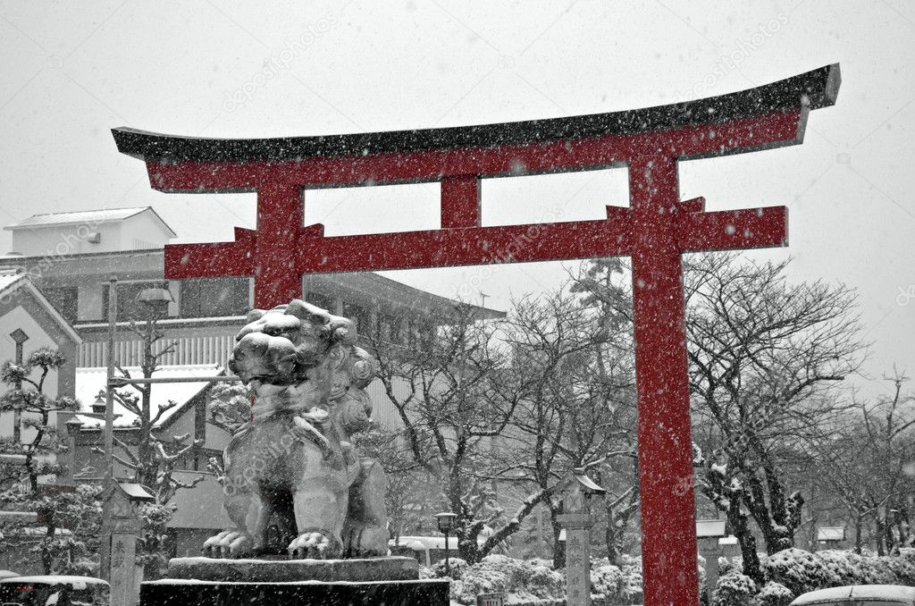
Torii “Entrance to the world of the Kami”

Slide 9
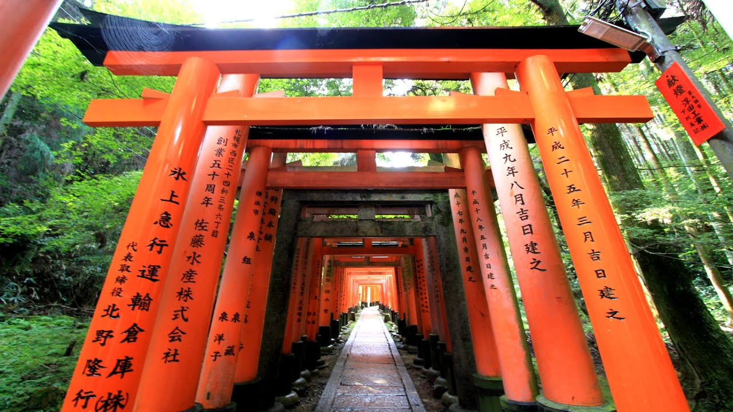
Torii Gates in Kyoto

Slide 10
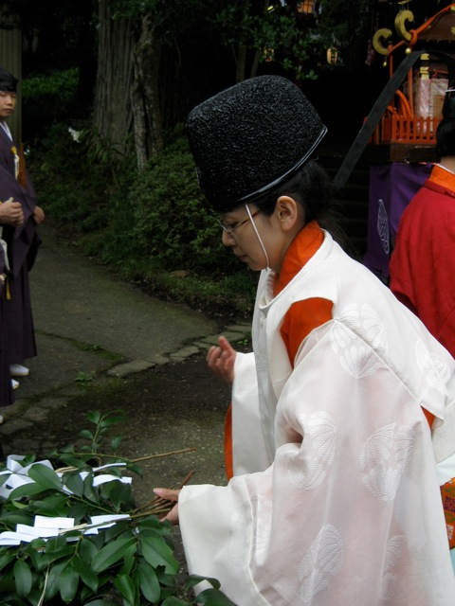
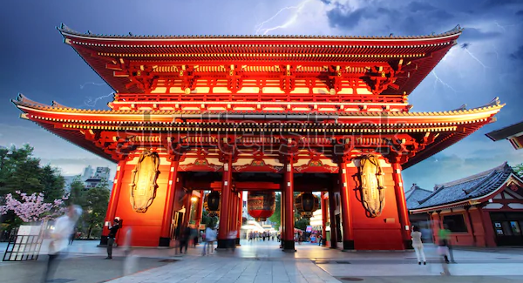
Shinto Temple

Slide 11
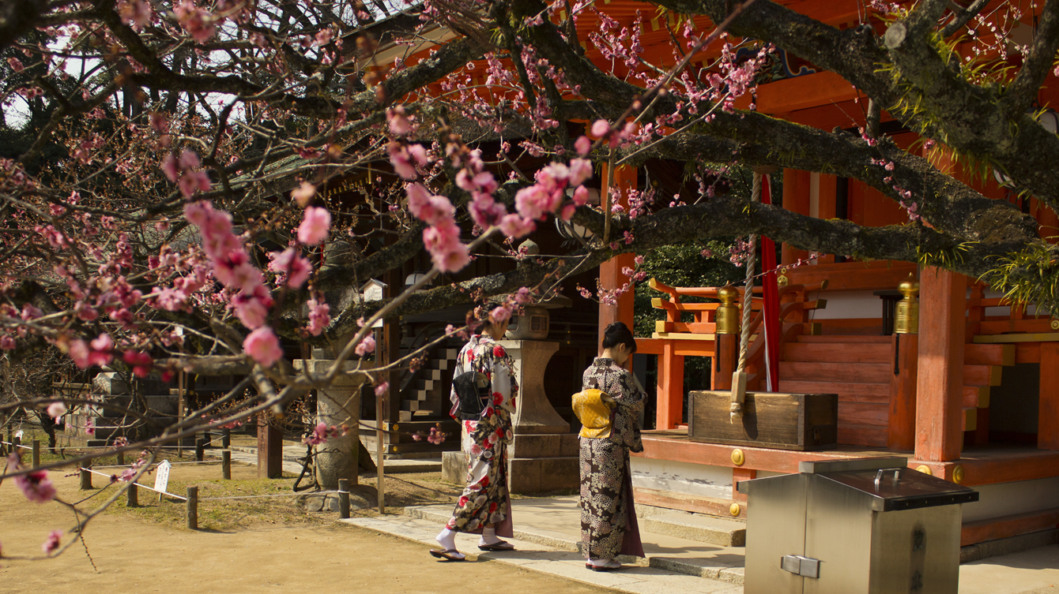
Shinto Shrine

Slide 12
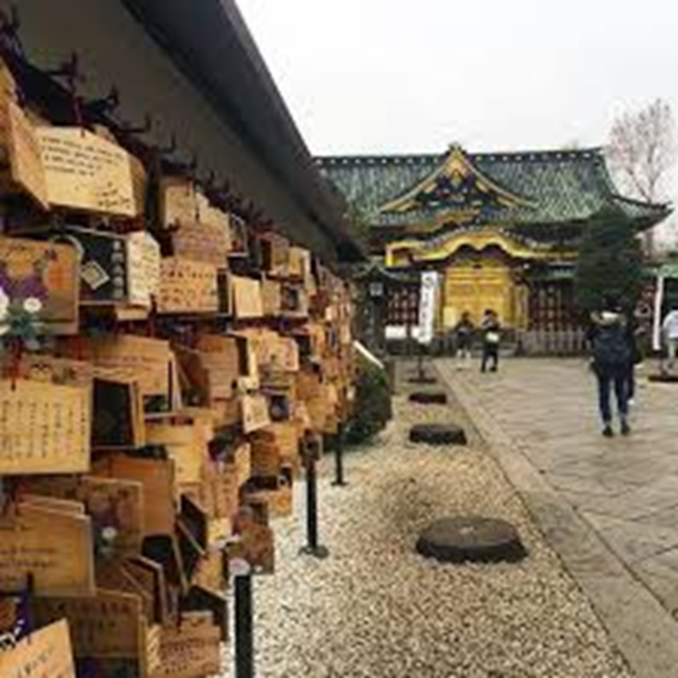
Ema “Thoughts, prayers, wishes”

Slide 13
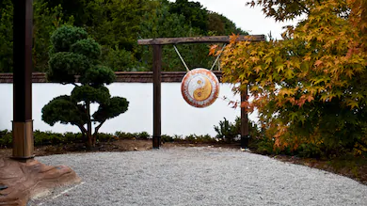
Torii Gong

Slide 14
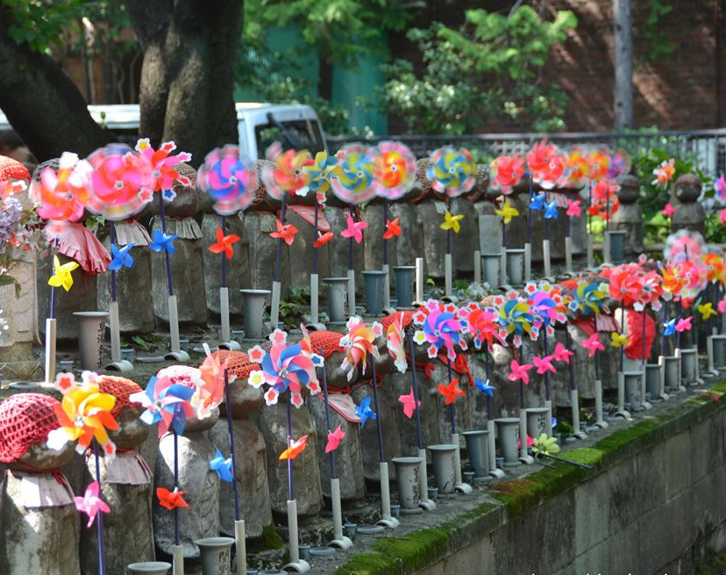
Jizo Statues “Protectors of children & unborn babies”

Slide 15
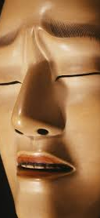
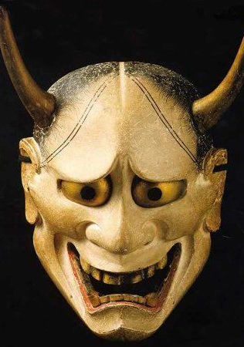
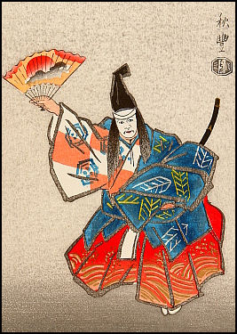
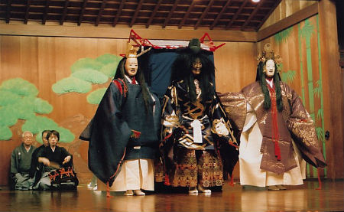
Noh theater

Slide 16
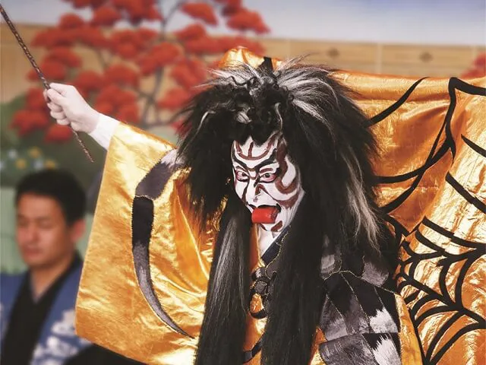
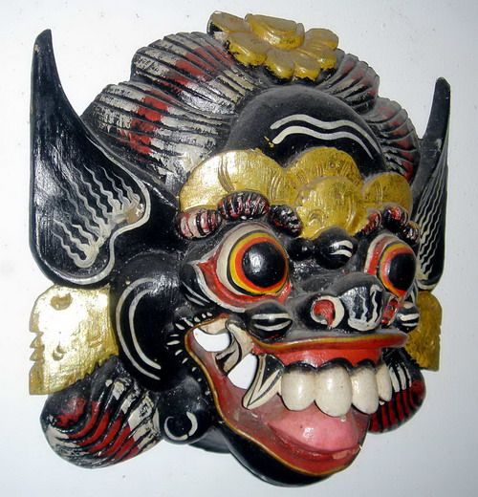
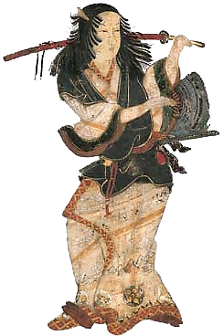
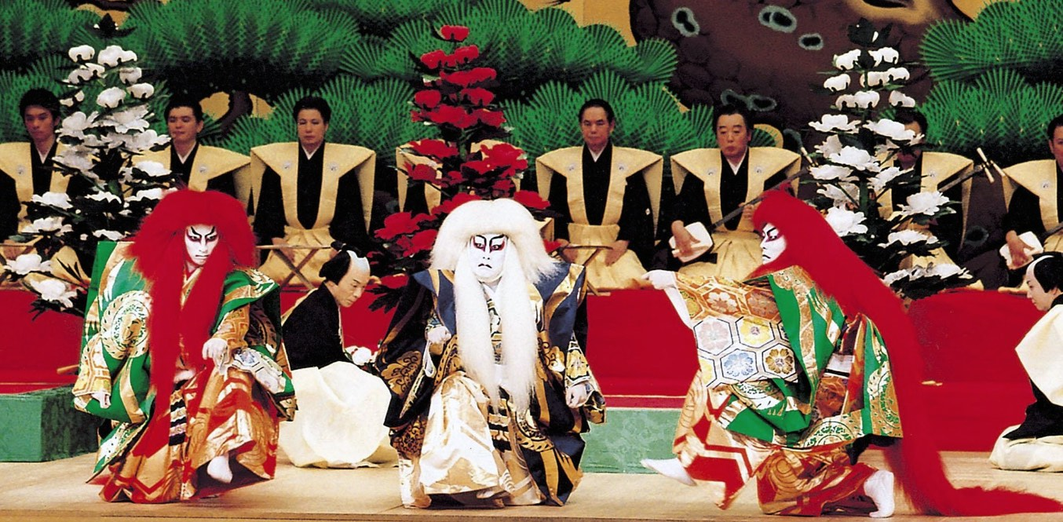
kabuki theater

Slide 17
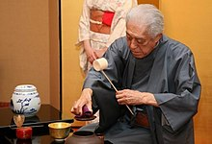
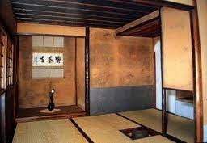
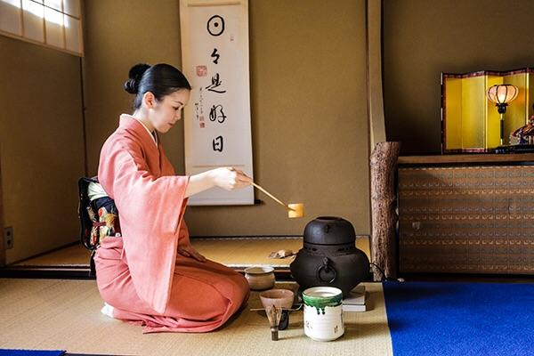
Tea Ceremony “purity, tranquility, respect and harmony ”

Slide 18
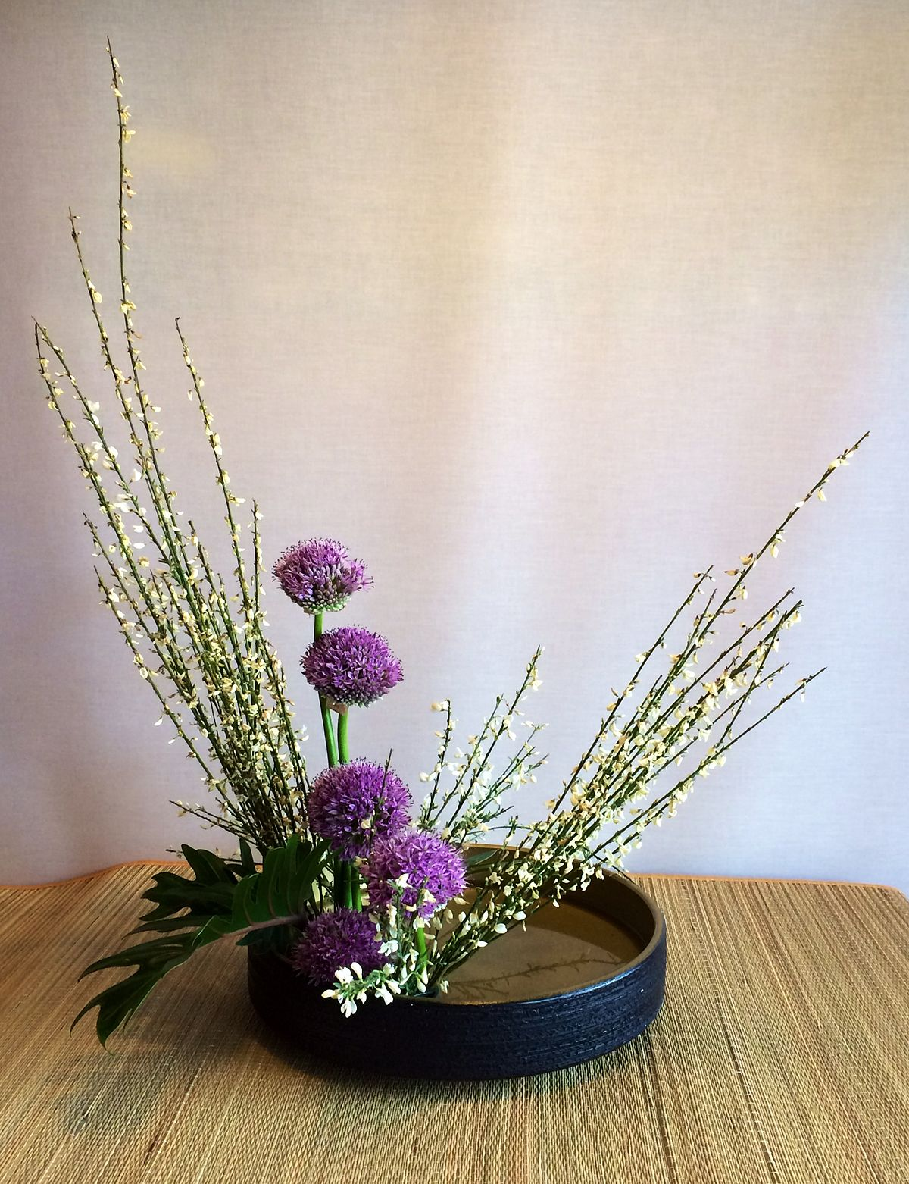
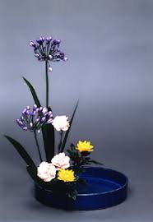
ikebana “Art of flower arrangement”
Tallest Heaven
Middle Man
Lowest Earth

Slide 19
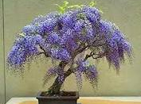
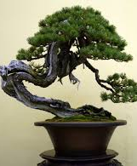
bonsai “Growing trees in a container”

Slide 20
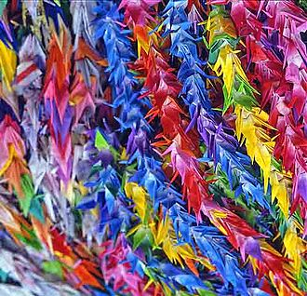
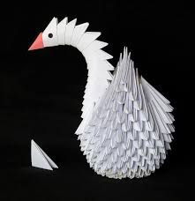
origami “Art of folding paper”

Slide 21
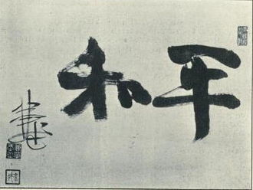
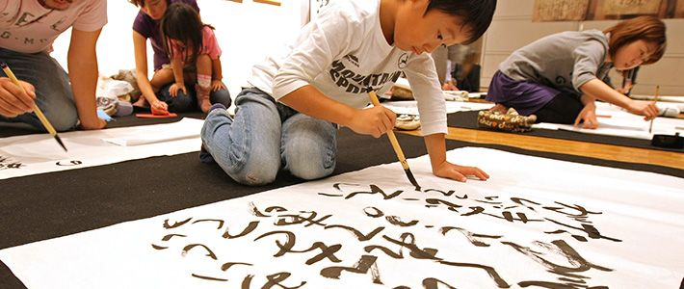
Calligraphy

Slide 22
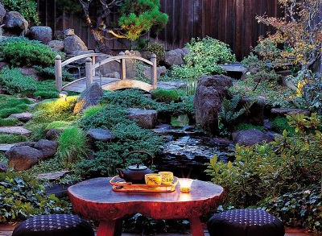
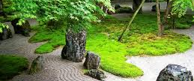
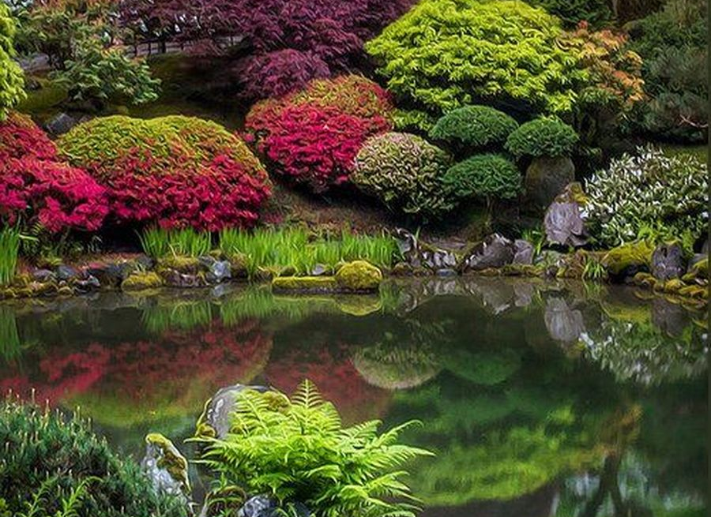
Zen meditation garden

Slide 23
minimalism

