Slide 1
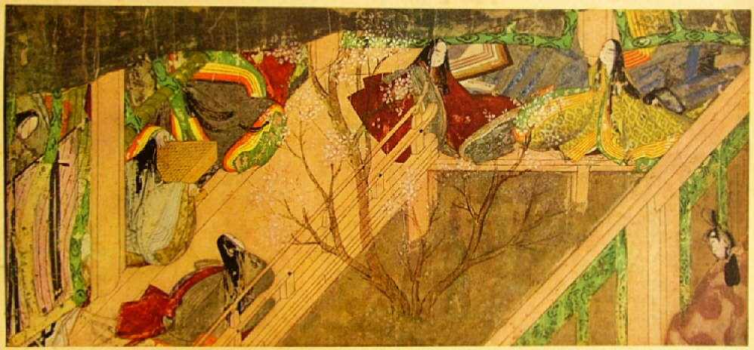
History of Japan

Slide 2
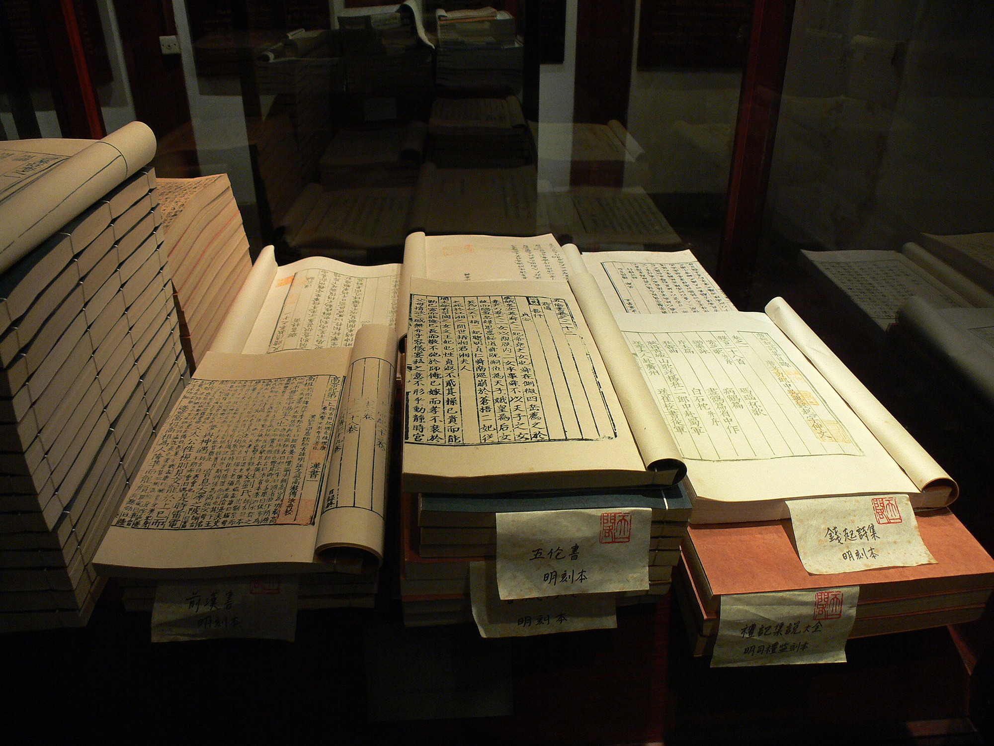
Book of Han
First reference to Japan
Chinese influence

Slide 3
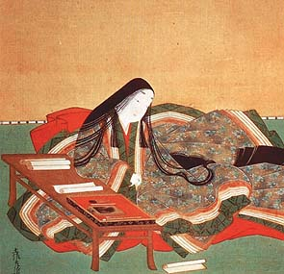
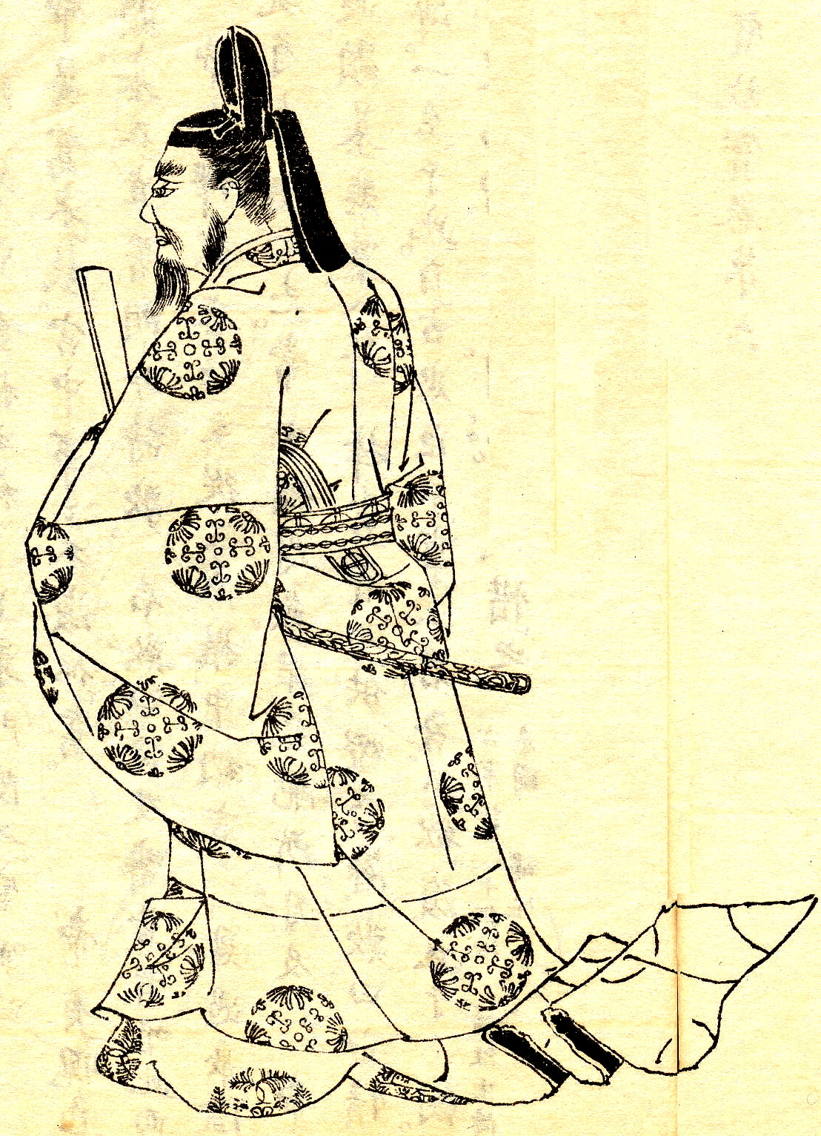
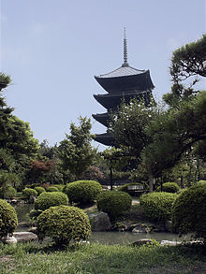
Heian Dynasty (794-1185 CE) Kyoto
Cultural “golden age”
Tale of Genji (Murasaki Shikibu)
c. 1021 ce
Buddhism, Taoism
Rise of
Samurai
class
Powerful
Fujiwara
family

Slide 4
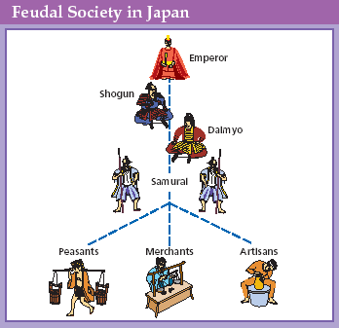

Slide 5
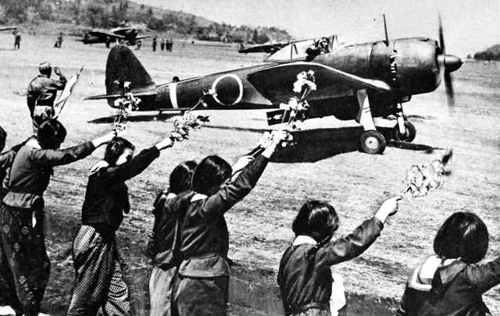
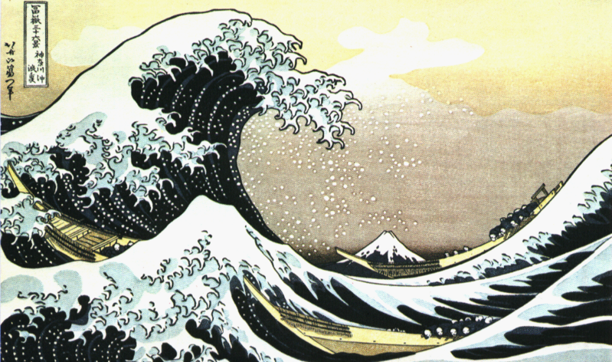
Kamikaze (“Divine Wind”)
1274 CE attack by Mongol, Kublai Khan
Typhoons “saved” Japan

Slide 6
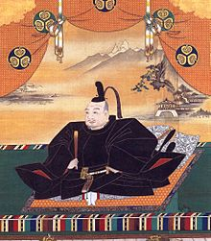
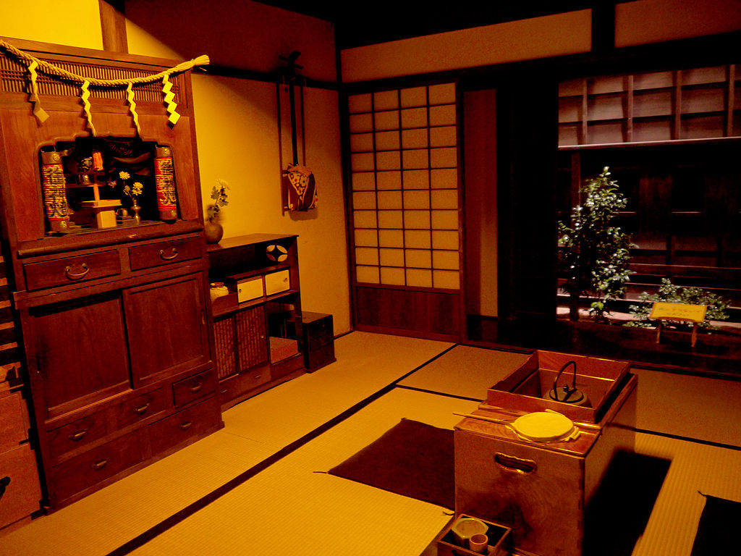
Edo Period (1683-1868 CE)
Centralized gov’t collapsed into civil war
Unified under ShogunTogugawa Ieyasu = ruled from Edo (Tokyo)
Emperor ruled from Heian-kyo (Kyoto)
Period of peace + isolation, anti-Christian

Slide 7
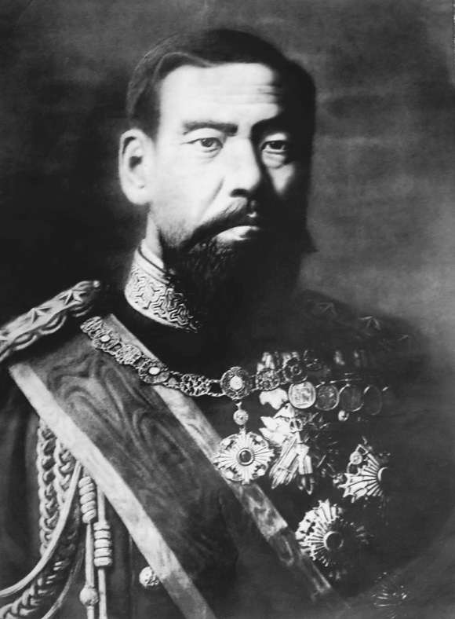
Meiji Restoration “enlightened rule”
1854: Perry forced opening of Japan
1863: Power restored to the Emperor
Modernized
Ended feudalism
Powerful military (constitution + military based on Prussian, French models)

Slide 8
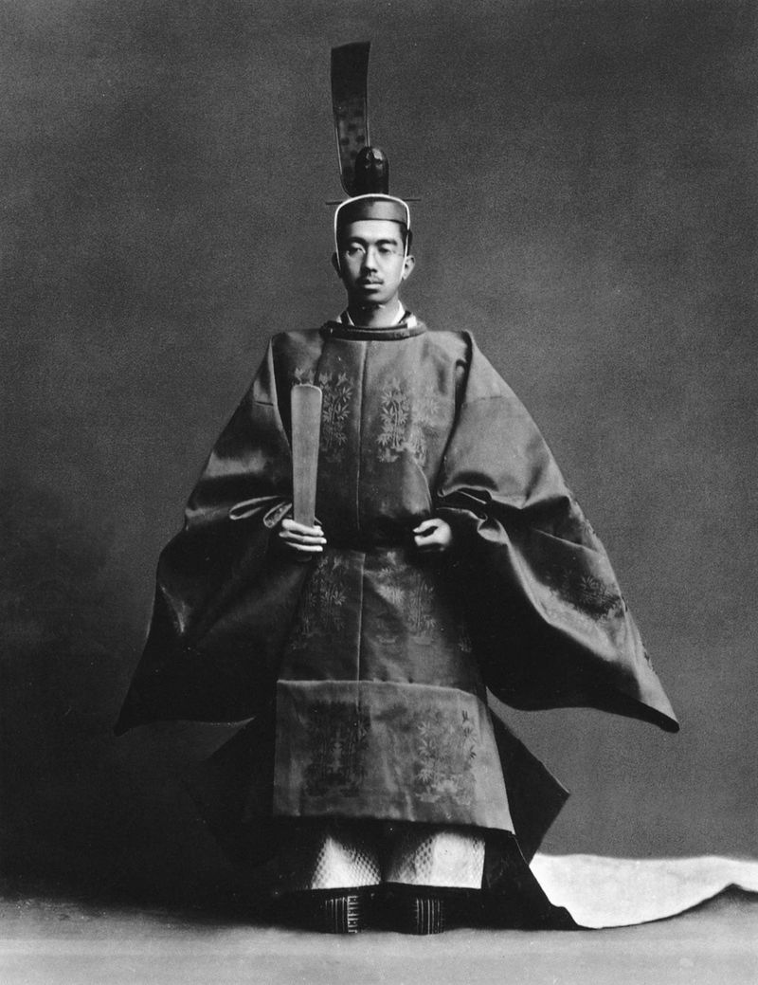
Showa Period 1926-1989 Emperor Hirohito
Totalitarian, ultra-nationalist, fascist, racist
1931 Invasion of Manchuria
By 1937 full scale invasion of China

Slide 9
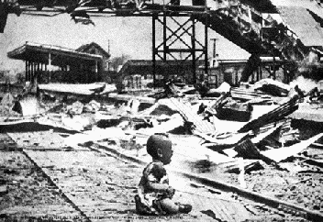
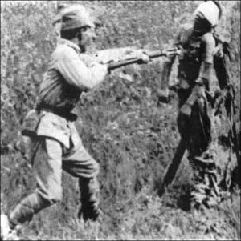
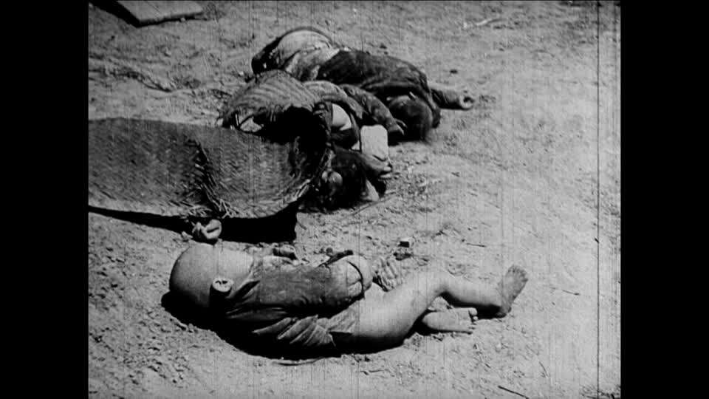
Shanghai Bombing 1932

Slide 10
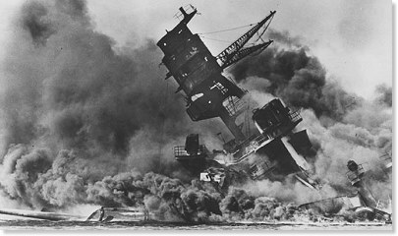
Pearl Harbor (Dec. 7, 1941)

Slide 11
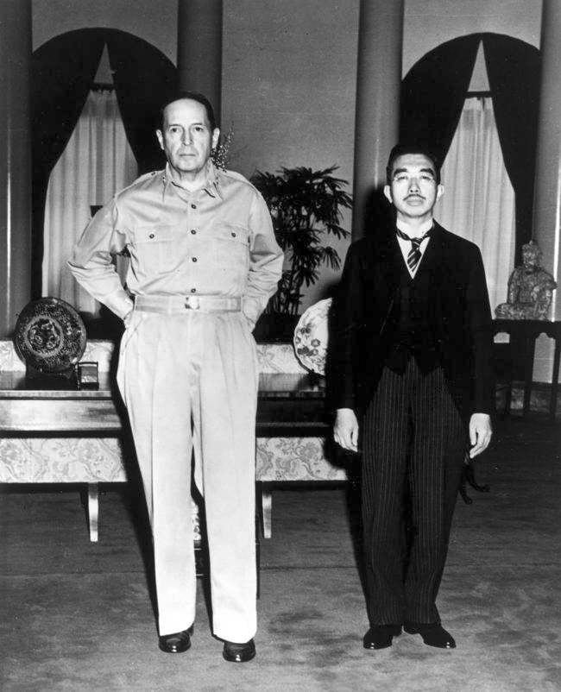
Late Showa Period (1945-Present)
U.S. occupied until 1952
Demilitarized
Democracy, capitalist
High standard of living

