Slide 1
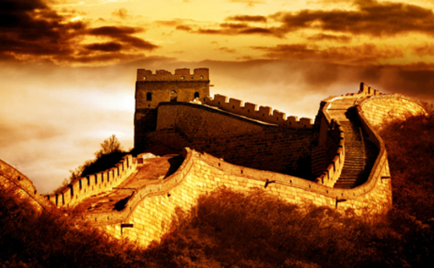
History of China

Slide 2
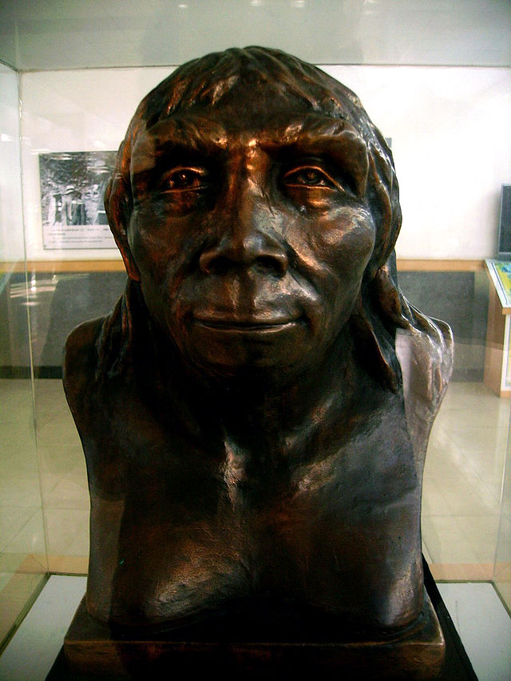
Peking Man
Paleolithic era
(750,000 yrs. Old)
Homo erectus pekinensis
Cranium almost the size of modern man
Discovered 1923-1927
"Peking Man" by Mutt - Own work.

Slide 3
Four Great River Valleys

Slide 4
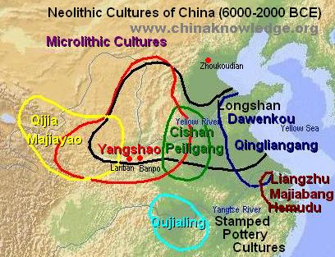
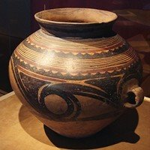
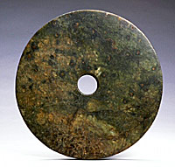
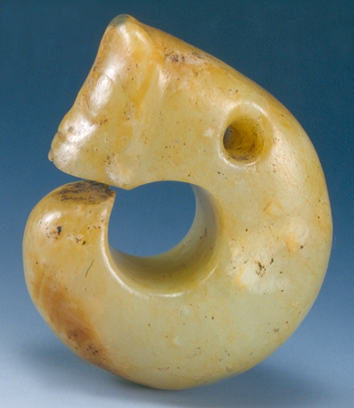
Settlement along Yellow River

Slide 5
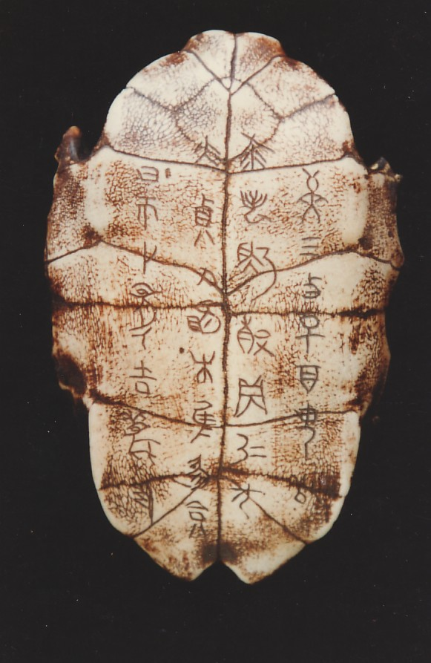
Xia Dynasty (2100-1600 BCE)
Some scholars feel it is mythical
Started by Yu the Great (father had controlled floods along Yellow River)
First to irrigate crops, use cast bronze, and form an army

Slide 6
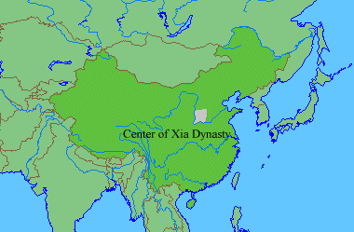

Slide 7
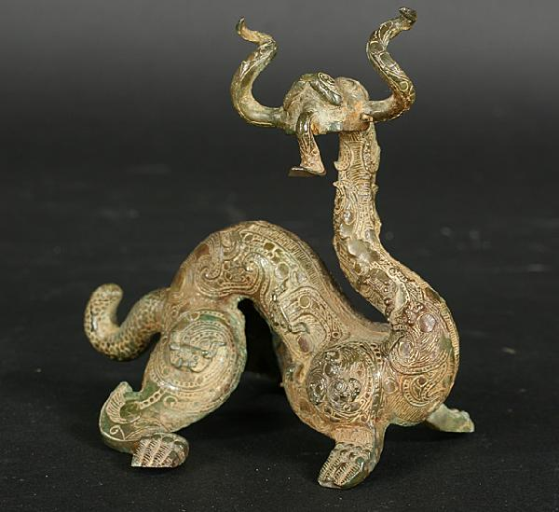
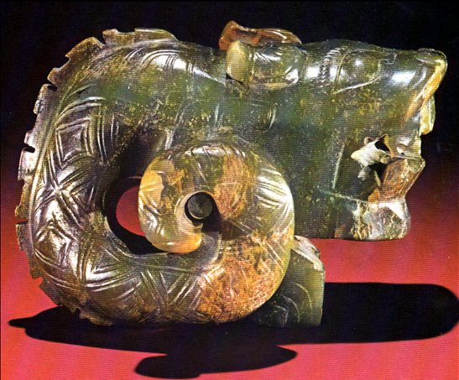
Shang Dynasty (1600-1050 BCE)
Dragon became symbol of China

Slide 9
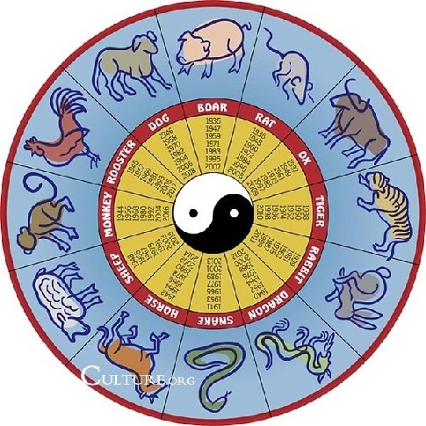
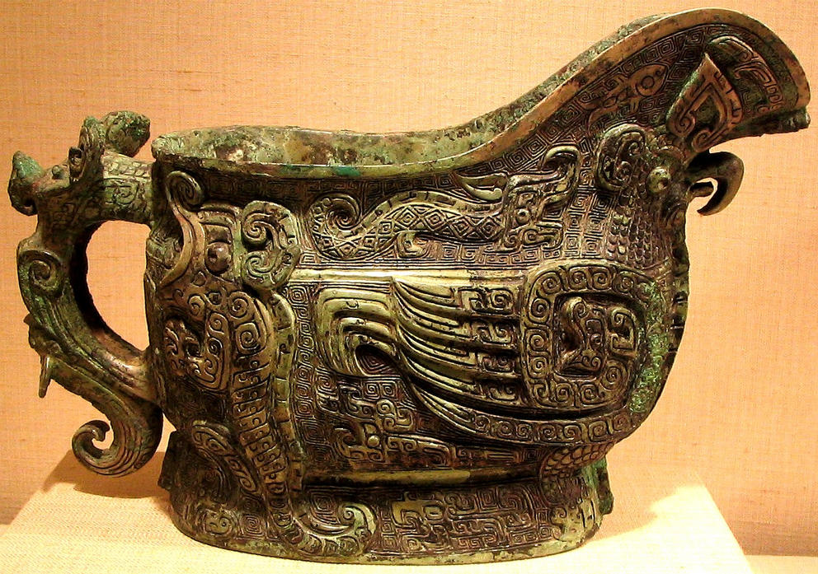
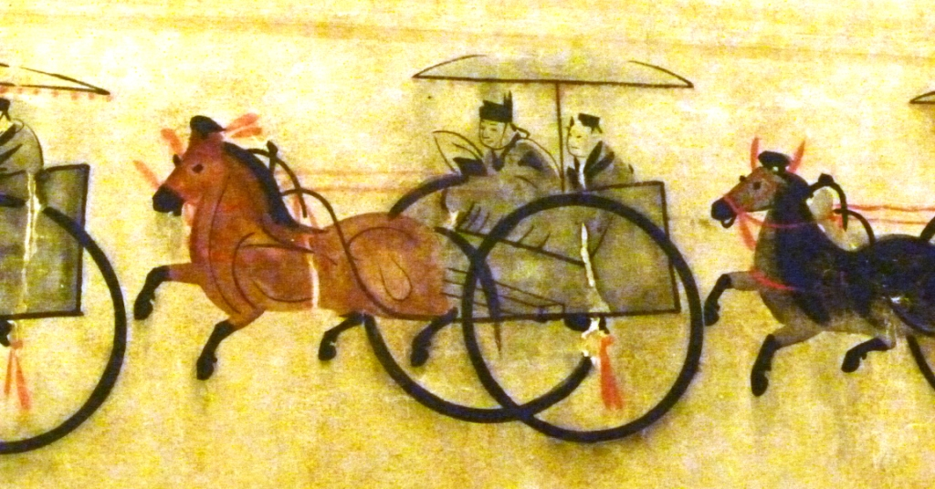
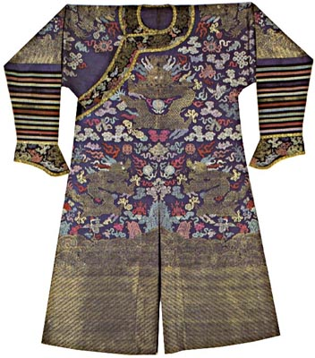

Slide 10
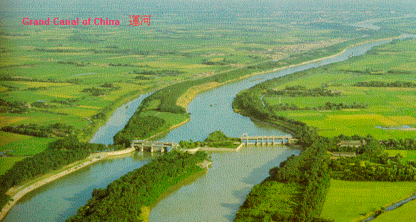
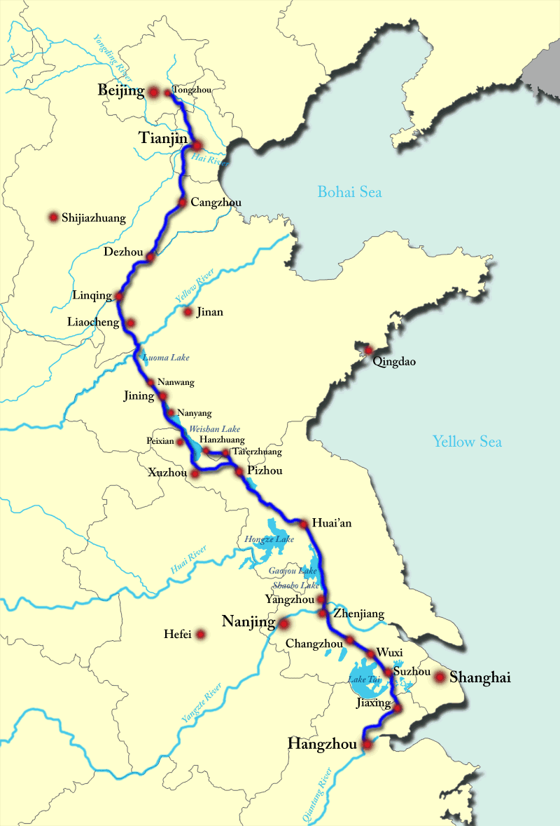
Zhou Dynasty (1046-256 BCE)
“Sons of Heaven”
City-states under central gov’t

Slide 11
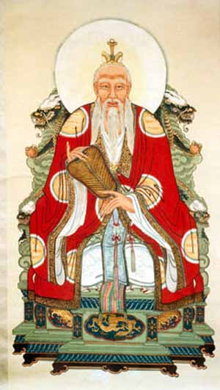
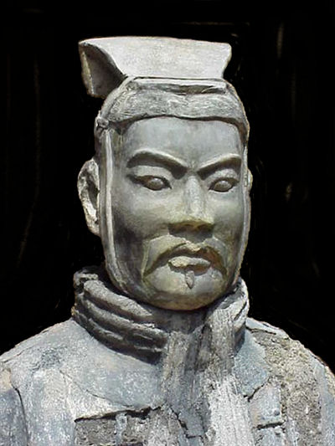

Slide 12
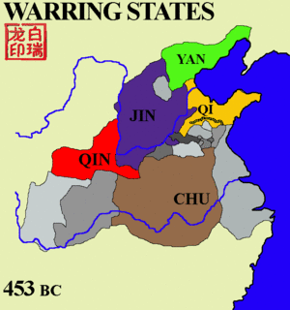
The Warring States, 475-221 BCE
Ended in Civil War and “False Alarm”

Slide 13
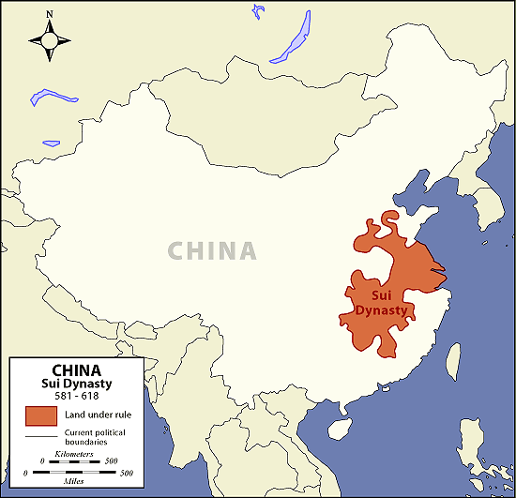
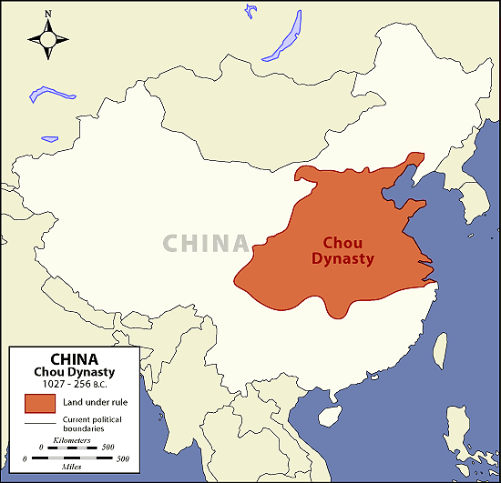

Slide 14
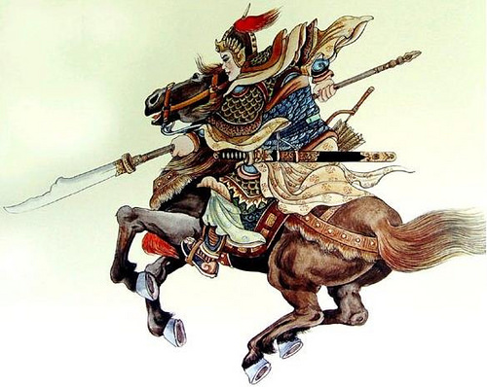
Chi’in Dynasty (221-206 BCE)
“China”
Autocracy under Shi Huangdi
Harsh rule = Legalism
Standardized:
Law
Weights & measures
Coinage
Writing
Cart & Axle widths

Slide 15
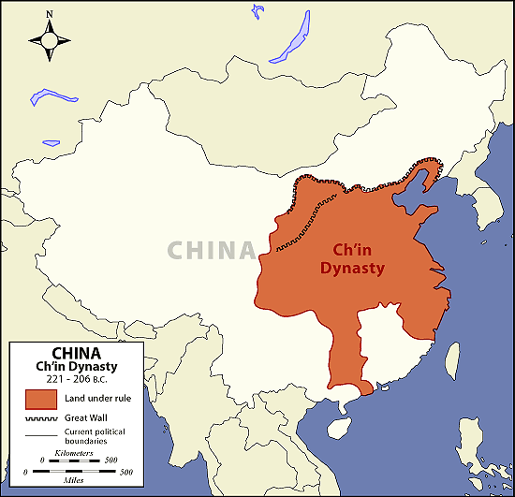

Slide 16
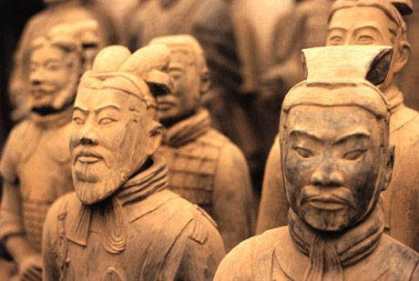
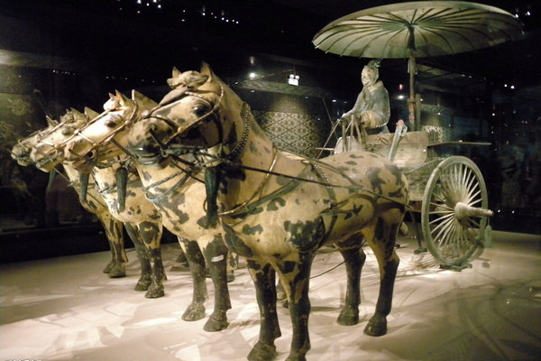
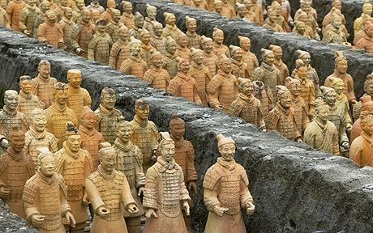
Terra Cotta Warriors of Xi’an

Slide 17
Han Dynasty (206 BCE-220 CE)
Capital at Xian
Extended into Manchuria, Korea, Indochina
Established Civil Service System
Pax Sinica
Silk Route

Slide 18
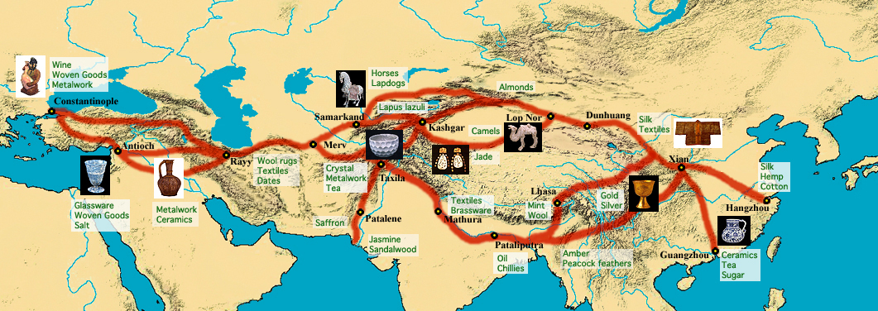
Silk Route

Slide 19
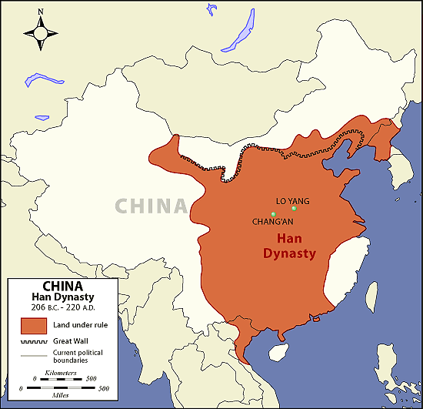

Slide 20
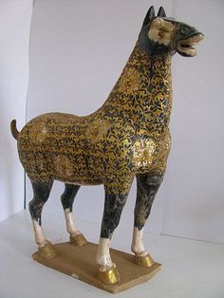
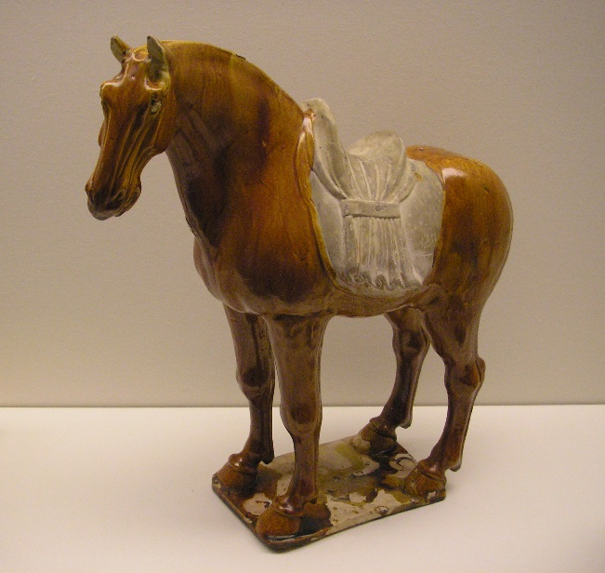
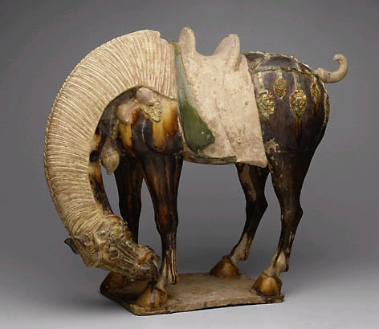
T’ang Dynasty (619-906 CE)
Height of Buddhist influence
Territorial expansion until stopped by Arabs
Height of Buddhist influence
Active territorial expansion until stopped by Arabs

Slide 21
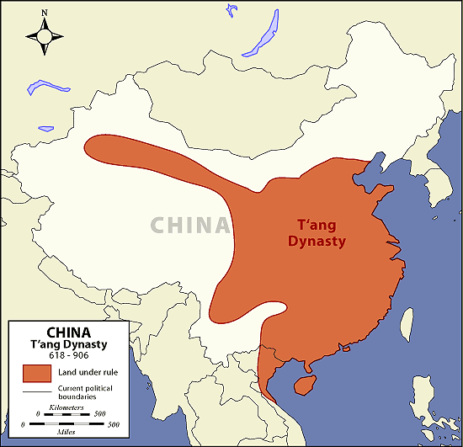

Slide 22
Song Dynasty (960-1275CE)
Significant economic and social changes
Monetization of the economy
Growth in commerce and maritime trade
Urban expansion and technological innovations
Examination system for civil service system was provided intellectual basis for political and social order of the late imperial period

Slide 23
Yuan Dynasty (1279-1368CE)
Ruled by Mongols as part of world-wide expansion
Introduced 1st post office, road system, tribute tax
Capital at Peking (Beijing)

Slide 24
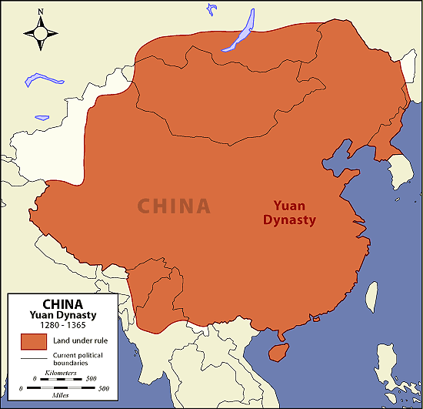

Slide 25
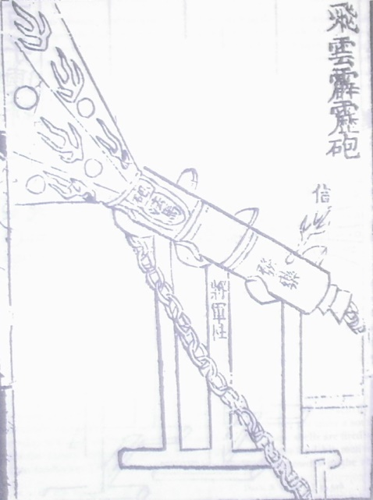
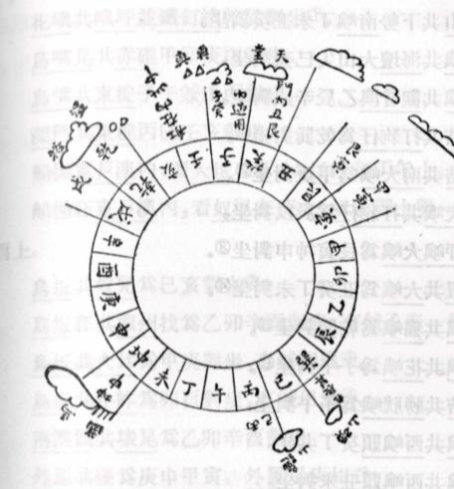
Ming Dynasty (1368-1644CE)
First Ming emperor, Hongwu = autocrat
Created agrarian base for military (1 million)
Gradual increase in commercial sector (Zheng He)
Collapsed when Little Ice Age destroyed crops

Slide 26
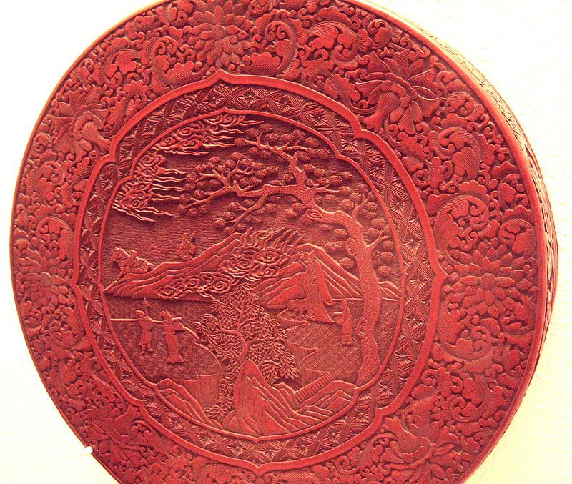
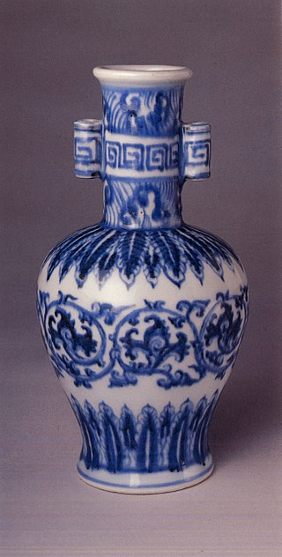
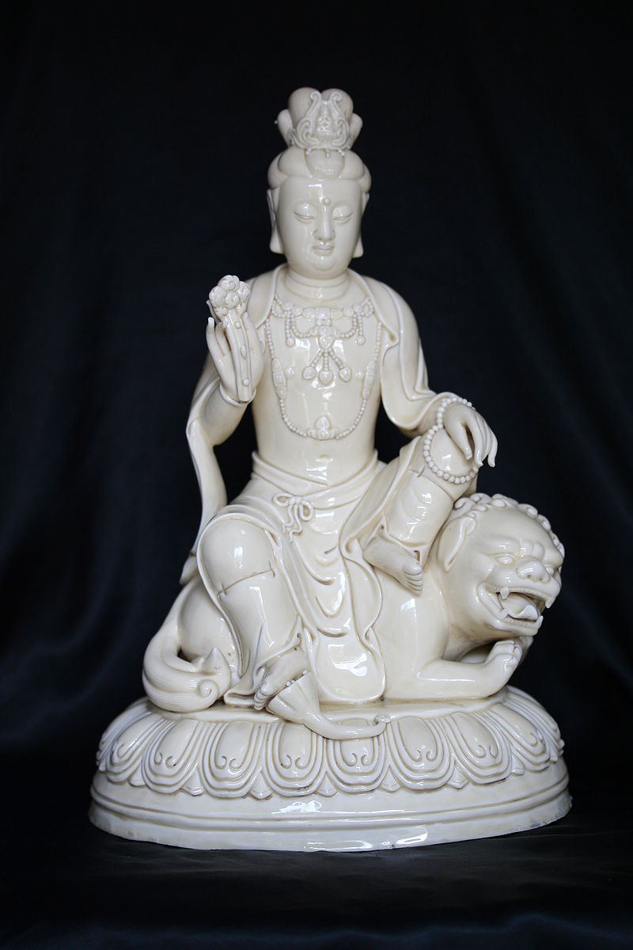

Slide 27
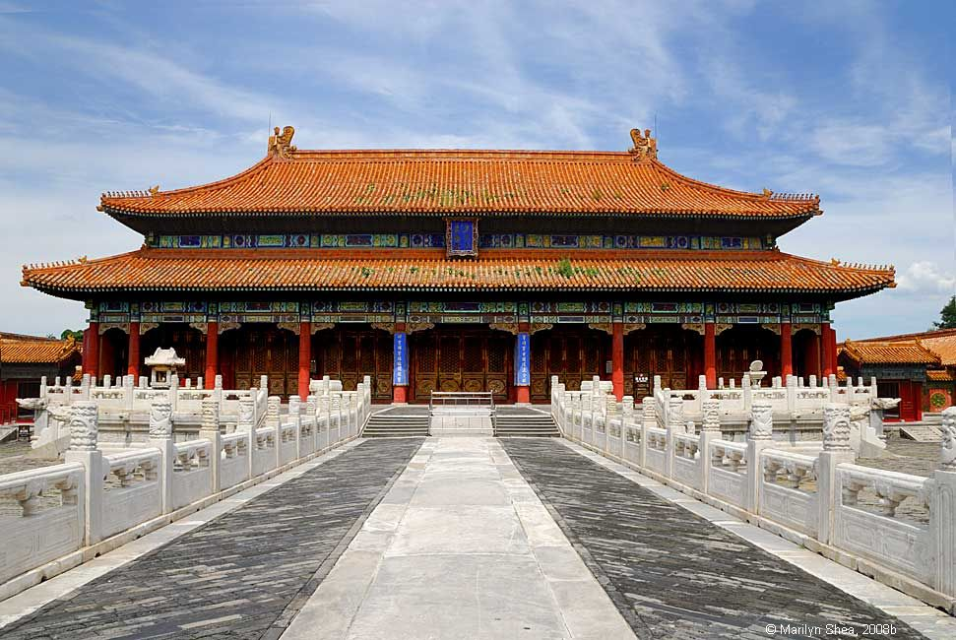
The Forbidden City

Slide 28
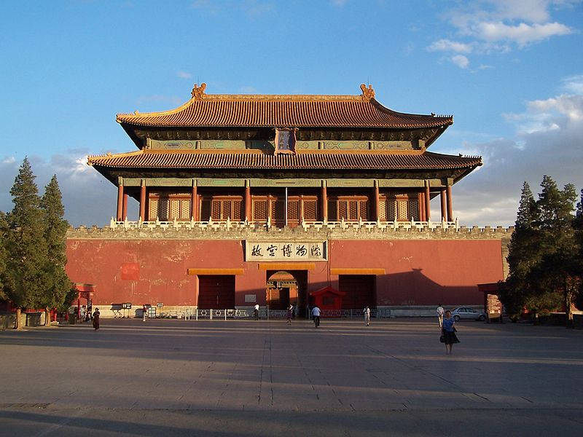
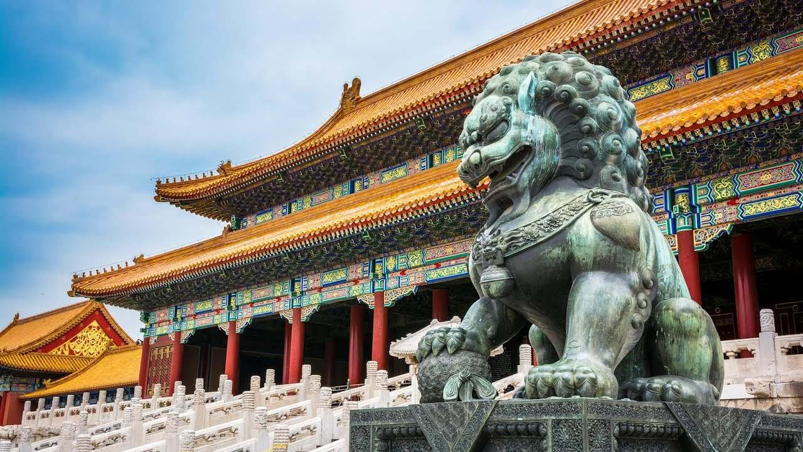
1420-1912
980 buildings
180 acres
Gate of Divine Might (North Gate)

Slide 30
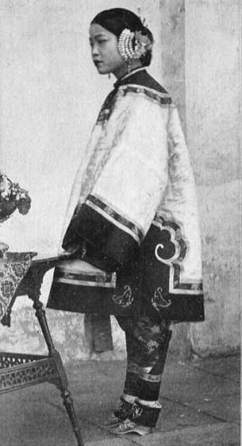
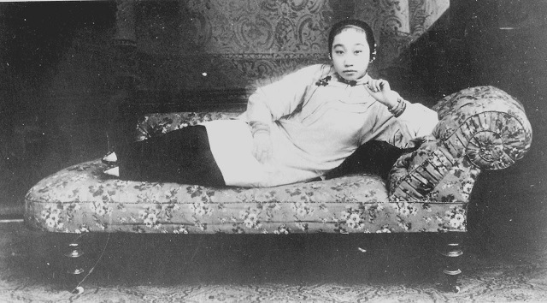
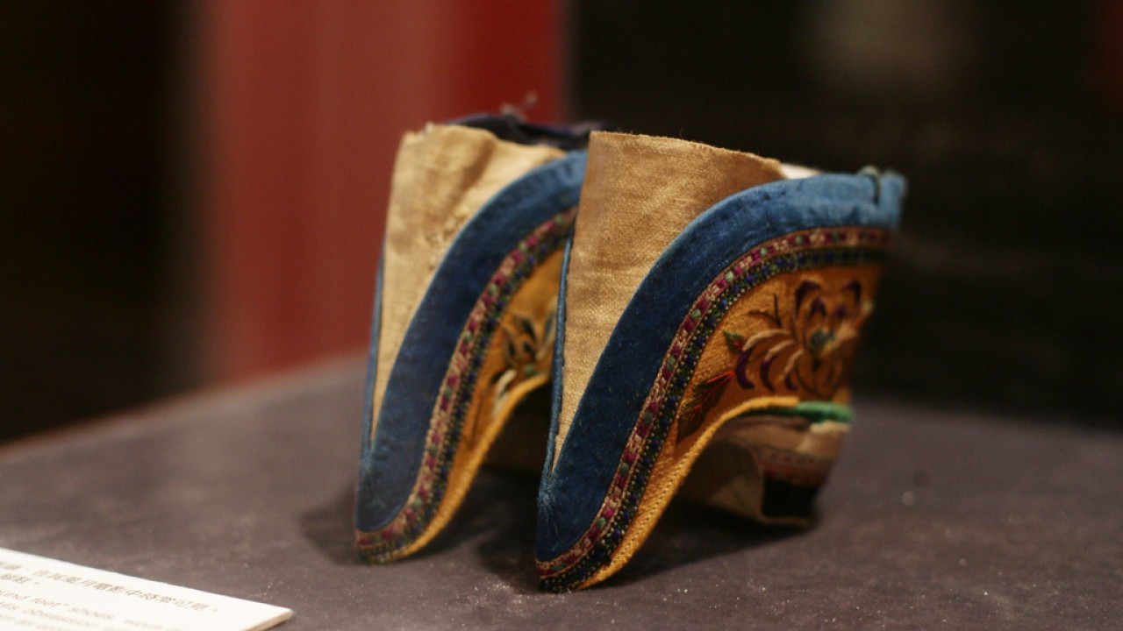
Foot Binding

Slide 31
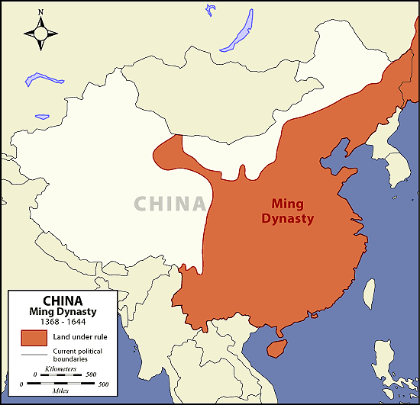

Slide 32
Qing Dynasty (1644-1912CE)
Manchu Dynasty
Westernization = New cultural movement (science, democracy)
1st Opium War 1839
Taiping Rebellion 1850
Boxer Rebellion 1899
Weak central gov’t collapsed

Slide 33
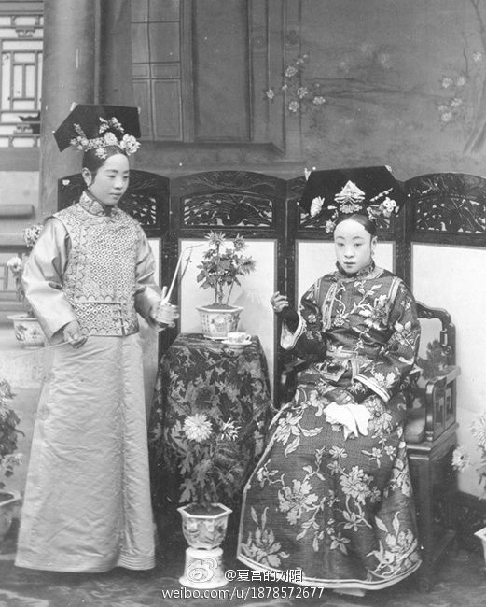
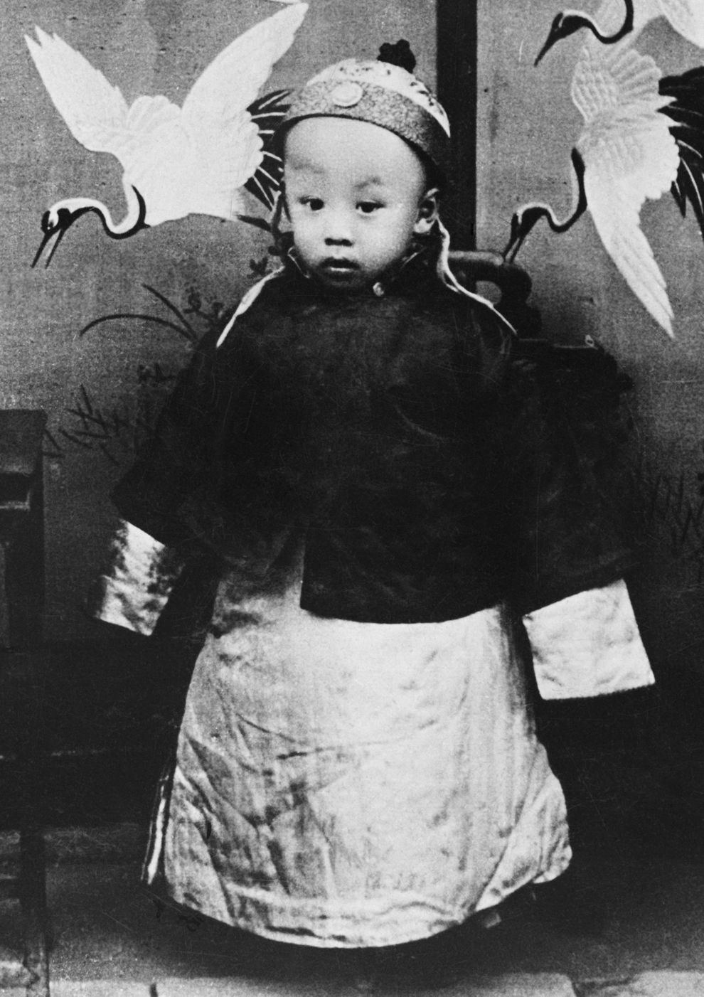
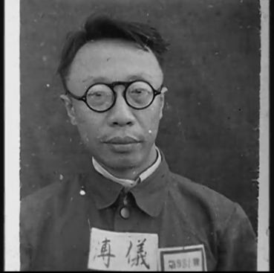
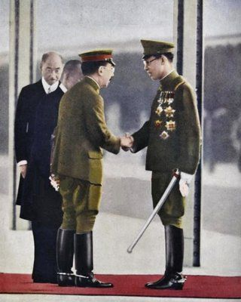
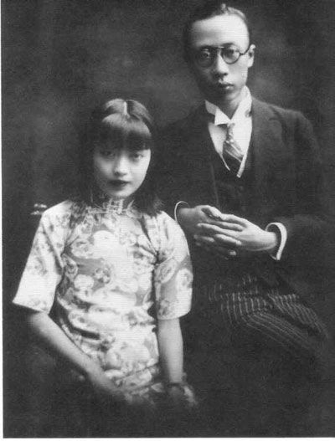
Last Emperor of China Henry PuYi

Slide 35
Republic Period (1912-1949 CE)
1928 Nationalist gov’t tried to unify, but revolutions + Jap.
Fled to Taiwan after Communist defeat
Chang Kai-Shek

Slide 36
People’s Republic of China (1949 CE-Present)
Communist Government under Mao Tse-Tung (Long March)
Great Leap Forward
Cultural Revolution

Slide 37
Long March
Over 4000 miles
Only 8000 of 100,000 survived
Result: Mao was undisputed leader of Chinese Communists

Slide 38
Japanese Occupation/Civil War

Slide 39
Nixon in China 1972
1st time American President visited Communist China
Feared by Soviet Union and N. Vietnam
Agreed to cut support to Taiwan
Increased trade with US
Had no effect on Vietnam War

Slide 40
Cultural Revolution 1966-1976
“Cult of Maoism”
Little Red Book
Young people
1.5 million killed
Death of Mao 1976
"Rules for Discipline" were: "Obey orders in all your actions; Do not take a single needle or thread from the masses; and Turn in everything captured."

Slide 41
Tiananmen Square 1989
Student led democratic protest
Deng Xiaoping
Hundreds killed (10,000)

