Slide 1
Hinduism
“There is only one God, but endless are his aspects and endless are his names.”

Slide 2
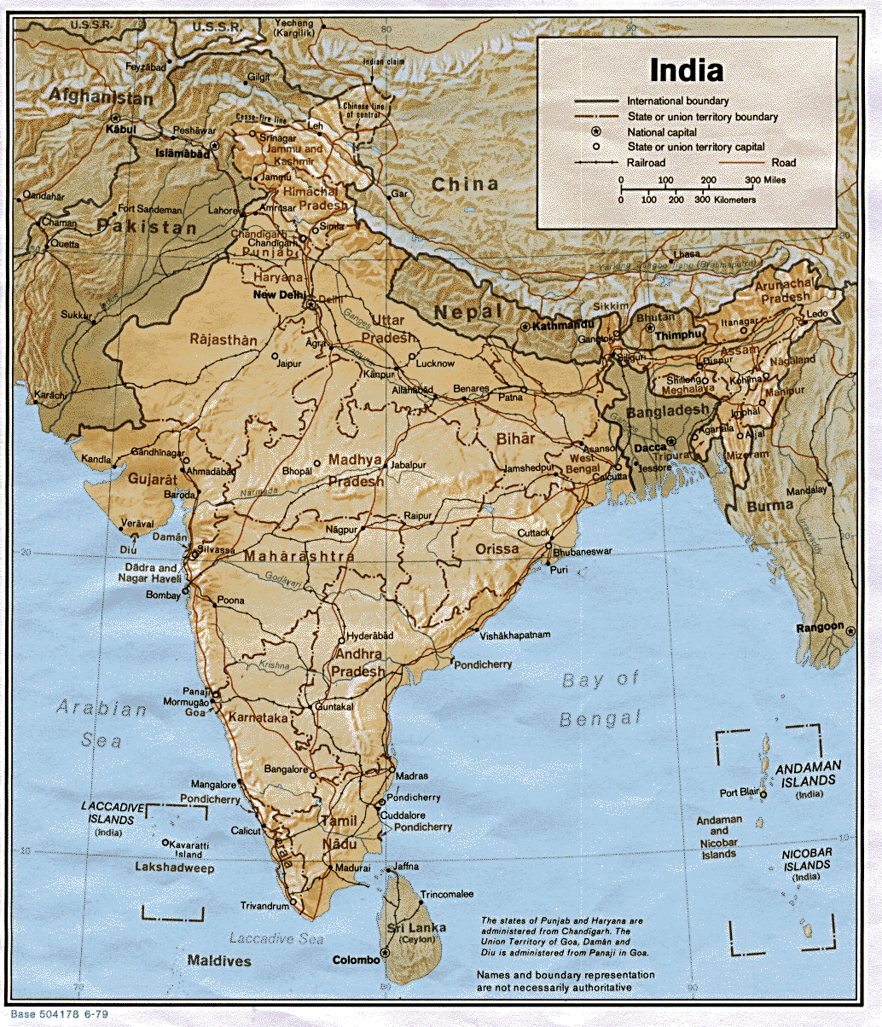
Most Hindus live in India and Nepal.
80% of Indian population
World’s 3rd largest number of devotees behind Christianity, Islam

Slide 3
Origins
2300 B.C. and 1500 B.C. in the Indus Valley
OR
is timeless and has always existed
No one founder but is instead a fusion of various beliefs
Possibly a fusion of Aryan and Indus Valley beliefs

Slide 4
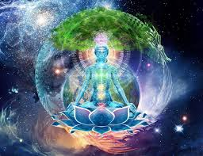
Brahman: "essence of reality"
Universal soul
Has no form, is eternal: creator, preserver, transformer of all things
Appears in human spirit as the atman, soul
1st mentioned in the Upanishads

Slide 5
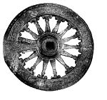
Goal of Hinduism
The universe undergoes endless cycles of creation, preservation and dissolution.
Moksha: “release or liberation, to be united forever with the divine, infinite bliss and awareness”
Monism: “to become one with Brahman”

Slide 6
Karma & Dharma
Dharma: ethical duty based on the divine order of reality. The word is the closest equivalent to “religion.”
Karma: “action” or “deeds” = the law of cause and effect by which each individual creates his own destiny by his thoughts, words and deeds.
Karma moves one closer or further away from one’s Dharma.

Slide 7
Reincarnation “transmigration of the soul”
Samsara: the wheel of rebirth which means the soul is reborn from one life form to another.
Reincarnated at a higher or lower level of existence depending on their karma from their present life.
May be reborn as plants or animals or they may be elevated to a higher caste as a human.
Death not final for Hindus

Slide 8
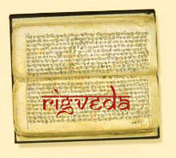
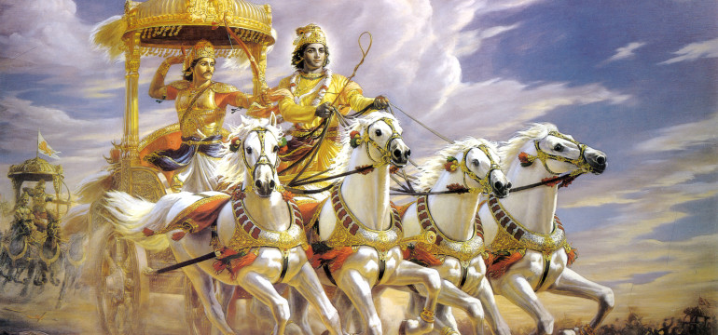
Sacred Texts
Rig Veda: Hinduism’s oldest text- nearly 4000 years.
Bhagavad Gita: Story of Dharma (Vishnu + Arjuna)
.
Upanishads: Basic source of Hindu philosophy, meant to inspire

Slide 9
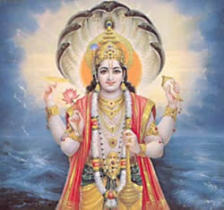
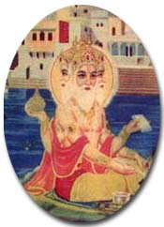
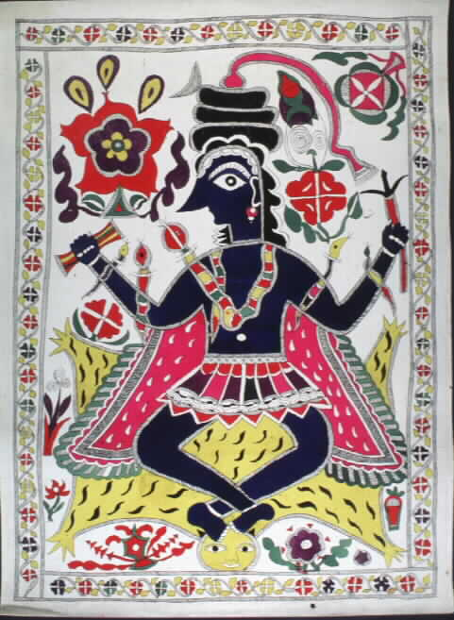
The Trimurti (Trinity)
VISHNU
“Preserver”
BRAHMA
“Creator”
SHIVA
“Destroyer”

Slide 10
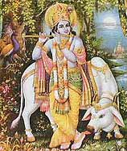
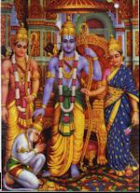
Avatars of Vishnu
Krishna
“Compassion”
Rama
“Model behavior”

Slide 11
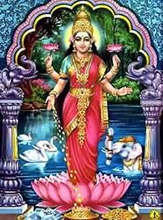
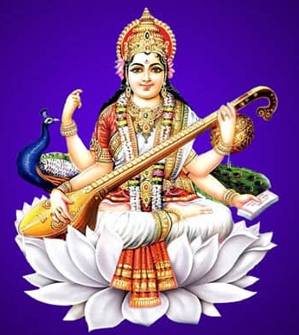
Goddesses
Saraswati
“wisdom, music, and learning”
Lakshmi
“wealth, abundance, and fertility”

Slide 12
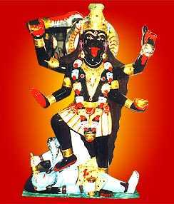
Kali
Wife of Shiva
Black in color & wearing a necklace of skulls.
Bloodthirsty goddess.
A violent destroyer of her enemies
Affectionate and caring for her devotees.
.

Slide 13
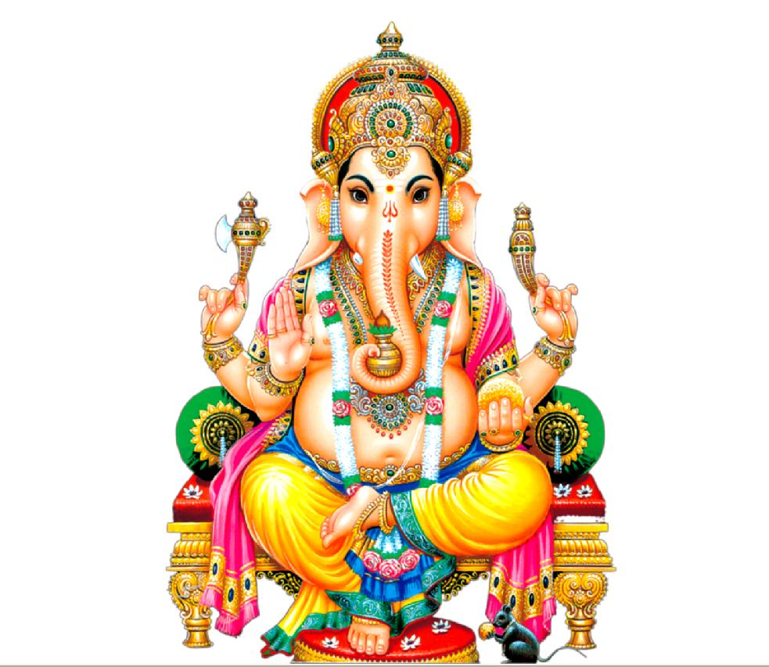
Ganesha “the remover of obstacles”

Slide 14
Caste System (jati)
1500 BC : Indo-European Aryans invaded Indus Valley peoples (across Hindu Cush Mtns.)
Established casta (Portuguese) to establish dominance over indigenous peoples
Varnas: Classes divided by jobs in society or religion
First mentioned in Rig Veda

Slide 15
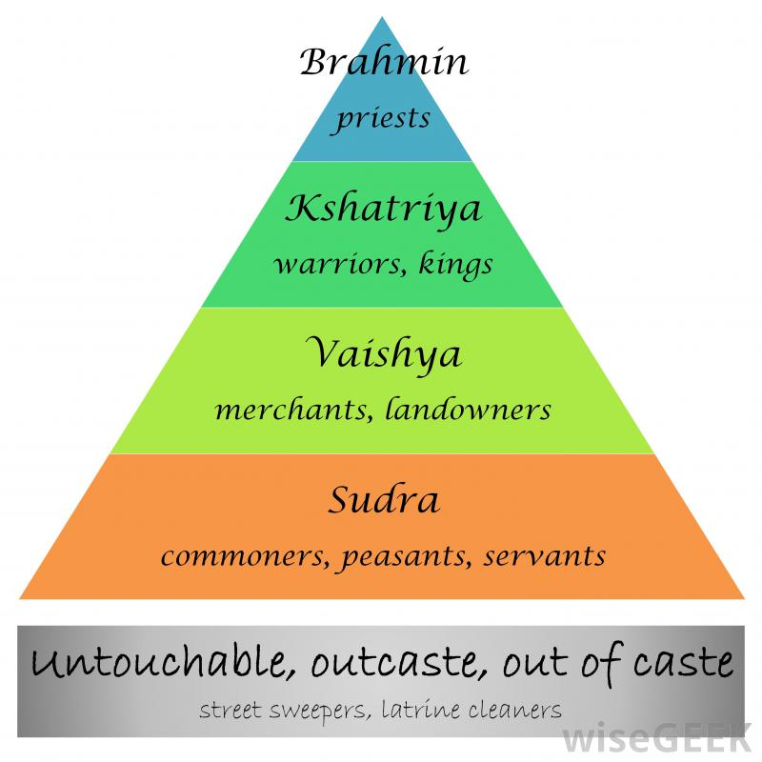
Caste System

Slide 16
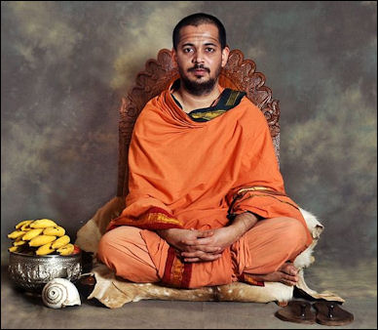
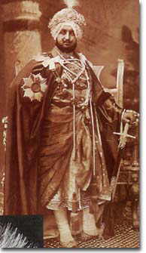
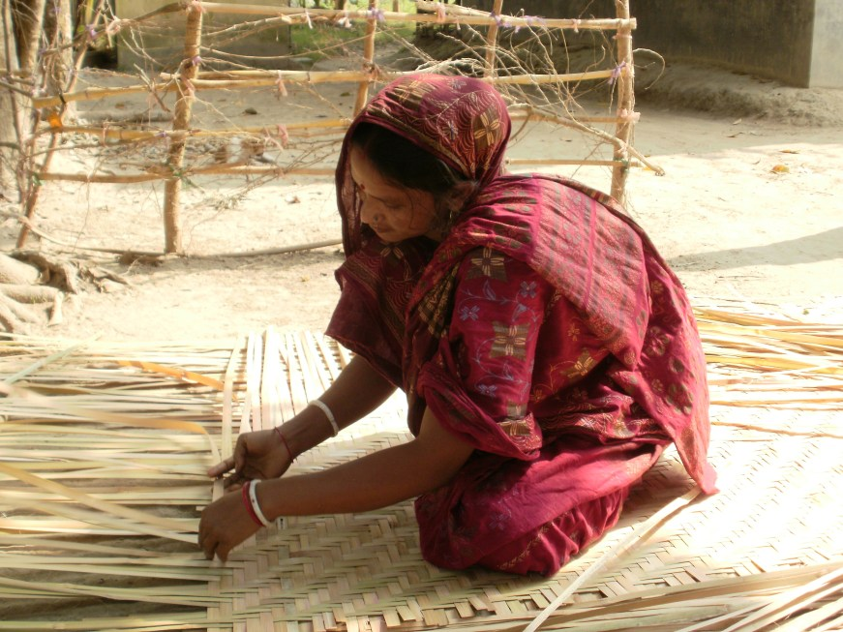
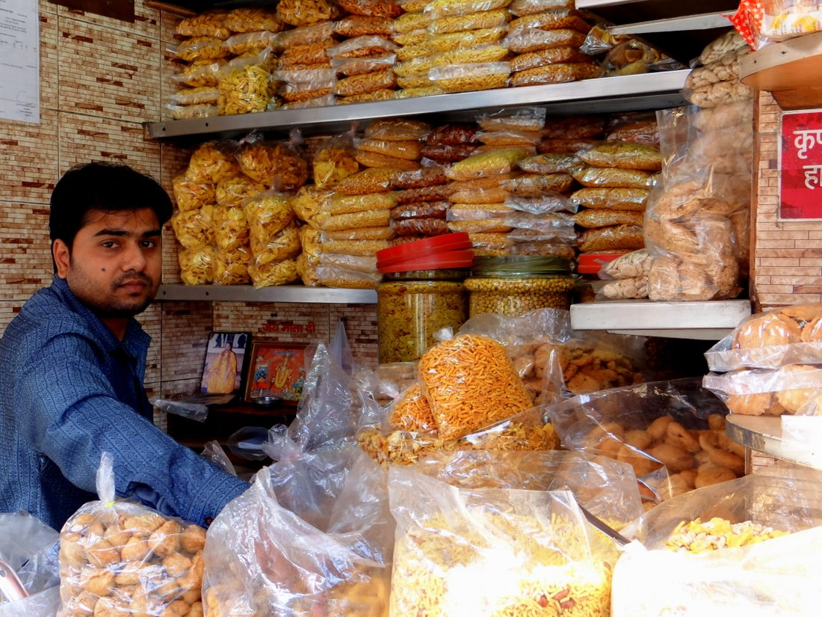
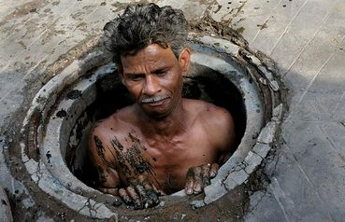

Slide 17
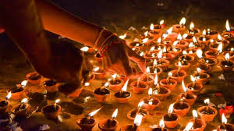
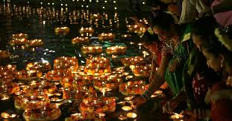
Festival of Diwali “Row of Lights”
In Oct. or Nov.
Festival of new beginnings
Lights are floated on small rafts
If the candle remains lit, good luck will follow.

Slide 18
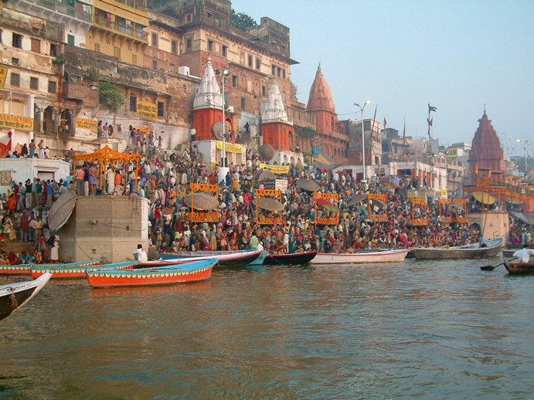
The Ganges River
India’s Holy River, believed to be the goddess Ganga, thought by many to be purifying

Slide 19
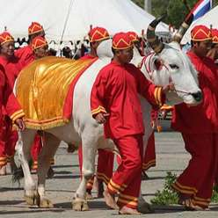
Sacred Cow of India
Not worshipped as a god
Seen as an expression of ahimsa (to abstain from causing hurt or harm)
Most Hindus = vegetarians

Slide 20
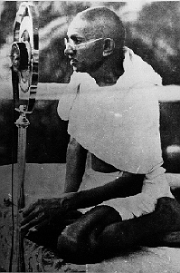
Gandhi: The Father of India
Social concern deeply rooted in his conviction of the Sacredness of life
Believed that human beings should strive to live as simply as possible since overindulgence often meant that others may have to do without their basic needs
Believed in Ahimsa: nonviolence
Notes:
overindulgen

