Slide 1
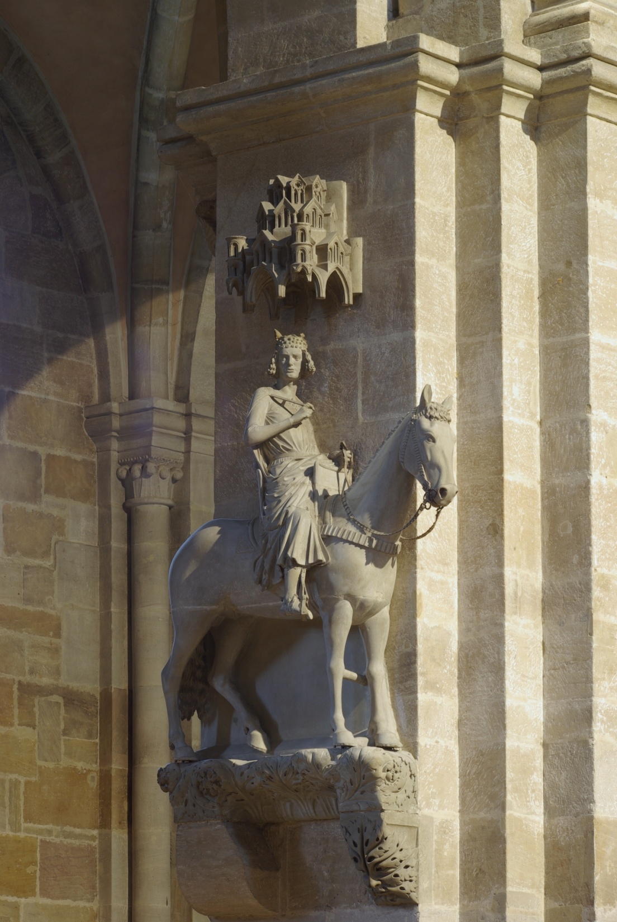
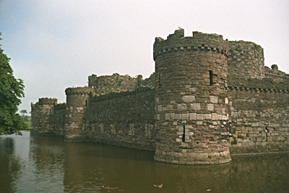
FEUDALISM
&
MANORALISM
Der Bamberger Reiter, 1237

Slide 2
FEUDALISM
“The political & military system in which Kings and powerful nobles granted land to other nobles in exchange for loyalty, military assistance and services.”

Slide 3
Setting
476 A.D. Fall of the Roman Empire
widespread chaos decentralized government. (weak kings left nobles to fend for themselves) way for nobles to control large areas without support of a central government

Slide 4
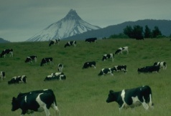
Monarch
Land, Protection to Lords
Supply Lord with Knights, ransom, entertainment
Fief
Lords
Land, Protection to Knights
Promised to fight for Lord
Produces food for kingdom
Fief
Provides serfs with protection
Knights
Serfs

Slide 5

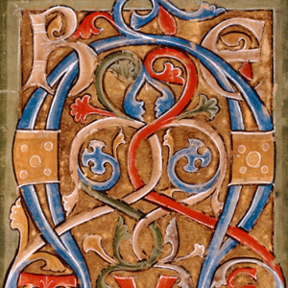
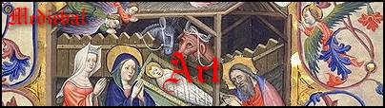
Characteristics
Positions passed to oldest son = “primogeniture”
Partnership between equals (only nobles could be vassals)
One person might be both Lord and vassal
King + Church could be feudal lords or vassals
Personal relationship
6. Women = few rights

Slide 6
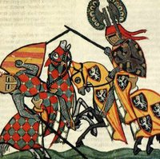
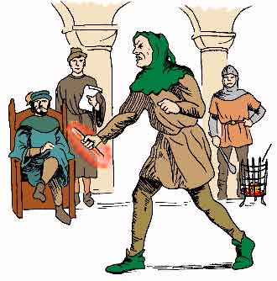
Feudal Justice
Trial by Battle
(war, tournaments)
Trial by Compurgation (“Oath-taking”)
Trial by Ordeal

Slide 7
MANORALISM
“The economic system centered around feudalism, run by nobles and worked by serfs.”

Slide 8
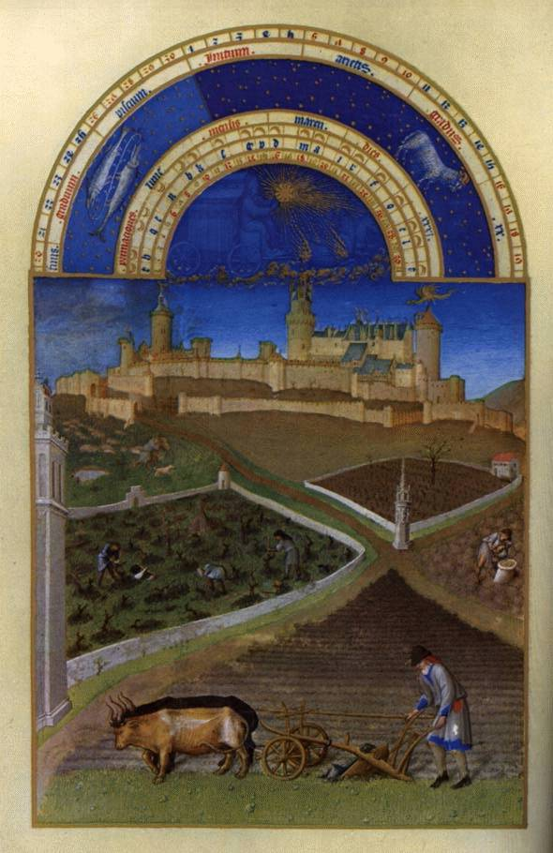
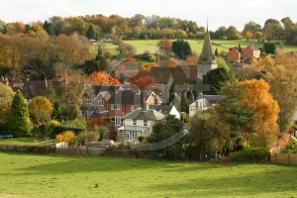
THE MANOR

Slide 9
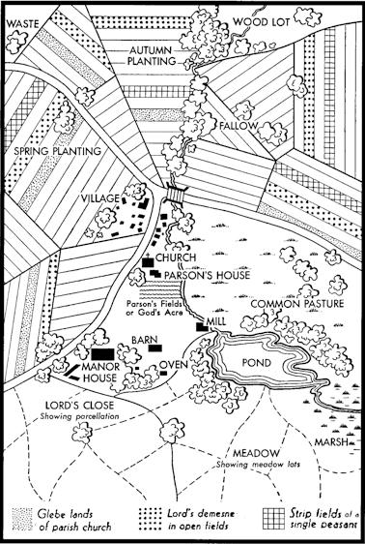
The Manor
1. Manor House
(castle)
“Commons”
(pastures)
Fields (open,
divided into strips)
4. Local village
5. Chapel

Slide 10
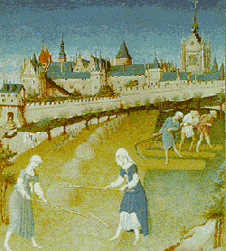
The Manor
Lord’s Demesne
1/3 of manor
Near manor house
Worked by serfs 3 days per week
Serf’s Portion
Rented 2/3 of estate:
Share of crops
Work on Lord’s land
Services on manor
(handiwork)
Paid taxes

Slide 11


Peasant Life
Bound to land = NOT slaves
Free workers (villeins, artisans, cooks)
Only left village in time of disaster
Food simple: little meat, “gruel”, famine common
Homes: Wattle (braided twigs smeared with mud, central beam, dirt floors, little furniture)
Life expectancy: 40 years

