Slide 1
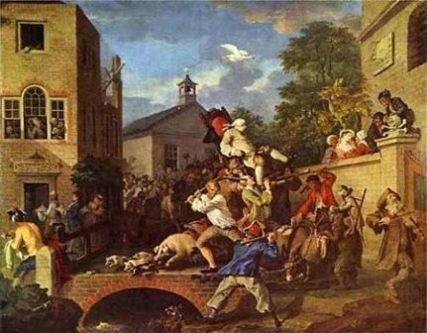
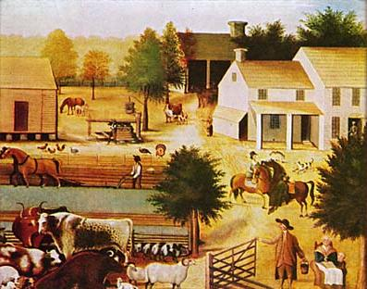
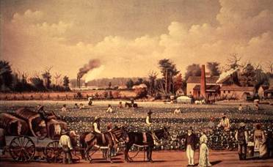
Colonial Society
Karen H. Reeves
Edmund Burke Academy

Slide 2
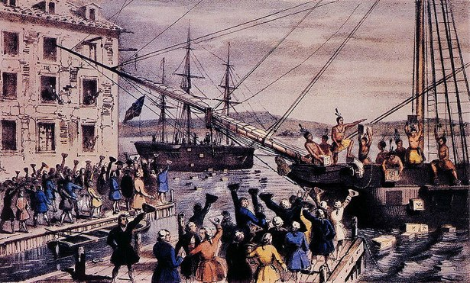
Characteristics
Colonial Society
Self Government (white, male landowners; govs elected RI, CT)
Religious Toleration (all some tolerance; RI, PA most liberal)
No Hereditary Aristocracy (class system based on economics)
Social Mobility (except for slaves, anyone could move up in society)

Slide 3
Enlightenment idea (Locke) that gov’t. should be based on consent of the governed.
Popular sovereignty (apportioned rep.)
Republic = limited Gov’t.
Ownership of property
Standing armies dangerous
Agrarian life virtuous
Right to rebel if natural rights not protected
Republicanism

Slide 4
Structure of Government
All but 2 colonies had appointed governors
All had bicameral leg. = taxed only with represent.
Local gov’t (NE = town meetings, town green + South = county gov’t)
Voting limited to white, male property owners
Politics

Slide 5
Economic, social center of life
Married younger, raised more children
90% lived on farms
Higher standard of living than Europe
Men: Owned land, ran politics, control over wives
Women: Divorce legal but rare, variety of tasks gave more freedom = more than in Europe
Family

Slide 6
By 1760 ½ of British trade was with colonies
Mercantilism = protect British industry
GB limited manufacturing to rum, flour
Agriculture = most of econ.
Increasing professional class
Economy

Slide 7
1651 Navigation Acts
Enumerated Goods: list of goods that had to be shipped on English ships
Prohibited colonial trade with Holland, France, Spain
Designed to protect British industry under Mercantilism
Under salutary neglect, col. Formed trade agreements with other countries
Loosely enforced
Economy

Slide 8
Money
Limited to hard currency
Local paper money inflated
Transportation
Water transport cheaper
Increasing use of horses, wagons, buggies
Taverns = social centers
Mixture between colonies
Economy

Slide 9
New England
Rocky soil = <100 acre farms
Subsistance farming = family, hired hands
Trading, logging, fishing, shipbuilding, rum-distilling
Boston
Regional Economies

Slide 10
Middle Colonies
Rich soil = <200 acre farms
Corn, wheat for export
Family, indentured servants, hired hands
Trading, logging, fishing, shipbuilding, rum-distilling
Philadelphia, New York
Regional Economies

Slide 11
South
Diverse climate, soil
Small family farms + plantations >2000 acres
Family, hired hands, slaves
Tobacco, naval stores (tar, pitch), rice, indigo
Charleston
Regional Economies

Slide 12
Denominations
New England: Puritans = Congregationalists
New York: Dutch Reform, Anglican
Pennsylvania: Lutherans, Mennonites, Quakers
South: Anglican
Maryland: Catholics
New York, Boston, Charleston: Some Jewish congregations
Religion

Slide 13
1730’s-1740’s
“fervent expressions of religious feeling among masses of people”
Jonathan Edwards: Sinners in the Hands of an Angry God
George Whitefield: eternal damnation, no need of ministers
Great Awakening

Slide 14
Religious Impact
Increased emotionalism in Protestant faith
Bibles more common in homes
Denominational Divisions
“New lights” vs. “Old lights”
More evangelical sects (eg. Baptists, Methodists)
More calls for separation of church and state
Great Awakening

Slide 15
Political Impact
First “common experience” in colonies
Democratized religion = greater appreciation for democratic participation
Not an idea in 1740, but would form basis for challenging British government by 1770
Great Awakening

Slide 16
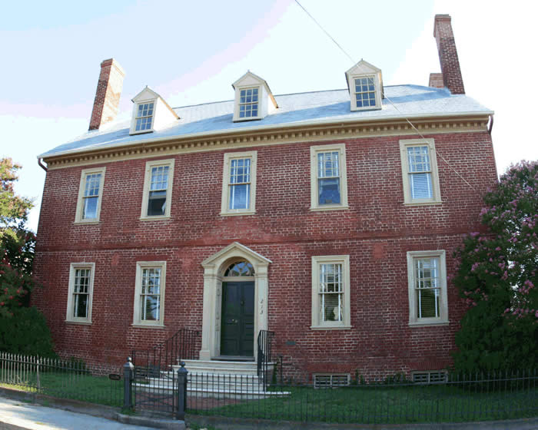
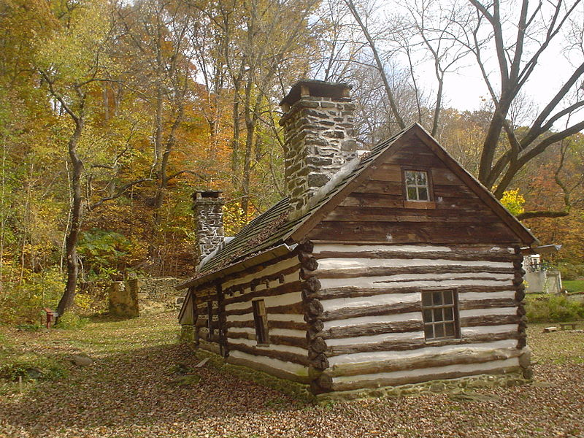
Architecture
Georgian
Cultural Life

Slide 17
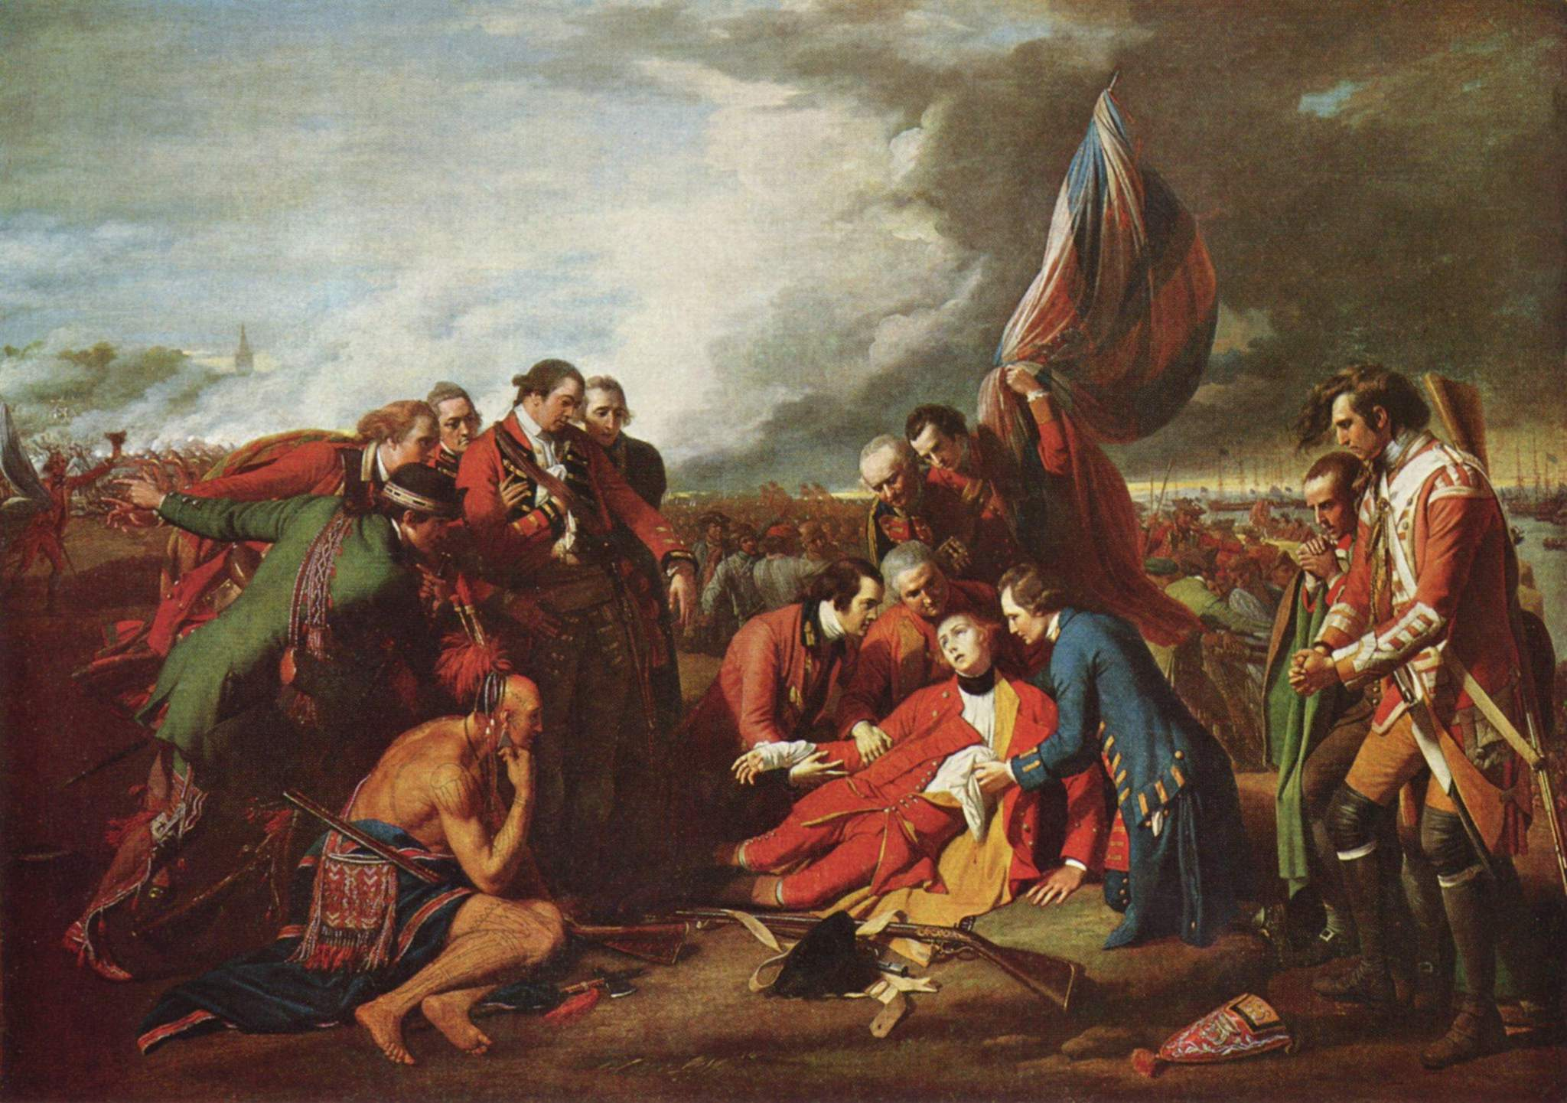
Art
Death of General Wolfe
by Benjamin West
Cultural Life

Slide 18
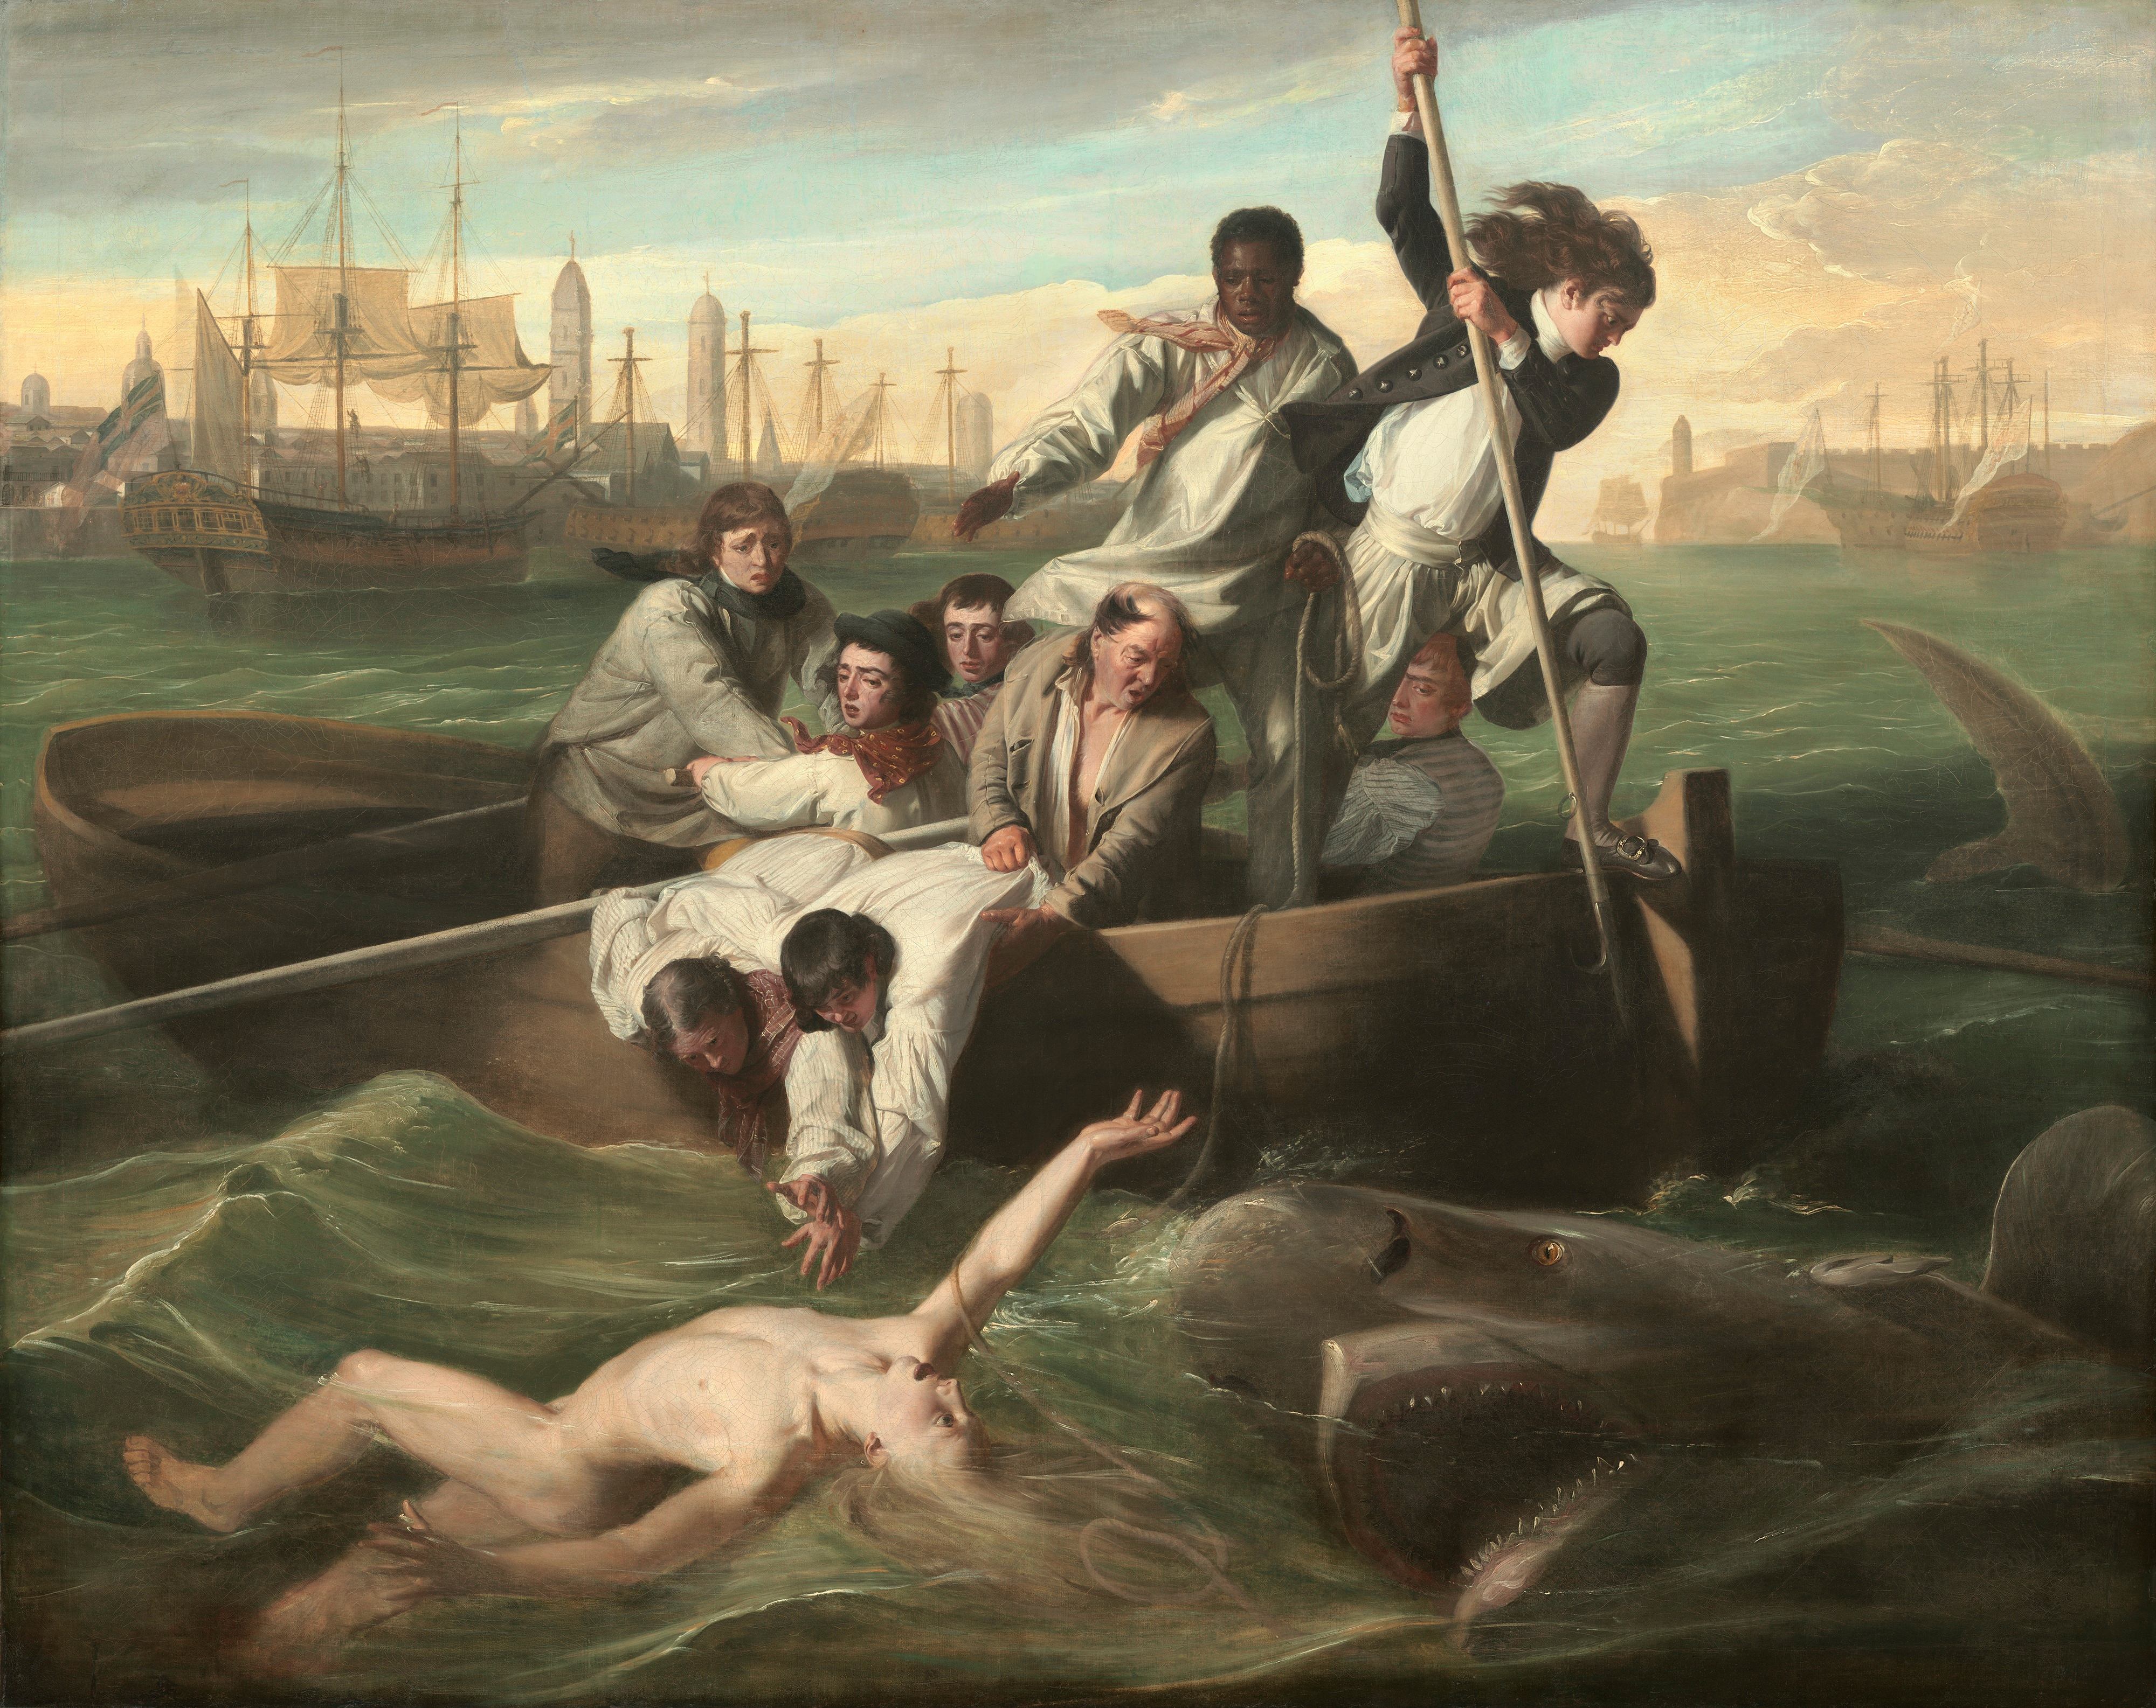
Watson and the Shark by John Singleton Copley
Art
Cultural Life

Slide 19
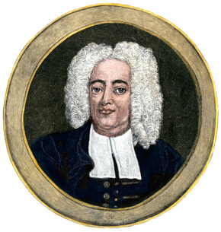
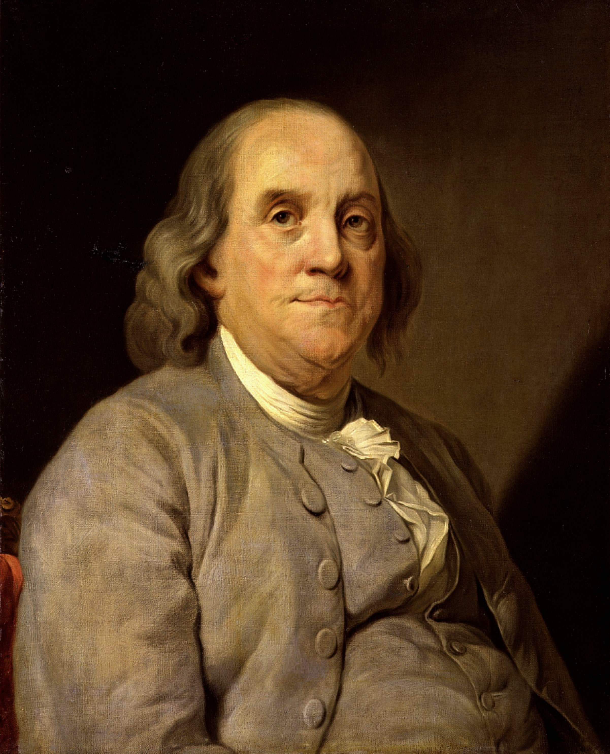
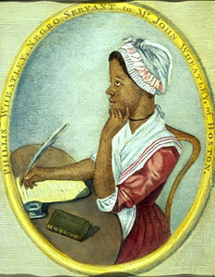
Literature
Cotton
Mather
Phillis
Wheatley

Slide 20
Education
1647 Mass. 1st colony to tax for public education
Parochial schools
Tutors
Colleges (est. by churches)
Harvard, 1636 (Puritan)
Wm. & Mary, 1694 (Anglican)
Yale, 1701 (Congregationalists)
Princeton, 1746 (Presbyterian)
Brown, 1764 (Baptist)
Rutgers, 1766 (Reformed)
Cultural life

Slide 21
Literature
Anne Bradstreet (1st female poet to be published)
Phillis Wheatley (1st African-American poet to be published)
Cultural life

Slide 22
The Press
By 1776, 40+ newspapers (1st political cartoon in Philly Gazette, Franklin)
Zenger Case
1735 John Peter Zenger (NY editor) charged with libel for printing comments about NY royal gov.
Eng. Common law = criminal act to damage aristocrat’s reputation
Jury acquitted Zenger anyway
Cultural life

Slide 23
What then is this American, this new man?...he is an American, who leaving behind him all his ancient prejudices and manners, receives new ones from the new mode of life he has embraced, the new government he obeys, and the new rank he holds. …Here individuals of all races are melted into a new race of man whose labors and posterity will one day cause great changes in the world…..
Letters from an American Farmer
by J. Hector Crevecoeur
American National Character

