Slide 1
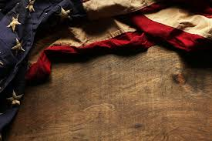
Burke County
World War II Veterans
Interviews by Jesse Stone and Karen Reeves for the Library of Congress
Writeups by Karen Reeves

Slide 2
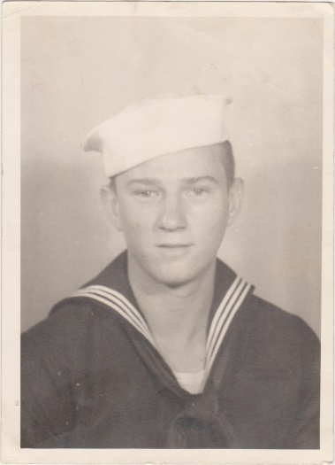
Fireman First Class James D. Smith U.S. Navy
James D. Smith was only 17 years old when he enlisted in the U.S. Navy on July 9, 1945. Following boot camp at Bainbridge, Md., he was sent to Ft. McHenry near Baltimore and was eventually assigned to the aircraft carrier, the U.S.S. Randolph CV-15, where he monitored pumps and repacked valves as an engineer in the Main Machinery Division. He would make a three day journey across the Atlantic on a mission to Naples to return 3000+ Italian POW’s who had spent part of the war in American POW camps stateside. Though minesweepers had cleared a path into the Naples, one distinct memory was of the twisted remains of ships bombed in the harbor. Smith also recalled the desperation of the Italian people who had little food and were living in the bombed out remains of what once had been a beautiful city. He recalls cigarettes being sold for $30 a carton because of shortages brought on by the war. The Randolph, which had a crew of 3300+ sailors, picked up 7250 U.S. soldiers for the return trip to the U.S. and docked in New York harbor on Christmas Day, 1945. Smith would make two such trips to Naples before leaving the service and settling in Waynesboro to become Superintendent of the Burke County school system. Mr. Smith passed away in 2016.

Slide 3
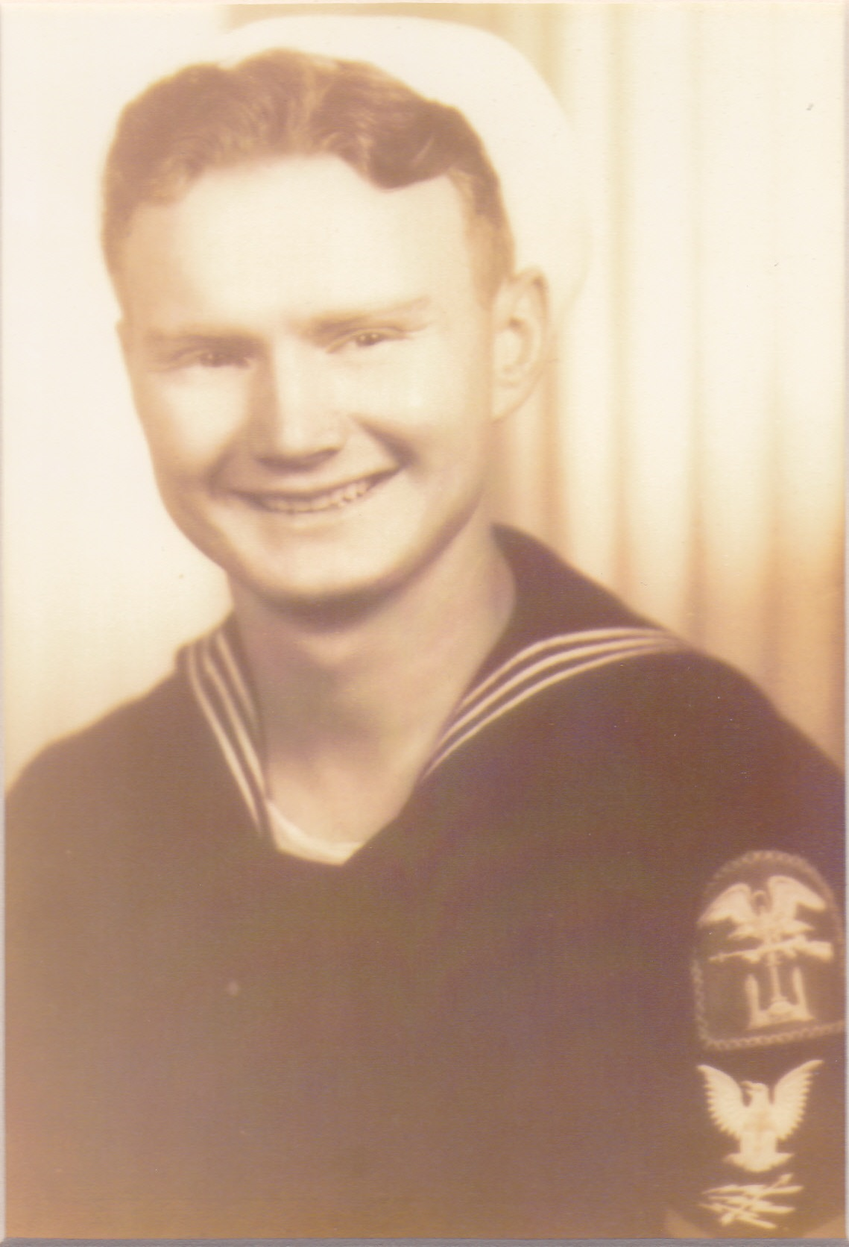
Radarman 2nd Class Billie Michael Holman U.S. Navy
A Harlan County, Kentucky native, Billie Holman lied about his age to join the Navy in 1943. Trained in clearing obstruction such as land mines, anti-tank and anti-aircraft weapons, he specialized in underwater demolition and was assigned to the “Beach Battalion” which later became known as the “Navy Seals.” Holman survived a German Dornier attack in which his convoy sustained casualties of over 40% to capture Italian soldiers in Palermo and transport Nazi soldiers to Algeria. He heard the word “Normandy” for the first time on the night of June 5, 1944, as his unit was transported, along with soldiers of the 29th and 116th Infantry, across the English Channel for the invasion. Holman’s crew of 32 men, charged with removing barriers, locating defensive land mines, and delivering blood plasma, had as their first priority the destruction of enemy pillboxes with grenades and satchel charges. Under heavy sniper fire and fire from 88mm projectiles, and forbidden to help their own wounded, only two members of the unit would survive the day. Separated from his crew, with no water or food , having lost his dog tags and still in his bathing trunks, Holman returned fire with a 98 Mauser until discovered by U.S. infantrymen suspicious of his identity. Saved by a North Carolina sergeant who recognized his “Southern accent,” Holman was returned to England and made 75 subsequent trips to Normandy, under heavy German opposition, during which time two ships were sunk beneath him. Ending his service as an Electronics specialist, Holman attended Georgia Tech on the G.I. Bill, was a member of the Chrysler team that designed the coolant system for the Saturn Five booster rocket, and started up nuclear plants around the world. He died in Waynesboro, Ga. in July of 2010.

Slide 4
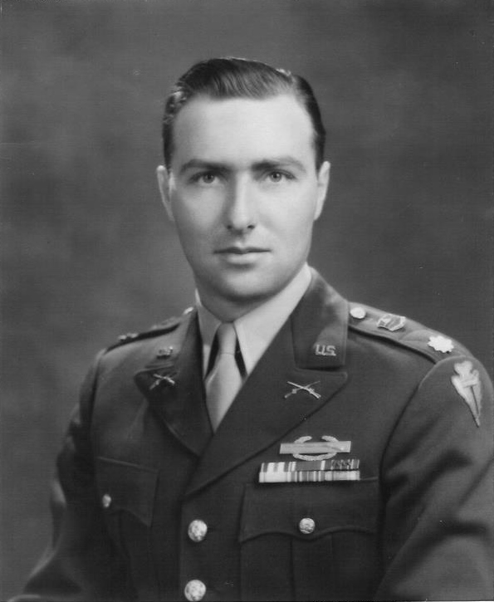
Major William Tinsley Stone U.S. Army National Guard
A Citadel graduate (Class of 1941), Lt. William Tinsley Stone arrived in Oran, North Africa in April 1943, as a member of Company L of the 3rd Battalion of the 142nd Infantry Regiment of the “Fighting 36th” Infantry Division, assigned to the 5th Army. From there, Lt. Stone was with the first Americans to land in mainland Europe at Salerno, Italy on September 9, 1943. After heavy fighting in the mountains near Monte Cassino and the Rapido River, Stone was awarded the Silver Star for gallantry in action on February 3, 1944, in the vicinity of Terelle, Italy, for “advancing over heavily mined terrain while under intense fire from a hidden machine gun emplacement which had pinned down a battalion column and which machine gun nest he destroyed with cool determination and utmost daring by hurling a single grenade at close range”. Shortly afterwards, Stone was hospitalized for pneumonia in Naples, during which time he was promoted to Captain. Upon recovery, he was reassigned to Battalion headquarters as an S-3 (plans and training officer/maps), and returned to the 142nd in time to participate in the Anzio breakout and the liberation of Rome on June 7, 1944. After fighting the German army north almost to Florence, Stone was brought back to Salerno in time to regroup for the invasion of southern France. He landed on the Riviera (Green Beach) on August 15, 1944. Two days later, he was severely wounded by the explosion of an 88 caliber tank shell in Draguignan, France. For this injury, Stone was hospitalized until after the end of the war and returned home to Waynesboro, Georgia. He was retired with a termination promotion to Major and passed away on July 12, 2011.

Slide 5
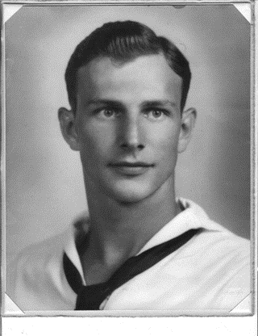
Pharmacist Mate 2-C John Thomas Wynne U.S. Navy, Marine Division
Just a few weeks after the atomic bombs were dropped over Japan, Burke County native and Pharmacist Mate with the Second Marine Division, John Thomas Wynne, landed near Nagasaki. Assigned to the U.S.S. Sanborn and one of the first to volunteer to disembark in the blast area, his mission was to help set up a medical facility and pharmacy. Initially deferred because his medical skills were classified as “necessary to the war effort,” his military service began with a 59 day trip from San Diego waiting for the island of Guam to be secured. He would have been among those who landed at Iwo Jima had his name been earlier in the alphabet. Instead, he was sent to Saipan with D Medical Company where his unit acted as decoys, launching two fake landings on Okinawa and witnessing the actual landing Easter weekend of 1945. But it was in Nagasaki where the Sardis pharmacist would set up the division’s first pharmacy following the blast in a set of janitor’s quarters to dispense medication to sick and injured GI’s, and would help organize a hospital in the wreckage of a hilltop schoolhouse. Within a week of returning home to Burke County after the war, Wynne continued his service to the public by resuming his practice as a pharmacist for the next forty years before his death in 2015.

Slide 6
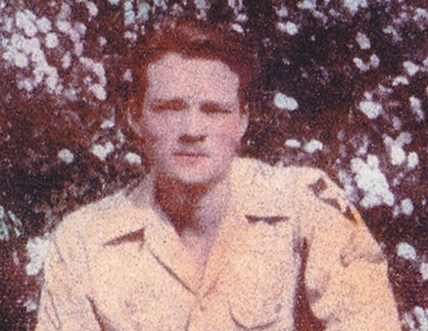
Sgt. William Broadus Carter U.S. Army
Drafted into the Army in February of 1944, Sgt. William Broadus Carter would find himself serving as a Scout in the 99th Infantry Division during the last major German offensive, the Battle of the Bulge, a month after his 19th birthday. His company of primarily “green” troops sustained heavy “silent” mortar fire, machine gun fire, and bombardment by shrapnel from howitzers and stiff opposition from the German SS, yet held their position during the campaign which lasted from 12/16/44 to 1/25/45. Carter’s company would have to be replaced at the rate of 300% due to the high casualties. By December 23rd, with temperatures of 20 degrees below 0, Carter had lost all feeling in his feet and was transferred to a Paris hospital, then to the U.S. Army 65th General Hospital in England where it was determined that amputation was necessary. Carter pleaded with the doctor who agreed to assign “ward boys” to rub ointment into his feet. Remarkably, after 63 days of treatment, circulation returned, and Carter would eventually be returned to duty with the task of carrying, in person, the announcement from battalion headquarters back to his own company, now near Berlin, that Germany had surrendered. Following 2 months of occupation duty, he was transferred to the 2nd Infantry Division and reassigned to the Pacific Theater. While on furlough in Waynesboro, he learned of the Japanese surrender. Carter’s military service followed in the footsteps of his uncle and namesake who was lost in World War I. He died in Burke County on February 6, 2014.

Slide 7
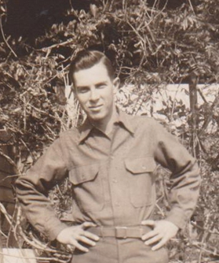
Master Sgt. Herbert Lewis DeLaigle U.S. Army
Herbert DeLaigle, son of a Telfair, Georgia sharecropper and veteran of three wars, followed his three brothers into the service in 1944, but only after his father gave reluctant permission to his youngest son. Almost rejected by the Army because of his “high instep,” DeLaigle begged to be taken and was eventually deployed to England where he heard of the death of U.S. President Franklin D. Roosevelt as he pulled into the harbor. Sent to a town near Munich, Germany, he was assigned to the 500th Field Artillery, Battery B of the 14th Armored Division as an Ammunition Handler. Following V-E Day, his duties included searching homes for “military equipment” and screening German regulars from the SS. He was reassigned to the 20th Armored Division and visited Dachau concentration camp two weeks following its liberation, viewing the gas chambers, and noting that nearby civilians claimed they knew nothing of the camp’s purpose. DeLaigle was home on leave when he heard of the bombing of Hiroshima which changed the mission of his unit scheduled to enter Japan 3 days after an Allied invasion. He was granted a hardship discharge at his father’s request, returning to Waynesboro only 1 month before his father died. DeLaigle joined the National Guard in 1950 not long before the unit was mobilized for the Korean Conflict, serving in Wisconsin under local Commander Paul Stone for two years. He then re-enlisted in the U.S. Army, completing a tour of duty in Vietnam in 1967 as a Communications Chief at Bien Hoa Air Base near Saigon. DeLaigle, who still suffers the effects of exposure to Agent Orange, recalls the constant night shelling and the poor reception Vietnam vets received upon returning to the States. Retired from the Army in 1970, DeLaigle would retire, once again, as a Security Officer from Plant Vogtle. He passed away in 2019 on the same day as his bride of 71 years.

Slide 8
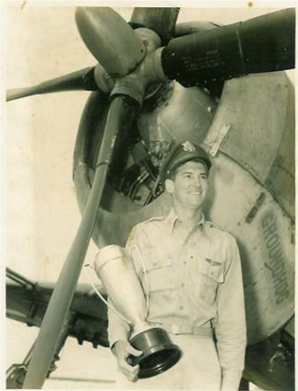
1st Lt. Charles Edward Johnson, Jr. U.S. Army Air Force
Boy Scout, Charlie Johnson, declared himself “hooked” on flying at an early age after being taken up in a Piper Cub on his first flight by local pilot, Holder Watson. This incident was instrumental in Johnson’s choice of the U.S. Army Air Force when he enlisted in March of 1943 while still a student at Middle Georgia College. Johnson had first heard of the attack on Pearl Harbor while eating in the dining hall there in December of 1941. Having qualified for flight school, Johnson completed his preflight training at Maxwell Field in Montgomery, Alabama where he was chosen, because of his class ranking, to be fast-tracked due to the shortage of military pilots. Assigned to the single-engine PT-13 trainer, Johnson eventually completed his advanced flight training in combat aerial maneuvers and was designated a Flight Instructor at the Mariana Army Air Field in Florida in the AT-6. After completing Gunnery School at Metagorda Island, Texas, Johnson was reassigned to Eglin AF Field as an Aerial Gunnery Instructor where he recalled having to teach “Yankee boys” how to lead a target by shooting skeet. Johnson, married by now, was sent to P-40 school the day his first son was born. He remained in the Reserves for five years following his discharge, was called back when the Korean Conflict began, but was sent home when it was discovered he had two children. Johnson returned to Waynesboro to eventually take over the family car dealership before passing away in 2016.

Slide 9
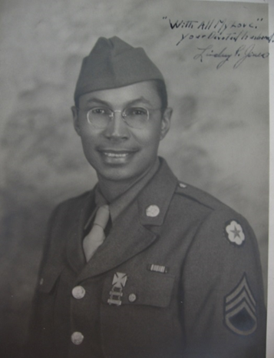
Staff Sgt. Lindsey Paul Jones U.S. Army
Born September 20, 1908, the grandson of slaves, this self-described “plowboy from Briar Creek” was raised in Burke County, GA, graduated from high school in the 11th grade, and sold life insurance before being drafted. Jones, who was eating dinner in Albany, GA, when he heard about Pearl Harbor, was called up a month later and eventually sent to Camp Shelby, MS, for Basic Training which included pontoon bridge construction and gas attack defense. His unit, reviewed and chosen personally by Gen. George Patton, was assigned to the all-black 356th Engineer General Service Regiment attached to Patton’s 3rd Army. Following intense desert training in the U.S. in preparation for fighting in North Africa, his regiment was redirected to Colchester, England where they constructed staging areas and organized supplies for the first troops into Normandy. His unit served as infantry supply troops and burial detail in the 3rd wave on D-Day, and he remembered vividly the day his men buried Theodore Roosevelt, Jr. in Normandy. Jones recalled sustaining heavy fire from German 88mm artillery and sleeping in trenches in an apple orchard before being moved down the road by a “nervous Chaplain.” The next morning, the entire orchard was destroyed by enemy shelling, but the 356th survived to spend much of the remainder of the war near Cherbourg, France, unloading ships to supply Patton’s tank corps which was pushing toward Germany. At the war’s end, Patton promised the 356th they would be some of the first soldiers sent home because of their valuable service. Following his discharge, Jones worked for the U.S. Postal Service for 30 years until his retirement in1975. He passed away three months after this interview on December 30, 2007.

Slide 10
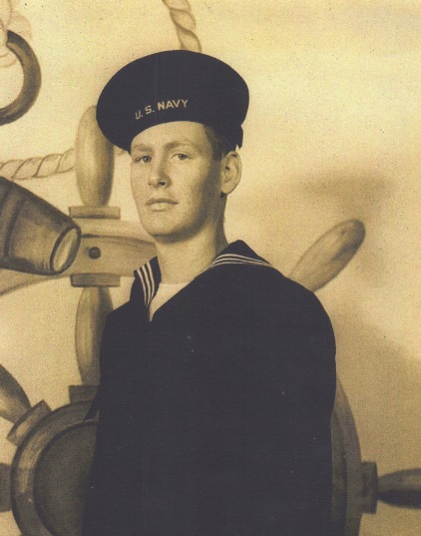
Seaman 1st Class Robert A. Reeves U.S. Navy
Still in high school in Millen, GA, Robert Reeves heard about Pearl Harbor the morning after the attack when his brother came home from town. Drafted at 18 in 1944. His boot camp training at NAS Great Lakes, IL, was cut short due to the expected invasion of Japan. He spent 3 weeks on the troop transport, USS Admiral E. Coontz, in crowded conditions with spoiled food. “The best meal I ever had in my life” was aboard the USS Iowa, part of Fast Carrier Task Force 38, to which he was assigned in the Caroline Islands and where he witnessed the gathering of the entire 3rd Fleet in Ulithi harbor. By June of 1945, Reeves was part of a 5-man 40mm anti-aircraft gun crew and witnessed Corsair and Hellcat airstrikes against the Japanese as well as a Kamikaze attack on the USS Yorktown during the Okinawa campaign. Reeves took part in three raids off the coast of Japan, both as a gunner and as part of the fueling crew, a task ordered daily to prevent capsizing in the event of typhoons. He was in Tokyo Harbor when his Captain announced the dropping of the two atomic bombs. At the end of the war, Reeves was assigned to care for one of 90 American “Bataan Death March” POW’s liberated from coal mine crews working in Japan. Their condition was so poor, one POW requested his return to the US be aboard ship rather than plane because “he didn’t want his family to see him in this condition.” Reeves remembered readying the USS Iowa for the surrender ceremony when it was shifted at the last minute to the USS Missouri at President Truman’s request in honor of his home state. Transferred to the USS Yorktown to a seaplane squadron, he was discharged in July of 1946, returned home to Millen, GA, where he served as a board member of Planters Electric for 43 years. He died June 29, 2013.

Slide 11
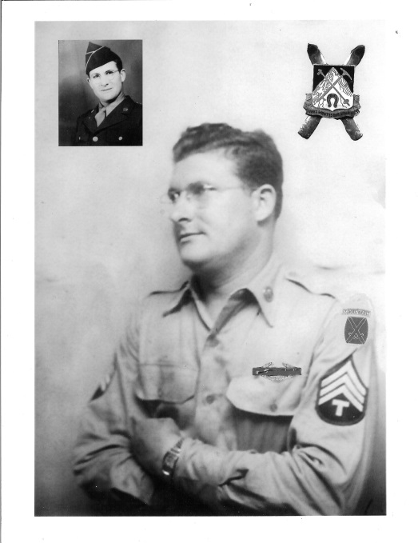
Sgt. Clifford Long U.S. Army
Born in Girard, Georgia, on November 18, 1925, Clifford Long would go on to be awarded three Battle Stars, two Purple Hearts, and three Bronze Stars for his exploits as a member of the 87th Mountain Infantry Regiment (10th Mountain Division) during World War II. Though he had no experience in either mountain climbing or skiing, Long enlisted in November of 1943, receiving Airborne training at Ft. Benning, Ga., and mountain assault training at Camp Hale, Co. In January of 1945, his unit crossed the Apennines in Northern Italy sustaining heavy casualties from German counterattacks as they cleared the way into the Po Valley. On April 23, 1945, Long would be the first American to set foot on the southern bank of the Po River as the 87th pushed toward Lake Garda under heavy opposition. With all escape routes blocked, the last German resistance in Italy ended on May 2nd after 114 days of combat, with 992 members of the 10th Mountain killed. Long was injured three times during the campaign. The 10th Mountain Division, scheduled to invade Japan when that country surrendered, was used instead as an occupation force in Italy and was disbanded on November 30, 1945. Long remained in the service until his discharge on March 10, 1950, and lived in Sardis, Georgia until his death on January 9, 2014.

Slide 12
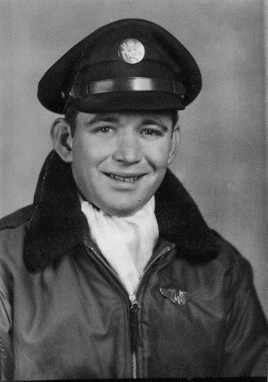
Staff Sgt. Luther Robinson U.S. Army Air Force
Luther Robinson was only 20 years old when he and his nine crewmates were forced to bail out of their B-17 bomber, the “Queen of Hearts” near Berlin. Born in Gough, Ga., and trained at Ft. McPherson, Atlanta, and in Amarillo, Tx., as an engineer gunner, Robinson was on his 11th mission when he was shot down and nearly killed by village women angered by the Allied bombing raids over Germany. “Rescued” by an 18-year old enemy soldier who would “not have hesitated to kill,” Robinson began what he referred to as his “slow walk through hell” as a POW in Stalag 11-A near Magdeburg. Plagued by cold and lice, American, Italian, Russian, and British captives were fed a daily ration of soup, bread, and rainwater captured in service helmets, causing the 180-lb. Robinson to shrink to 123 lbs. in 60 days. In April of 1945, Stalag flags were flown at half-staff signaling the death of President Roosevelt and what most Germans expected to be the end of the war. Two weeks later, control of the camp changed hands after a B-23 dropped an American sergeant into the compound and, soon after, the war in Europe came to an end. German guards tried to escape by jumping on the back of the American flatbed trucks before the Russians moved in. Robinson remembered with fondness the moment when his bus crossed over the Brier Creek Bridge to bring him back to Burke County where he lived until his death in 2010.

Slide 13
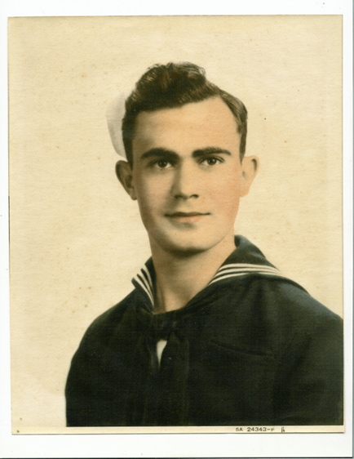
Seaman 2nd Class Frank Leslie Jenkins U.S. Navy
Born in Munnerlyn, Georgia, on October 4, 1925, Leslie Jenkins was a senior at Sardis High School, attending a movie in Augusta, when he heard of the Japanese attack on Pearl Harbor. He enlisted in the Army Air Force in April of 1944, and upon completion of Advanced Basic training at Biloxi, MS, was assigned to B-29 Gunnery School at Buckingham Air Field, Ft. Myers, Fl. There he remembers training in B-24’s by shooting clay pigeons with shotguns mounted in the plane gun turrets. Jenkins, whose petition upon graduation from high school for an appointment to the Naval Academy had been delayed due to lack of space, received notice that his appointment was ready, and he was inducted into the U.S. Navy in December of 1944. He attended the Naval Academy Preparatory School at Bainbridge, MD and Camp Perry, VA, before being assigned to NAS Norfolk as Provost Guard in the summer of 1945. His duties included guarding ammo and several thousand German POW’s, most of whom were veterans of Rommel’s Afrika Korps. He was discharged from service upon completion of school at Bainbridge and returned to Georgia intending to complete Law School, a plan he abandoned when “the girl he wanted to marry” (his bride of over 60 years now) announced she had “no use for lawyers.” He graduated a Business Administration major from Oglethorpe College. Jenkins father was a Chief Petty Officer on a troop transport during World War I and served with his boyhood friend, Clyde Herndon, whose daughter later became Mrs. Leslie Jenkins. He passed away November 15, 2016.

Slide 14
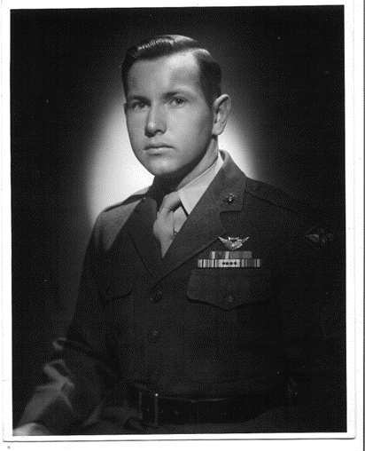
Staff Sgt. James McCord Williams U.S. Marine Corps
The son of a World War I Marine Corps veteran, Atlanta native, Jim Williams, enlisted in March of 1943. Following Marine boot camp at Parris Island, Williams was sent to Marine Air Station, Cherry Point, NC, then to Aviation Ordnance School in Memphis, TN, where he began training in aviation ordnance to eventually become a combat air crewman. Williams’ first flight in any type of aircraft was at Naval Air Station, Opelika, FL; eventually he was assigned to the SBD Dauntless dive bomber, Squadron MAG 45, operating the twin 30 caliber machine guns. Williams would go on to fly 52 combat missions in the Pacific Theater after joining the Marine Scout Bombing Squadron 245 on Makin Island in the Gilbert Islands. His first air strike would be on the airfield and radar installations in the Mili Atoll (Marshall Islands). Later transferred to the SB2C Helldiver, Williams would see action over Guam and the Mariana Islands. Williams’ final missions were “search and destroy” flights strafing the heavily fortified Truk Islands, and sub patrol and flier rescue missions around the strategically critical Ulithi Island which would serve as a staging base for the invasion of Okinawa. Williams’ reassignment to train in carrier-based aircraft was cancelled when the U.S. dropped the first atomic bomb. Williams ended his military career as an air traffic controller at MCAS Miramar, CA, married, and returned to Georgia where he eventually retired following a long career with the Southern Bell Company. His final medals, two Distinguished Flying Crosses, were awarded by the Marine Corps 60 years after the war’s end. He died in 2019.

Slide 15
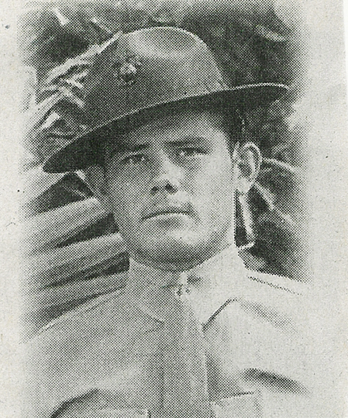
Gunnery Sgt. Willie Rufus Powell U.S. Marine Corps
Willie Powell, a Jenkins Co., GA native, enlisted in the Marines, November 1, 1938, at age 17, because he “wanted off the farm.” Trained at Quantico as a 3” heavy anti-aircraft Gun Captain, Powell traveled through the Panama Canal to his duty station in Pearl Harbor before being deployed to Midway where he helped fortify the island by using tractors to set the large defensive guns in place. He returned to Magazine Island, outside of Honolulu, where he was cleaning up before a shift change the morning of December 7th, 1941. The air filled with smoke, men were covered in oil, and chaos ensued as the wounded were trucked to hospitals. Armed with only a .45 caliber pistol, he watched as Japanese aircraft bombed hangers in a 30 minute attack that seemed “like a whole year.” One month later, Powell was deployed to defend Midway where his ship was hit by Japanese dive bombers before they could set up the large guns and where he saw that “many [American] planes didn’t get back.” His battalion was eventually deployed to Guadalcanal with orders to set up their guns first on Tulagi, then on Guadalcanal where his outfit would shoot down 39 enemy aircraft in defense of the nearby airstrip during daily Japanese airstrikes. Following a serious bout with malaria, Powell was sent to New Zealand as a Battalion Police Sgt., then flown back to the U.S. where he requested to be returned overseas. It was on Guam, while preparing for a Japanese invasion, that he heard of FDR’s death. Powell was stationed on Tinian when he learned that Hiroshima had been destroyed with the A-bomb secretly stored on the same island. He was discharged from Camp Lejeune, NC, in December of 1945, and returned to Burke County where he married and retired from DuPont. He passed away on July 25, 2014.

Slide 16
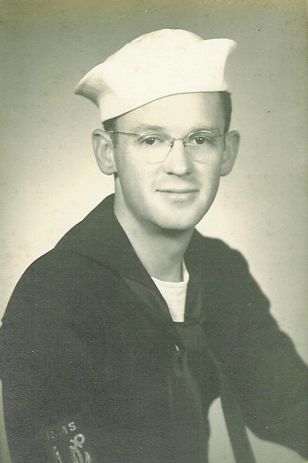
Quartermaster Henry Kenyon Erwin U.S. Merchant Marines
Born May 2, 1920, in Damascus, GA, to Methodist missionaries, Rev. Irwin was only two when his family witnessed the Bolshevik occupation of Vladivostok, Russian. Having returned to the U.S. and already a Methodist minister, Irwin graduated from high school on December 7, 1941. Following a year’s recuperation from malaria, Irwin joined the Merchant Marines in 1943 where he was eventually assigned to the Deck Department aboard the S.S. Henry Hadley as an Ordinary Seaman with duties ranging from standing lookout to mooring of the ship in dock. Later assigned to the position of Quartermaster, he crossed the Atlantic 11 times aboard tankers, Liberty (cargo), and ammo ships, often in the center of convoys for protection from German torpedo subs; on at least one trip, he discovered his ship was carrying over 3500 tons of TNT in the form of massive “blockbuster” bombs. Irwin was aboard the S.S. Modoc Point carrying 130,000 barrels of light diesel when forced to drop anchor for 20 days offshore from Yokosuka Naval Base. The war over, he returned to San Diego and eventually to Columbus, GA where he met his future wife and ended his service. He finished his education at Georgia Southern College and eventually retired in Waynesboro, GA, having served as pastor at the First United Methodist Church for four years during the 1960’s. Irwin was remembered during his service as an unofficial “chaplain” to the men with whom he served but was initially denied “veteran” status, as were all members of the Merchant Marines until 1988, and recalls that 46% of all Merchant Seamen were killed in action without receiving military honors.

Slide 17
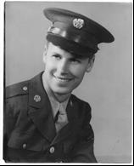
Corporal James Nichols U.S. Army
James Nichols, a Tuskahoma, OK native, emerged from a Bakersfield, CA movie theater to discover the “unimaginable” news that Pearl Harbor had been attacked. After graduating from high school in 1941, he worked on a ranch near Delano, CA until he received orders to report in April of 1943. Nichols was attached to Company B, 427th Medical Battalion, trained as the company clerk, and was deployed from NYC, February 12, 1944, aboard the Queen Mary with 19,000 fellow troops. It was while stationed in England that he met Vidette, GA native, Jack Bailey, who served as a driver in his unit. On July 20, 1944, his unit was dispatched to an area near Cherbourg, France, Utah Beach after sustaining aerial bombing by the Luftwaffe. It was there that Nichols remembered “the effects of war,” including burned-out tanks and cattle carcasses blown up into trees. Assigned to support the 5th and 95th Infantry as they moved across France and engaging the Germans at the Battle of the Bulge, the 427th was charged with getting the wounded to field hospitals while Nichols kept the records of the casualties. He was on leave in Nice when VE Day was declared and returned to his base in Luxembourg to discover that his unit had been dispatched to Czechoslovakia to retrieve American wounded and POW’s from Russian-held territory. In December of 1945, Nichols returned the U.S. aboard a Liberty ship, was discharged from Ft. Gordon, and went back to California. He later visited Burke Co. at the invitation of Bailey, married, and later retired from the Bank of Waynesboro. He passed away June 25, 2015.

Slide 18
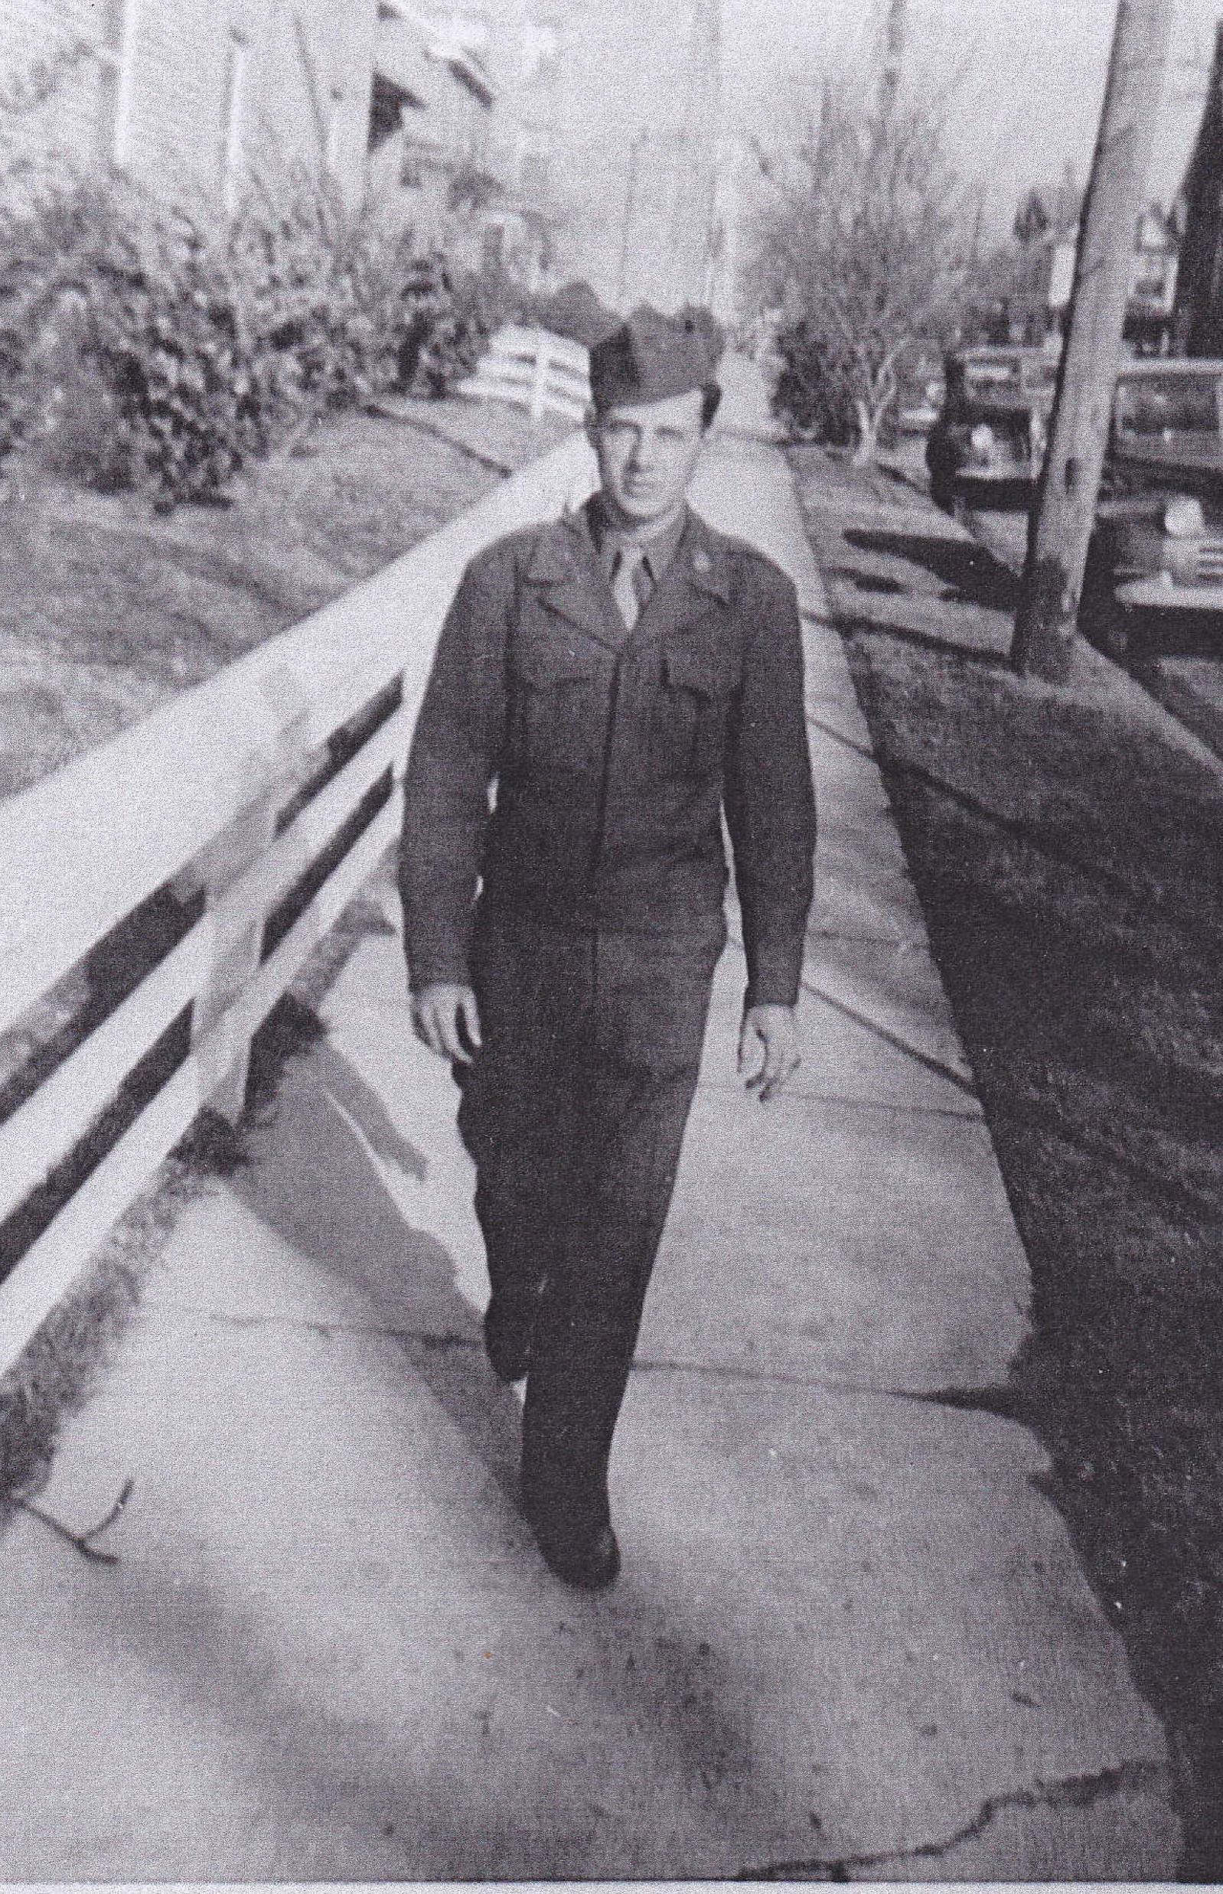
Private First Class Norman Thomas Reeves U.S. Army
Born in Munnerlyn, GA., January 16, 1927, Norman Reeves first heard of the bombing of Pearl Harbor while standing in a local service station and kept up with the news from the front on his family’s battery-operated Zenith radio. His uncle, Talmadge Jenkins, was already serving in the Army Air Force flying missions over Germany as a B-17 gunner. Reeves remembered the rationing of shoes, gasoline, and sugar, though he felt his family of farmers did not feel the impact severely. He graduated from Millen High School in 1944 expecting to be drafted and was working on the Georgia-Florida Railroad when he was called up in March of 1946. Because the final treaties between the Allied and Axis powers had not yet been signed, the U.S. was still considered to be in a state of emergency which qualified him to receive the WWII Victory Medal. Reeves received eight weeks of training as a Steam Locomotive Mechanic at Ft. Eustis, VA, in preparation to be deployed to work on the China-Burma Railroad, but remained stateside and was trained on Mulberry Island in anticipation of postwar railroad strikes. Discharged in 1947, Reeves attended business school on the GI Bill and retired from Ft. Gordon as Chief of Academic Records in January of 1982. He passed away in 2016.

Slide 19
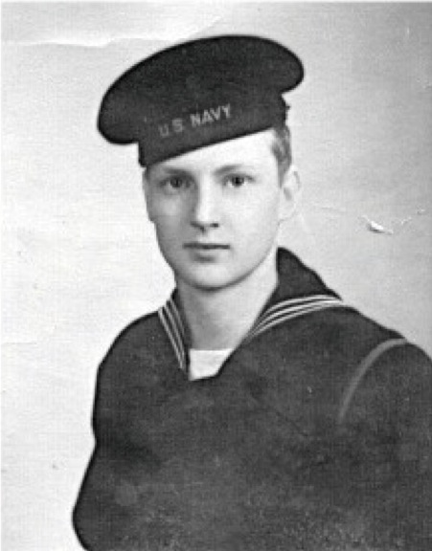
Seaman 1st Class Samuel Milton Jenkins U.S. Navy
This Sardis native recalled a crowd gathering at the store in downtown Girard, GA, across from his home, to listen to the news that Pearl Harbor had been attacked. Knowing that the draft was eminent, his principal taught all the boys in his 1944 graduating class physics, though not part of the curriculum, to better prepare them for their future in the military. Following graduation, Jenkins attended North Georgia College for one quarter until financial circumstances forced him home, where he married, and tried to join the Naval Air Corps. Rejected because he failed the eye test, Jenkins reported to Ft. McPherson, then NAS Great Lakes boot camp before eventually being sent to Camp Crowder, MO for training on teletype machines and San Francisco for training in the maintenance and operation of decoding machines. His work there was “top secret,” and he recalled being escorted by armed guard from his barracks on Mare Island to work each day. The cryptographic machine looked like a typewriter with 10 disks that correlated with a keyboard and were only installed aboard battleships, heavy cruisers, and large aircraft carriers. Each machine was encased in a safe with an explosive charge to be destroyed in the event a ship was hit by enemy fire. Jenkins was still working in cryptography in San Francisco when both VE and VJ days were declared. Discharged in May of 1946, he got home one day before his first son was born, worked for International Harvester for 10 years, then founded J& B Tractor in Waynesboro where he still lives.

Slide 20
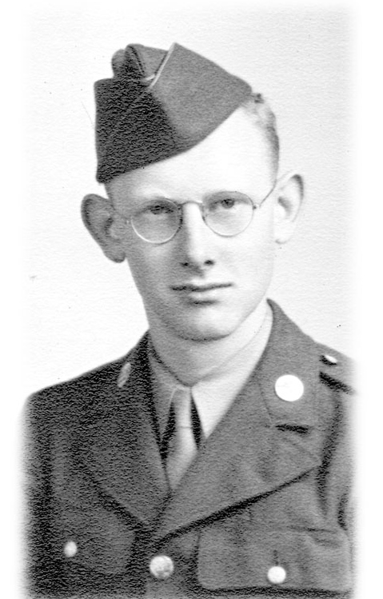
Pvt. Simeon Alexander Gray U.S. Army
Augusta, GA native, Alex Gray, emerged from the movie, “Sgt. York,” to hear of the December 7th, 1941 Japanese attack on Pearl Harbor. Drafted while a student at Clemson University, Gray then completed basic training in Macon at Camp Wheeler in December of 1944. He was hurriedly deployed with the 94th Infantry Division as the Battle of the Bulge still raged in Europe. By January of 1945, he was occupying a post on the front line as a rifleman in freezing weather, before being moved into the “compost woods” to continue the Allied offensive against heavy German resistance. On February 19th, the Allies stormed Muzigen Ridge, taking the heart of the Saar-Moselle Triangle. Gray was engaged under heavy fire near anti-tank obstacles, known as Dragon’s Teeth, when he was wounded in the chest by shrapnel and eventually returned to an aid station near Buren carried by two German POW’s. Gray was sent to the 108th General Hospital in Paris for several months before being transferred to the 48th General Hospital in England. There a portion of his right lung was removed by surgeon W.L. Shaw who would later operate on Texas governor Connelly following the Kennedy assassination. Gray returned to the US aboard a Liberty Ship in April of 1945 to convalesce before being discharged from active duty. Gray, who retired from the Post Office after 42 years of service, returned to Buren, Germany in 2001 to visit the American cemetery near Luxembourg. He currently lives in Waynesboro, GA.

Slide 21
Private First Class Ralph Grunewald U.S. Marine Corps
This New Orleans native, born April 10, 1924, was in a Tallahassee theater when the movie was interrupted with the announcement that Pearl Harbor had been attacked. Called up in January of 1943, Grunewald spent 6 weeks at Parris Island then attended paratrooper school at Camp Lejeune, NC, before his unit was disbanded due to the impracticality of using such troops on the small Pacific Islands. Assigned to the 5th Division, 26th Marine Regiment as a machine gunner, he was shipped out of Hawaii and told a week later that he was headed for Iwo Jima. Grunewald reported seeing both carrier aircraft and land-based bombing of the island for five days before his regiment stormed the beach in the 4th or 5th wave in February of 1945, at 1:00 pm. Passing the dead bodies of the men in the 1st wave and the sinking landing craft, his unit took two hours to wade ashore under heavy fire from Japanese pillboxes. Enemy fire was relentless from the caves, tunnels, and nearby Mt. Suribachi, but the hot volcanic ash made it difficult to dig trenches. As a result, by the 5th day, when Grunewald was shot in the leg, 150 of the 200 men in this unit had already sustained wounds or had been killed. Following his recuperation Grunewald returned to duty in April, 1945, was trained in Hawaii for the invasion of Japan and was on a Pacific island when he heard of the surrender. After two months at Sasebo in Japan, he was discharged, but was recalled by the Reserves to go to Korea. At Inchon, he met the 2nd Division, fought near the Chosin Reservoir in temperatures of -55°, sustaining heavy resistance from Chinese troops. Discharged in 1951 after a year in Korea, he remained in the active reserves until 1956, and lived in Girard, Georgia, until his death in 2015.

Slide 22
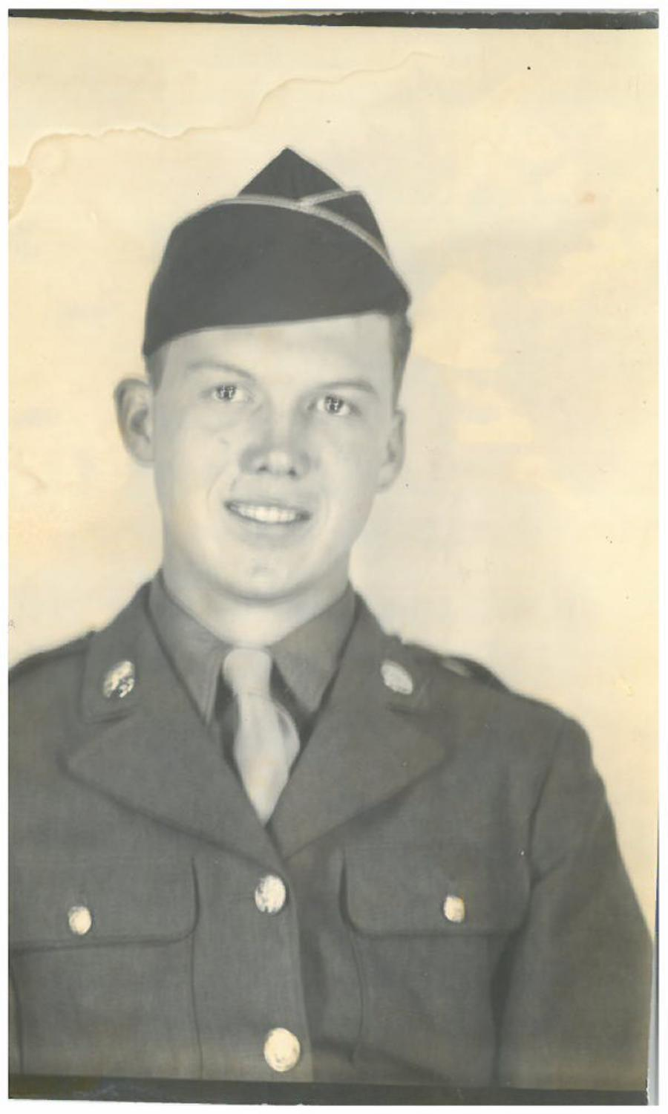
Private First Class Hugh Cal Johnson U.S. Army
Born June 15, 1925, in Livonia, GA, to John and Orreane Johnson, Cal Johnson registered for the draft at 18, later requesting a 90 day extension before reporting because his father needed his help on the family farm. Following training at Ft. Shelby, MS, he was sent to Camp Phillips, KS where he was assigned to the 44th Infantry Division as an auto mechanic helper just five days before that unit was ordered to join the 7th Army’s push through the Vosage Mountains. Because of its Rhineland location, the 44th was hit in mid-October with an intense German counter-attack just days into the campaign. Withstanding fierce opposition, it took several weeks to finally break through a pass in the Vosages to liberate the town of Strasbourg and push through the Maginot Line. Johnson was wounded during one of the few periods of rest and regrouping when his unit stopped at an old school house where a fellow soldier hit a booby trap with his backpack He was sent to a Paris hospital after the field hospital was bombed and strafed by enemy fire, but was eventually sent to Glasgow, Scotland. From there he sailed for home in March of 1945, passing by the Statue of Liberty in New York Harbor. Already a married man, Johnson would be discharged on June 29, 1945 only four days after the birth of his son. Mr. Johnson lived in Waynesboro with his family until his death on October 1, 1998.

